Slide 1

VOTER EDUCATION FOR INFORMED AND ETHICAL VOTING
The case of Uganda General Elections 2016
Sam Rwakoojo
Peninah Sekabembe

Slide 2
Introduction
The Electoral Commission of Uganda is established under Article 60 of the Constitution of the Republic of Uganda 1995 (as amended)
Functions of the Commission are stipulated under Article 61 of the Constitution.

Slide 3
Powers to Accredit
The Electoral Commission has also got powers to Accredit Non-partisan Individuals, Groups and Institutions to carry out voter education on its behalf according to the Commission guidelines.

Slide 4
Legal Basis For Voter Education
The Constitution of the Republic of Uganda (1995) gives power to the people to decide on Who shall govern them and How they shall be governed.
The Commission is also mandated by the Constitution to formulate and implement voter educational programmes.

Slide 5
Definition of Key Concepts
Voter Education: Building awareness for effective participation of all stakeholders in an electoral process.
Informed Voting: Deliberate effort by EMB’s to inform voters of electoral activities to enable them to make an informed choice on voting day.
Ethical Voting: Free and Fair elections that deliver acceptable results/outcomes.

Slide 6
Definition of Key Concepts Cont.
Quality Electoral Participation; Participating in all election activities according to the law and guidelines.
Stakeholders in an Election; All Individuals, Institutions, Groups and Organizations that have a role to play in an electoral process.

Slide 7
Understanding Ethical Voting
Informed Voters +Ethical Voting= Acceptable Results/Outcomes (A)
Informed Voters + Ethical Voting = Quality Participation (B)
Quality Participation + Acceptable Outcomes= Free and Fair Elections (C)

Slide 8
Theoretical Views on Ethical Voting
The Folk Theory on Voting Ethics:(Jason Brennan)
1) Each citizen has a civic duty to vote
2) Any good faith vote is morally acceptable
3) It is wrong to buy or sell one’s vote

Slide 9
Ethical Voting: Case of Uganda
Electoral system for Uganda; First Past The Post , FPTP; ( 50+1% ), Simple Majority (MPs)
Equal weight for every vote
Leveling the playing field for all Parties
Commercialization of Elections
Voting being voluntary.

Slide 10
Criteria For Voter Education
Target Group
Background Information
Medium/ Channel of communication
Methods of delivery
Content
Language
Timing of information
Source of Information

Slide 11
Excerpts of Voter Education
Election Slogan; Your Vote, Your Power, Your Country
Voting procedure and Modalities
Voter Education Through Road Shows
SMS Messages on Location of Polling Stations
Poster on Voting should not divide us
Poster on Not selling Votes

Slide 12
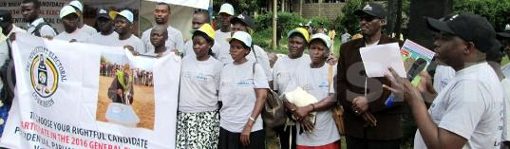
Launch of Voter Education

Slide 13
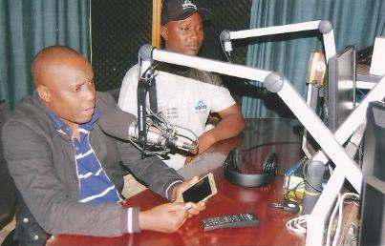

Conducting a voter education radio talk show

Slide 14
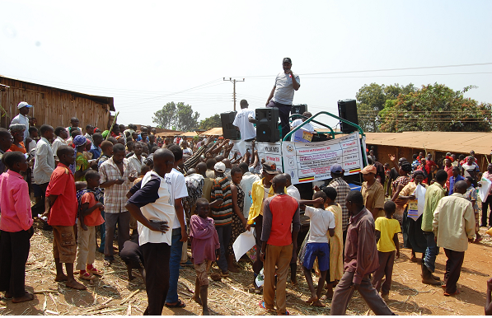
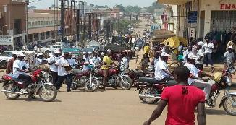
Conduct of voter education by road shows

Slide 15
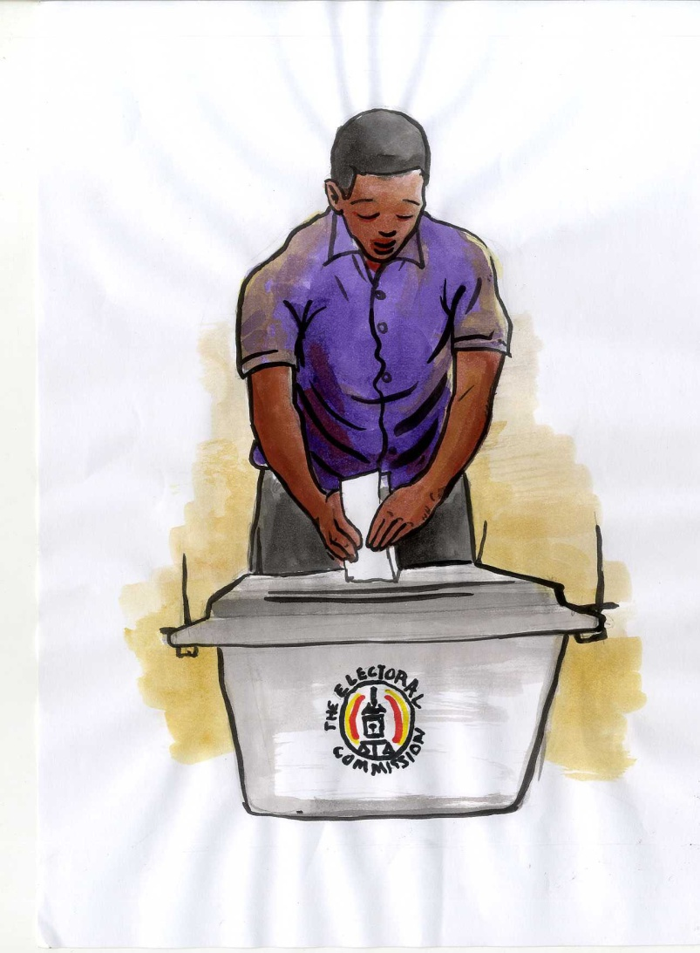
Your Vote, Your Power, Your Country
Go and Exercise It

Slide 16
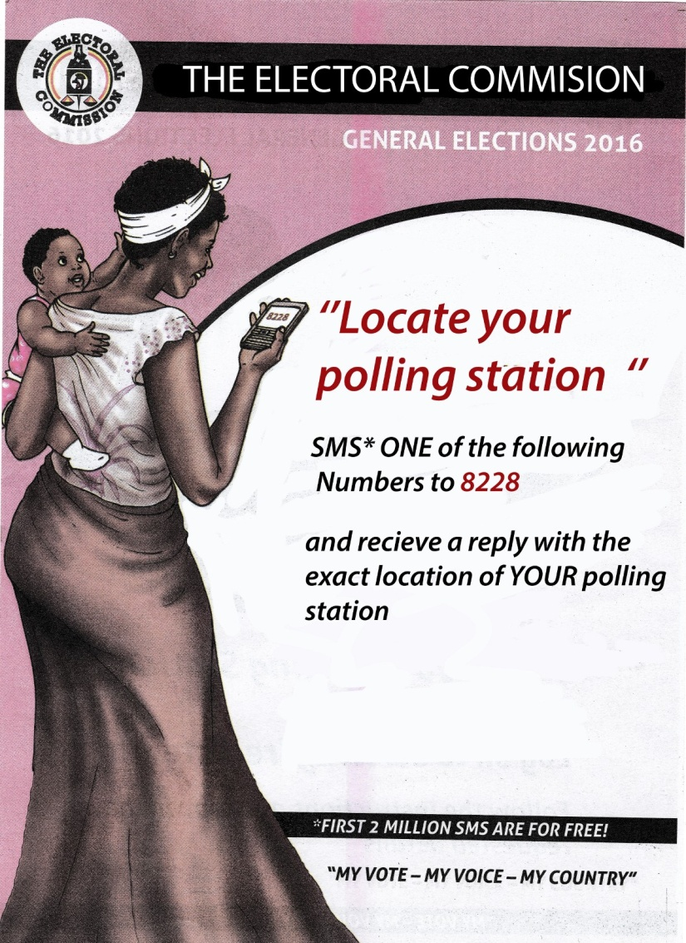
Use your phone to locate your polling station

Slide 17
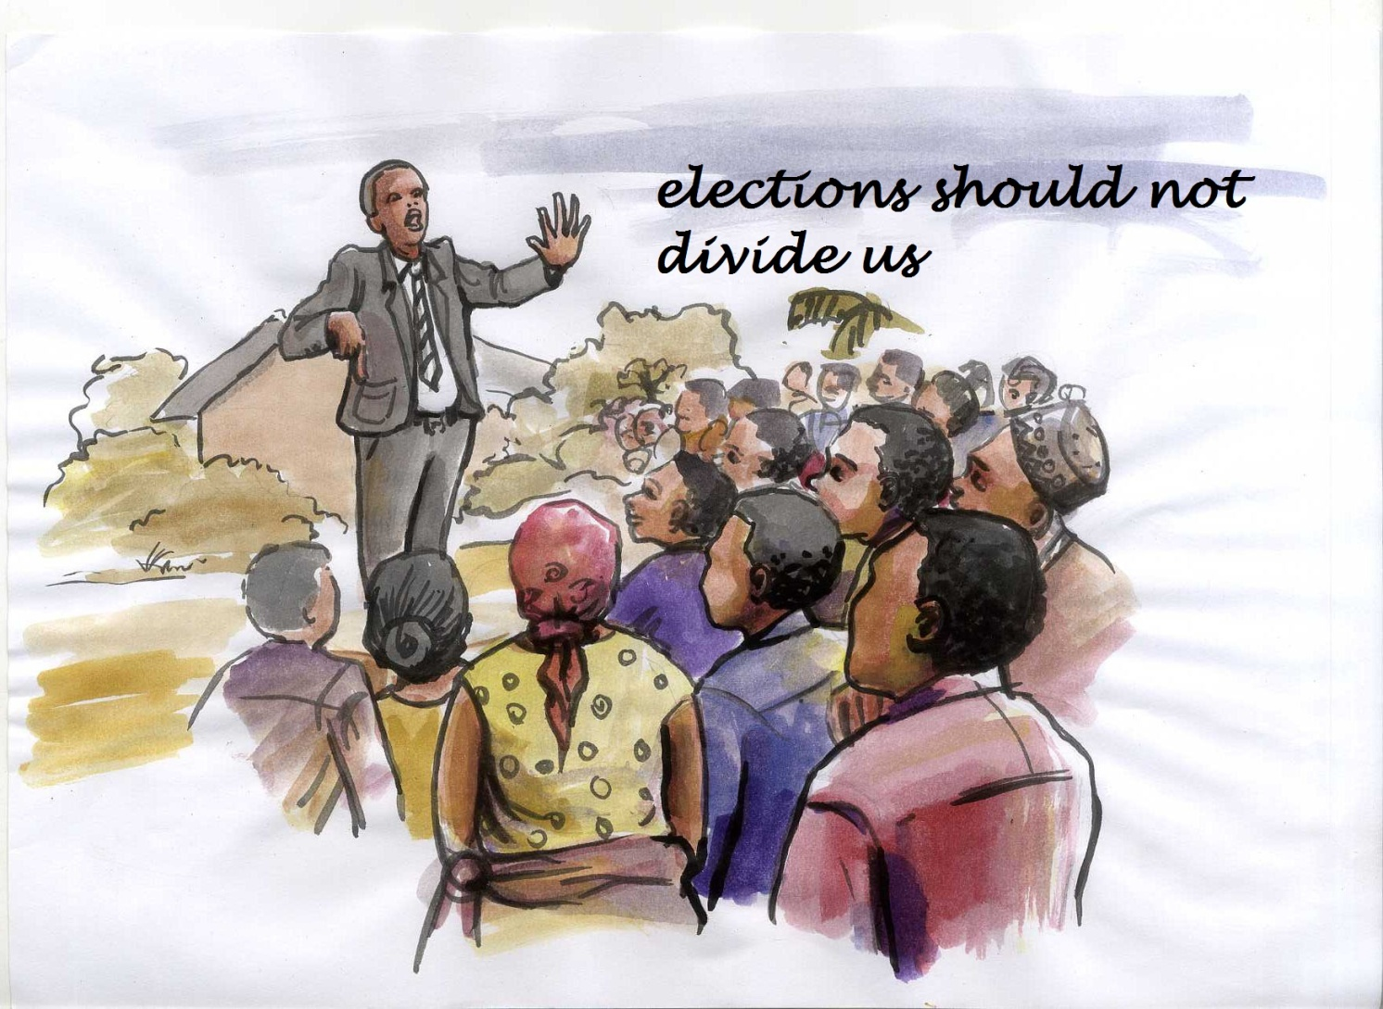
Attend campaign rallies

Slide 18
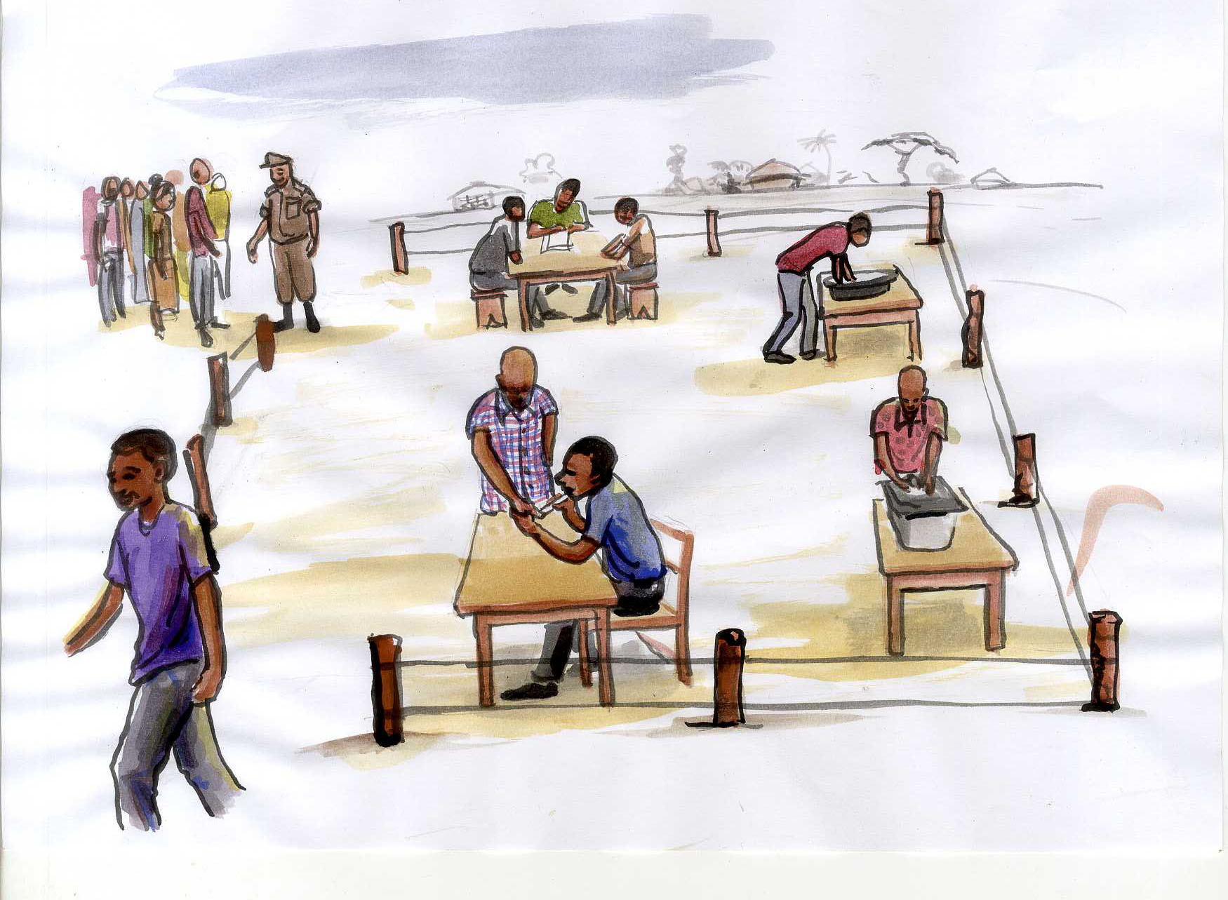
Observe the voting procedure and modalities at the polling station

Slide 19
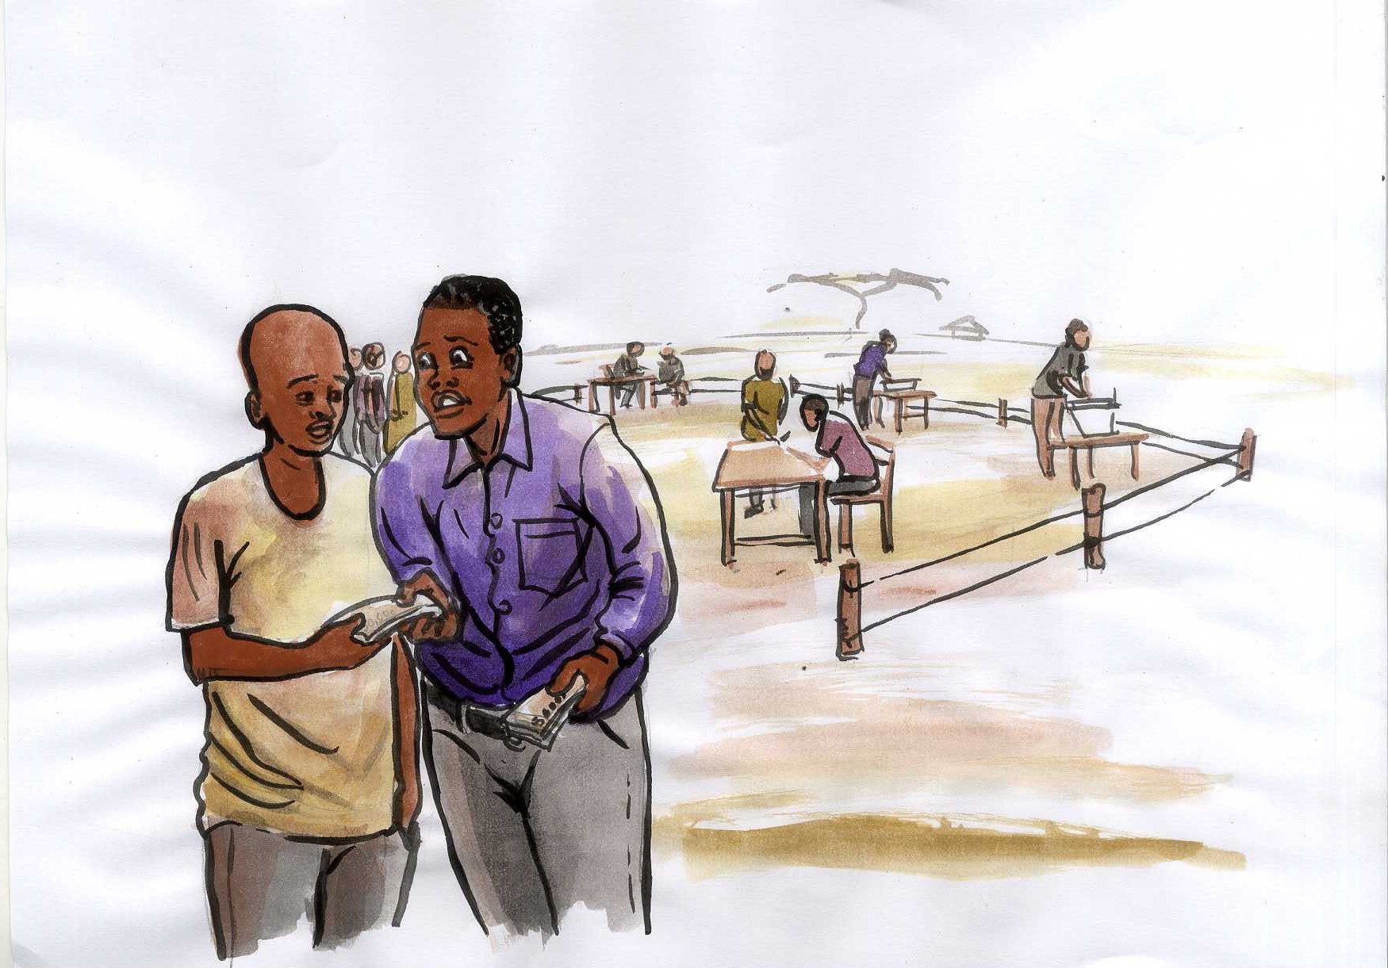
Your Vote is Your Power,
‘’Do NOT Sell It’’

Slide 20
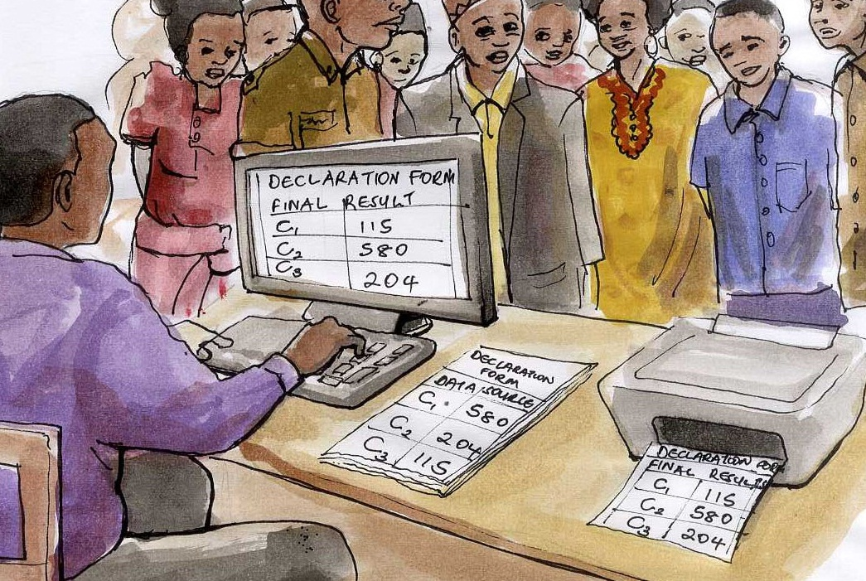
Determining Election Results /Outcomes

Slide 21
Challenges Encountered
Voter apathy and fatigue
Low levels of literacy among the voters
Multi tribal society
Poverty among voters
Commercialization of Politics
EMBs limited mandate to conduct only voter education
Inadequate funding
Continuous changes in the laws.

Slide 22
Conclusion
There has never been enough voter education
Focus on giving quality education to all the voters at the right time, to have an informed electorate, in order to achieve free and fair (Ethical) electoral participation.

Slide 23
Thank You For Listening To Me
God Bless You.

