Slide 1
VOTER EDUCATION FOR INFORMED & ETHICAL VOTING
ELECTIONS COMMISSION OF MALDIVES

Slide 2
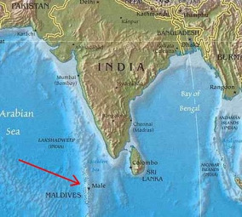
CONTENT
Introduction to Maldives
Current Voter Education
Voter Education plans
Conclusion

Slide 3
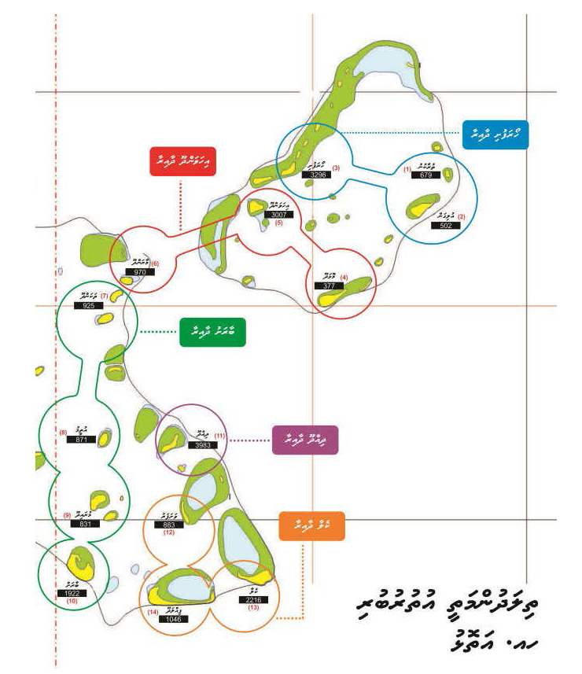
Introduction to Maldives
Haa Alif Atoll
Constituencies

Slide 4
Introduction to Maldives
Geographically dispersed
Administrative Divisions
Boundary Delimitation
Constituencies

Slide 5
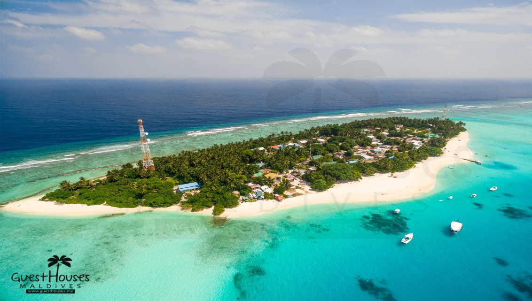
Current Voter Education
Civic Education
For School Students
For NGO’s
Vulnerable areas
Voter Education
TV / Radio Programs
Political Parties
Social Media Campaigns
Road Events
Atolls / Islands

Slide 6
VE & VA Materials
Local Council Election 2017
Re-Registration
Local Council Election 2017
Complains for Voters registry

Slide 7
VE & VA Materials
1414 Toll Free number
Local Council Election 2017
Election Day

Slide 8
VE & VA Materials
Local Council Election 2017
Vote Buying
Politically having a different view isn't a problem

Slide 9
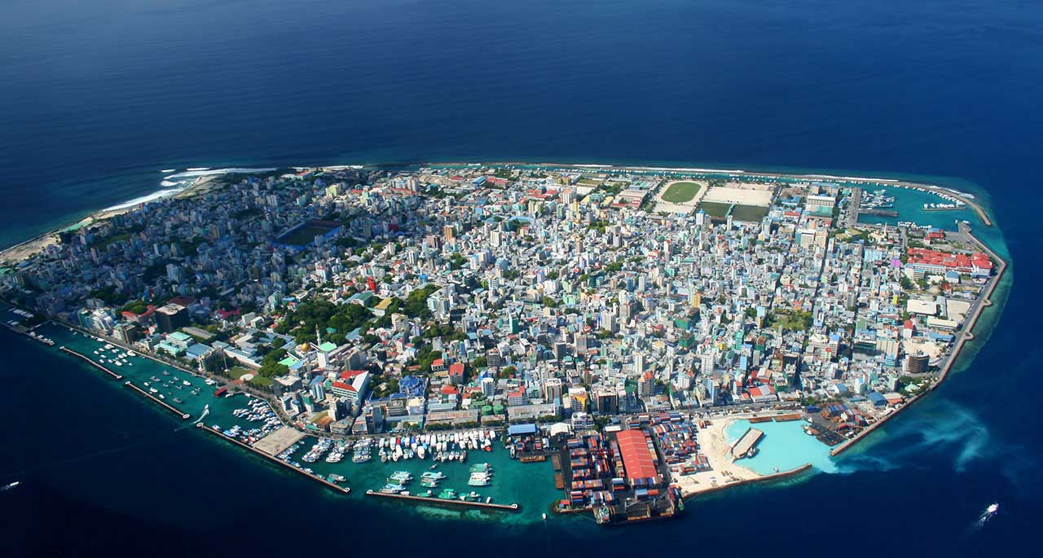
VE Plans
Social Media
Signage
New Strategy in
Process
Mobile Application
Male’ - Capital City

Slide 10
CONCLUSION

Slide 11
THANK YOU
ANY QUESTION??

