Slide 1
International Conference: Voter Education for Inclusive, Informed & Ethical Participation Election Commission of India, 19-21 October 2016, New Delhi India
Embedding electoral democracy in an illiterate society: the case of India’s first elections and its relevance in current times
Dr Ornit Shani
Department of Asian Studies
University of Haifa

Slide 2
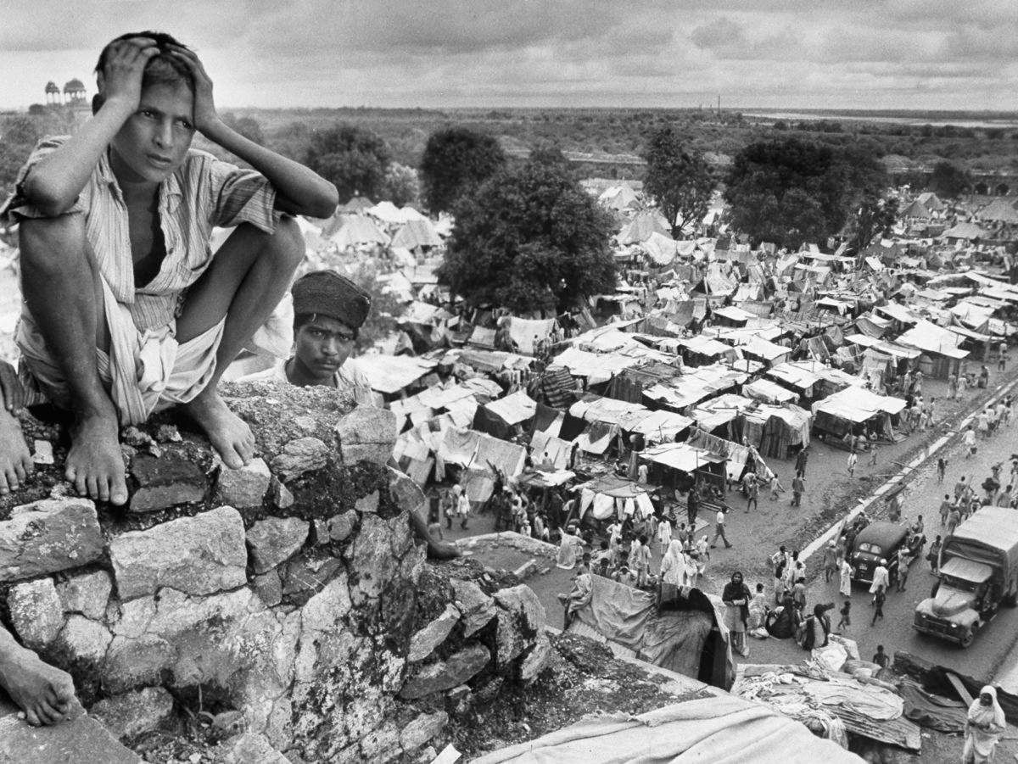
Historical Circumstances

Slide 3
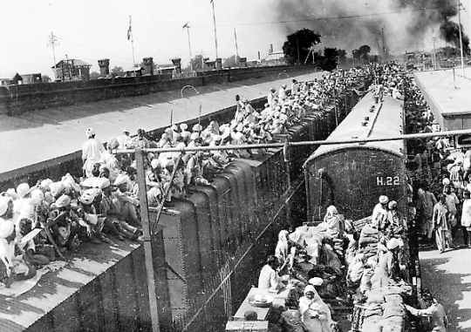

Slide 4
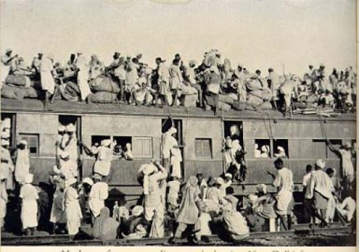

Slide 5
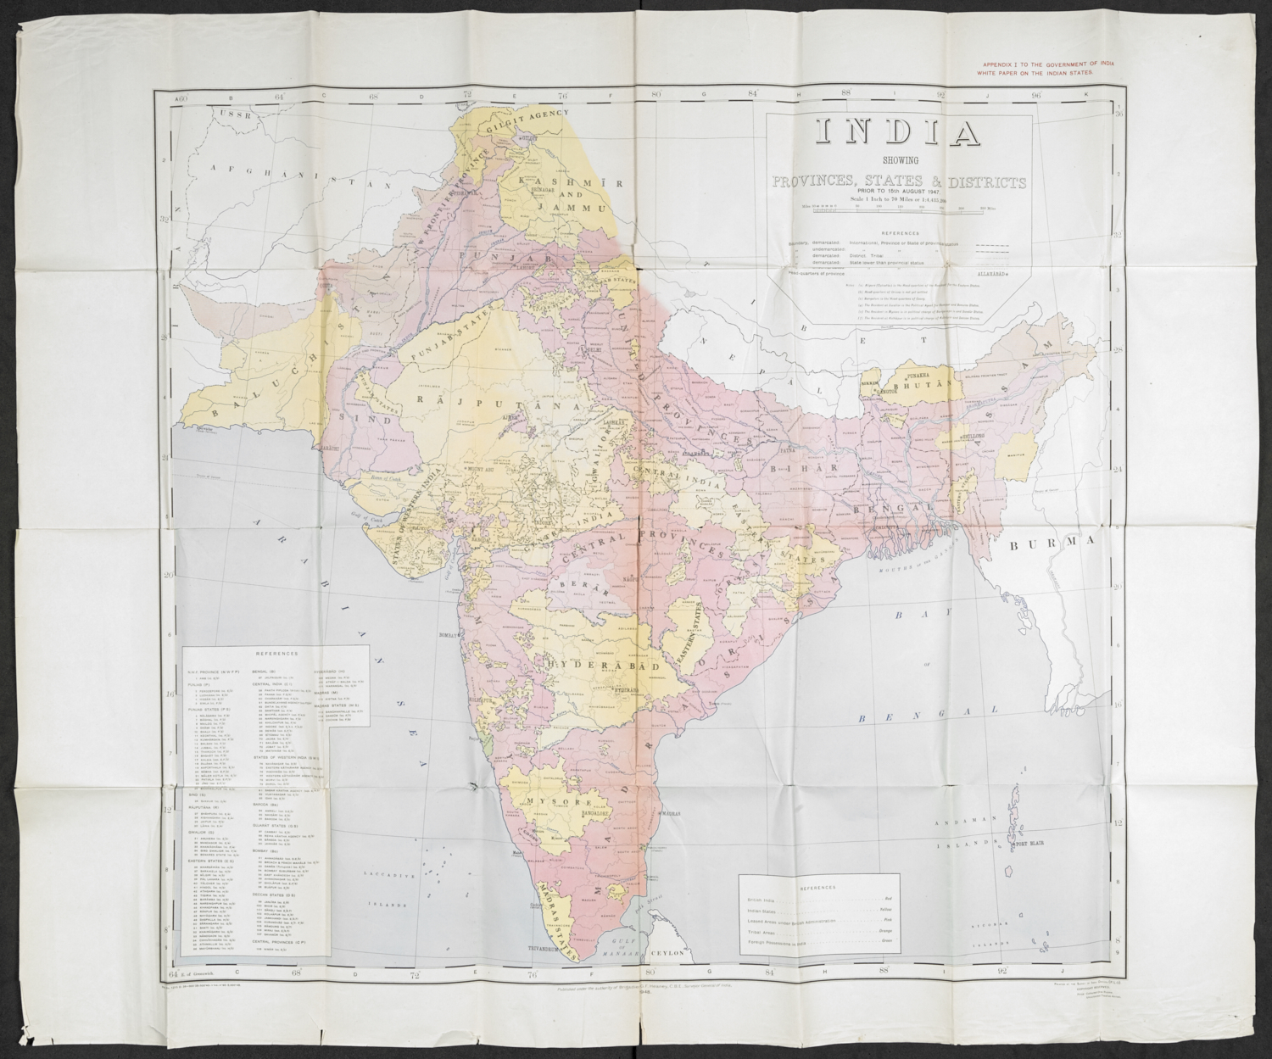

Slide 6
Voters > 173,000,000

Slide 7
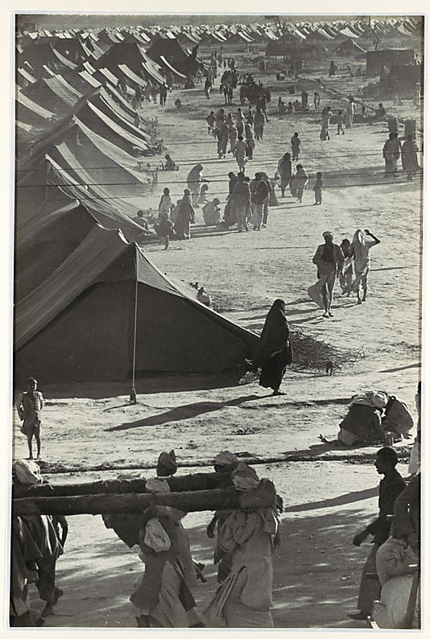
Registering refugees as voters

Slide 8
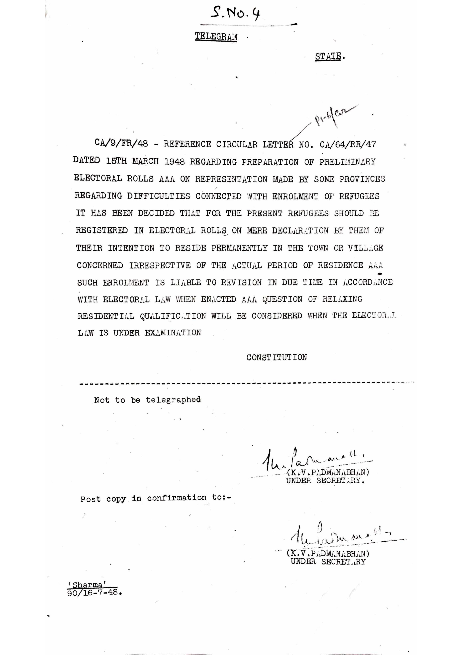

Slide 9
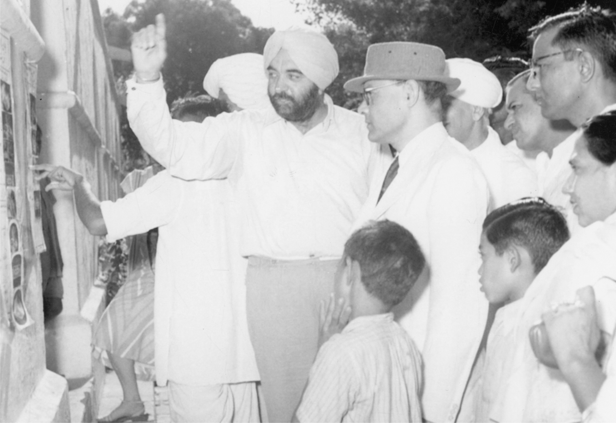
Explaining mock elections ahead of the first elections (S.H. Dhillon, CEO Delhi 1951)

Slide 10
‘The day of voting dawns, the day of decision. By all means look your best, for today you have to be at your best’ (Democracy in Action, Film Division of India, 1950)

Slide 11
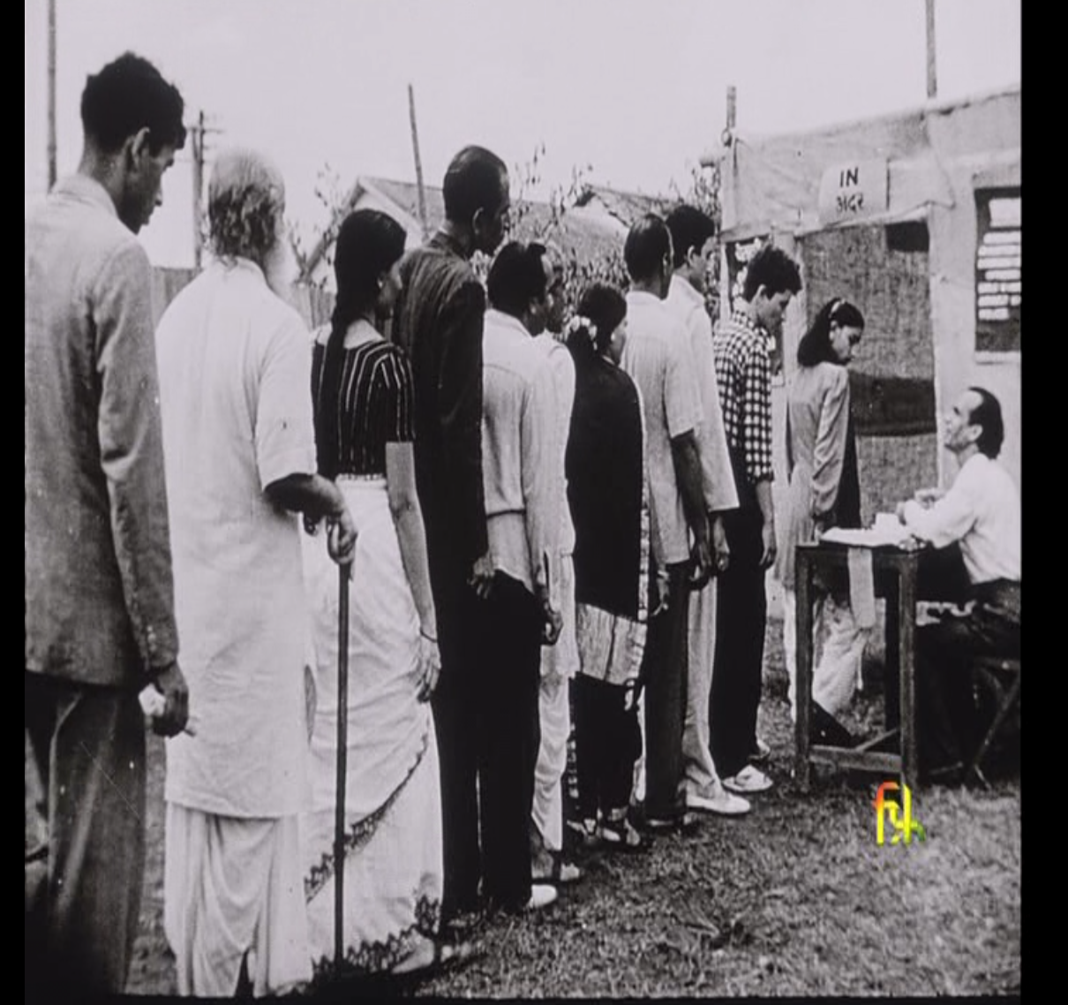

Slide 12
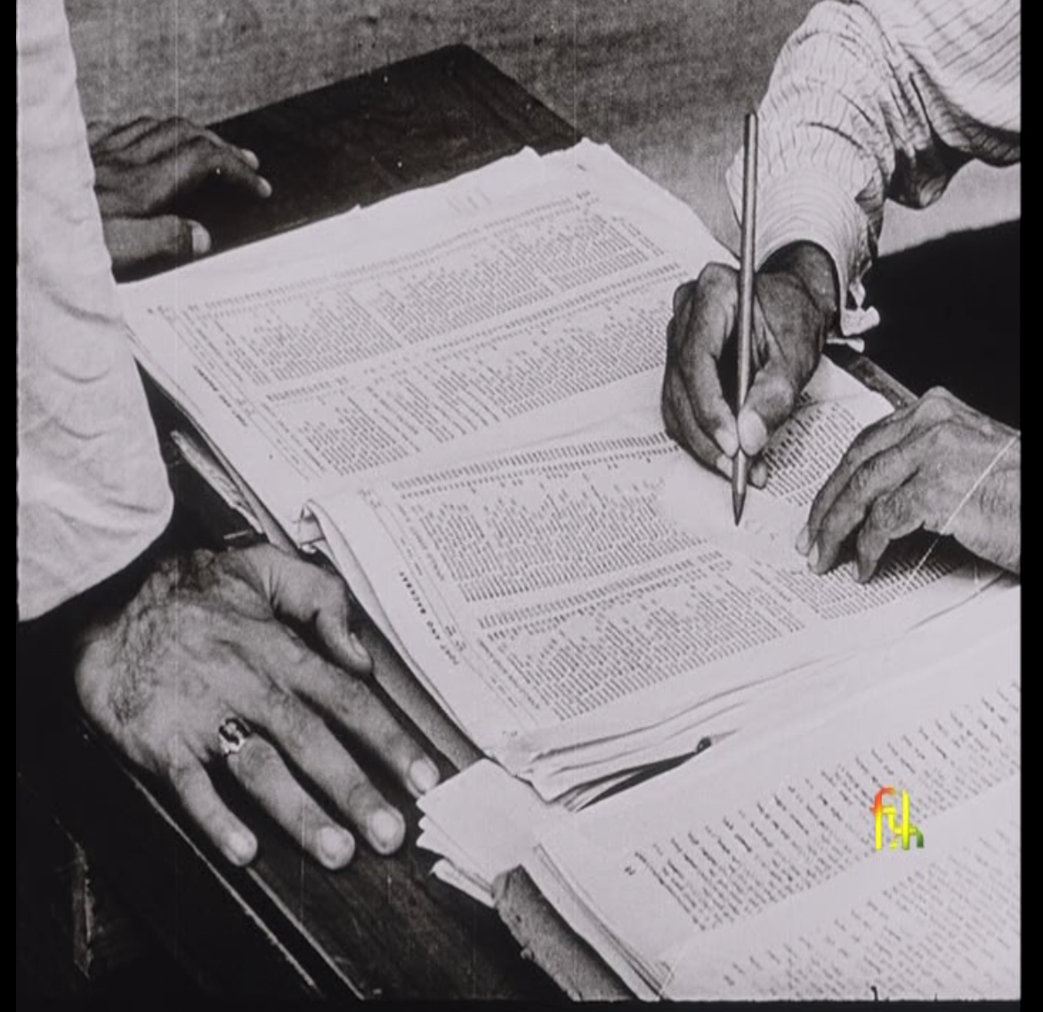

Slide 13
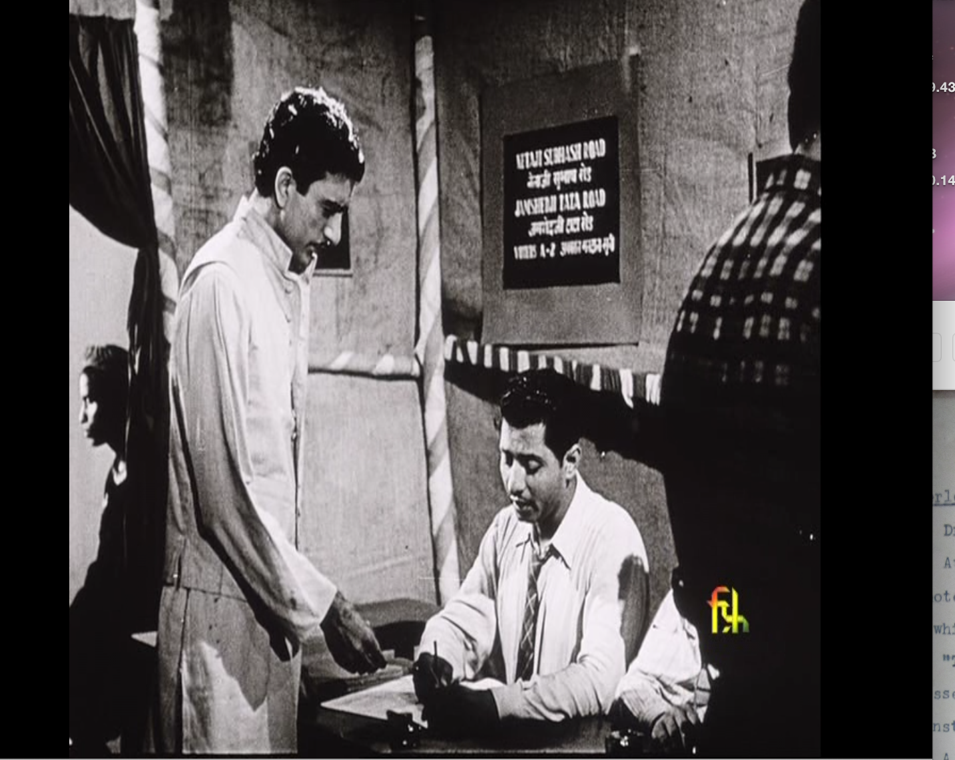

Slide 15
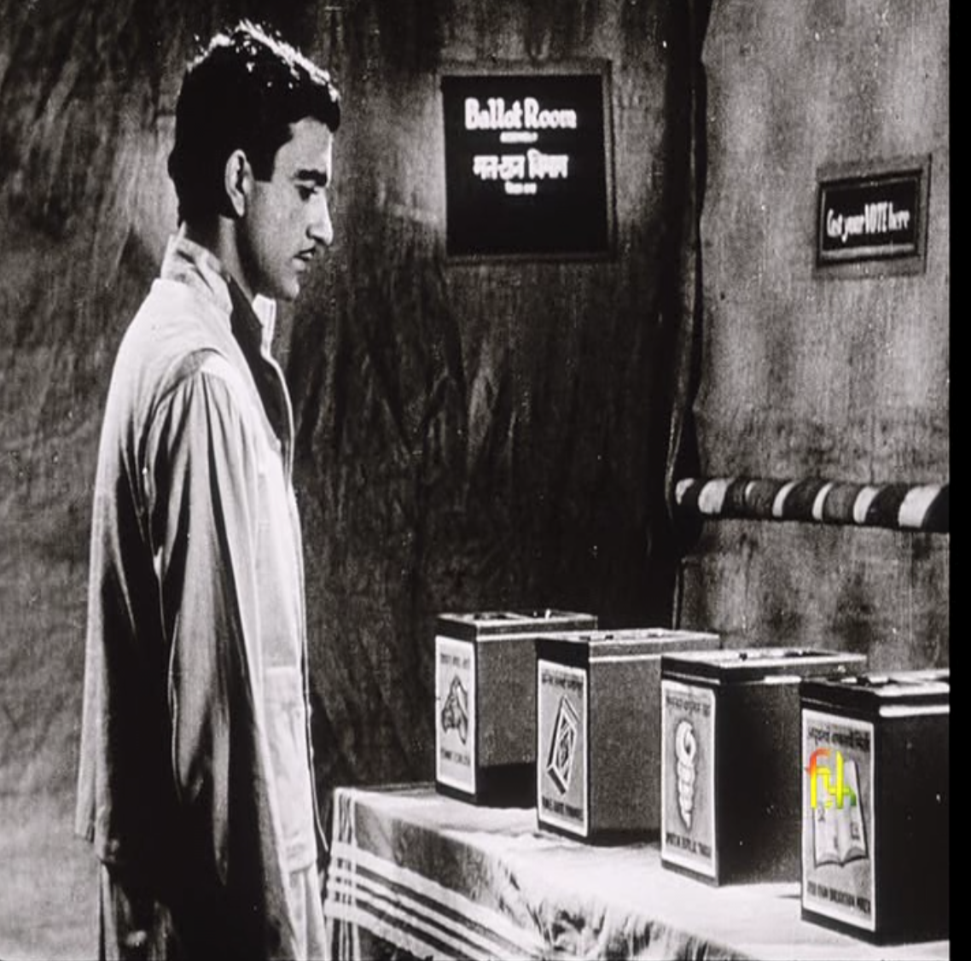

Slide 16
Implications for voter education for inclusive, informed & ethical participation
Breeding trust among the electorate and administrators was a precondition for voter education.
Tutoring into electoral literacy entailed a two-way learning process.
Electoral literacy had to be imparted to both voters and administrators at all levels.
Voter education had to imbue the spirit of democracy and a new ‘habit of mind.’

