Slide 1
Inclusive Electoral Literacy Through Informal Educational Channels

Slide 2
Afghanistan

Slide 3
Afghanistan
Afghanistan, officially the Islamic Republic of Afghanistan, is a landlocked country located within South Asia and Central Asia.
Population: Afghanistan has a population of approximately 32 million.
Neighbors: Afghanistan is bordered by Pakistan in the south and east; Iran in the west; Turkmenistan, Uzbekistan, and Tajikistan in the north; and China in the far northeast.
Literacy Rate: Afghanistan has one of the most illiterate population of the world. Only 40% of population is literate.
Security: Afghanistan has been engaged in civil war for about four decades and more than half of the population is living in unsecured areas.
Eligible voters: about 12 million people are eligible to vote.

Slide 4
Independent Election Commission (IEC)
The Independent Election Commission of Afghanistan was established in 2006 according to the article 156 of the Constitution of the country:
IEC shall be established to administer and supervise every kind of election as well as refer to general public opinion of the people in accordance with the provision of the law.

Slide 5
Overview IEC Public Outreach Department
The Department of Public Outreach at the IEC is responsible
for:
Planning, implementing and monitoring of voter information campaigns;
Preparation and development of the voter information and electoral procedural materials;
Electoral education;
Coordination of the voter information activities with government agencies and non-government organizations (national process);
Monitoring of voter information activities.

Slide 6
History of Elections in Afghanistan
However, Election has started in 1960s in Afghanistan, but due to civil war it became stopped till the end of the Taliban regime: During last 12 years, we had three elections with different turnouts as bellow:
In 2004, the final voter turnout was 7,364,000
In 2009 the final voter turnout was 4,059,069
In 2014 the final voter turnout was 6,443,155
Notes:
2014 turnout reflects 1st round only
2004 should be considered as unique as it was the first election after the fall of the Taliban

Slide 7
Trends of disqualified votes
Fortunately, we had a good promotion in decreasing disqualified votes, as shown by following figures.
Notes:
There is a steady decline in documented fraud from 2009 to 2014, but it should be noted that in 2014 criteria for documented fraud was increased dramatically and that there was a 100% audit, but still there was a decline in documented fraud.

Slide 8
Disqualified Votes 2009-2014

Slide 9
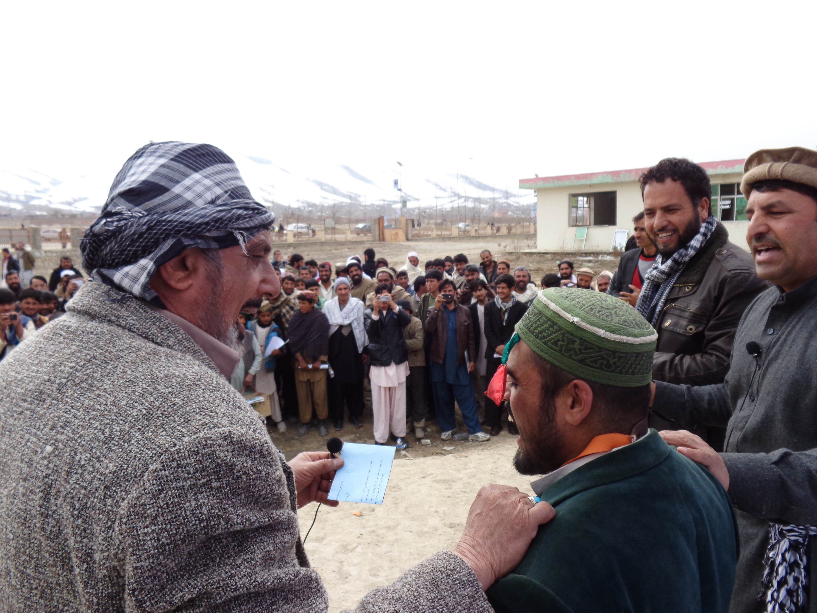
Background: Electoral Literacy Through Informal Education
Informal Education Remains the Preferred Method of Voter Education in Afghanistan, because of:
security challenges;
Strong tribal structure;
Influential religious networks;
Cultural limitations for reaching key target audiences.
Notes:
Image is from a Mobile Theater event

Slide 10
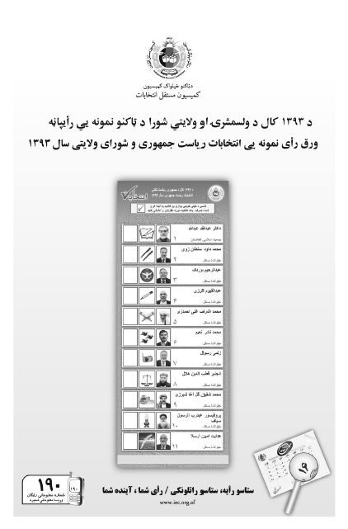
Direct Methods(1): Elections
1,450 Civic/Voter Educators deployed (31 percent female), sharing printed communication materials
Distribution of:
2,200,000 leaflets;
1,100,000 brochures;
1,300,000 sample ballots ;
406,000 mock ballots;
2,200,000 posters;
2,200,000 stickers;
1,700 flip charts;
1,700 flip chart manuals;
350 banners;
200,000 pocket calendars;
2,200,000 fact sheets.
Notes:
Image is from sample ballot for presidential elections (printed on newspaper style paper)

Slide 11
Direct Methods (2): (continued)
mobile theatre performances conducted
Elections Toll Free Call Centre (No 190)
Approximately 6,929 hours of toll-free access
to a voter information hotline
Notes:
Image from Pole Sign

Slide 12
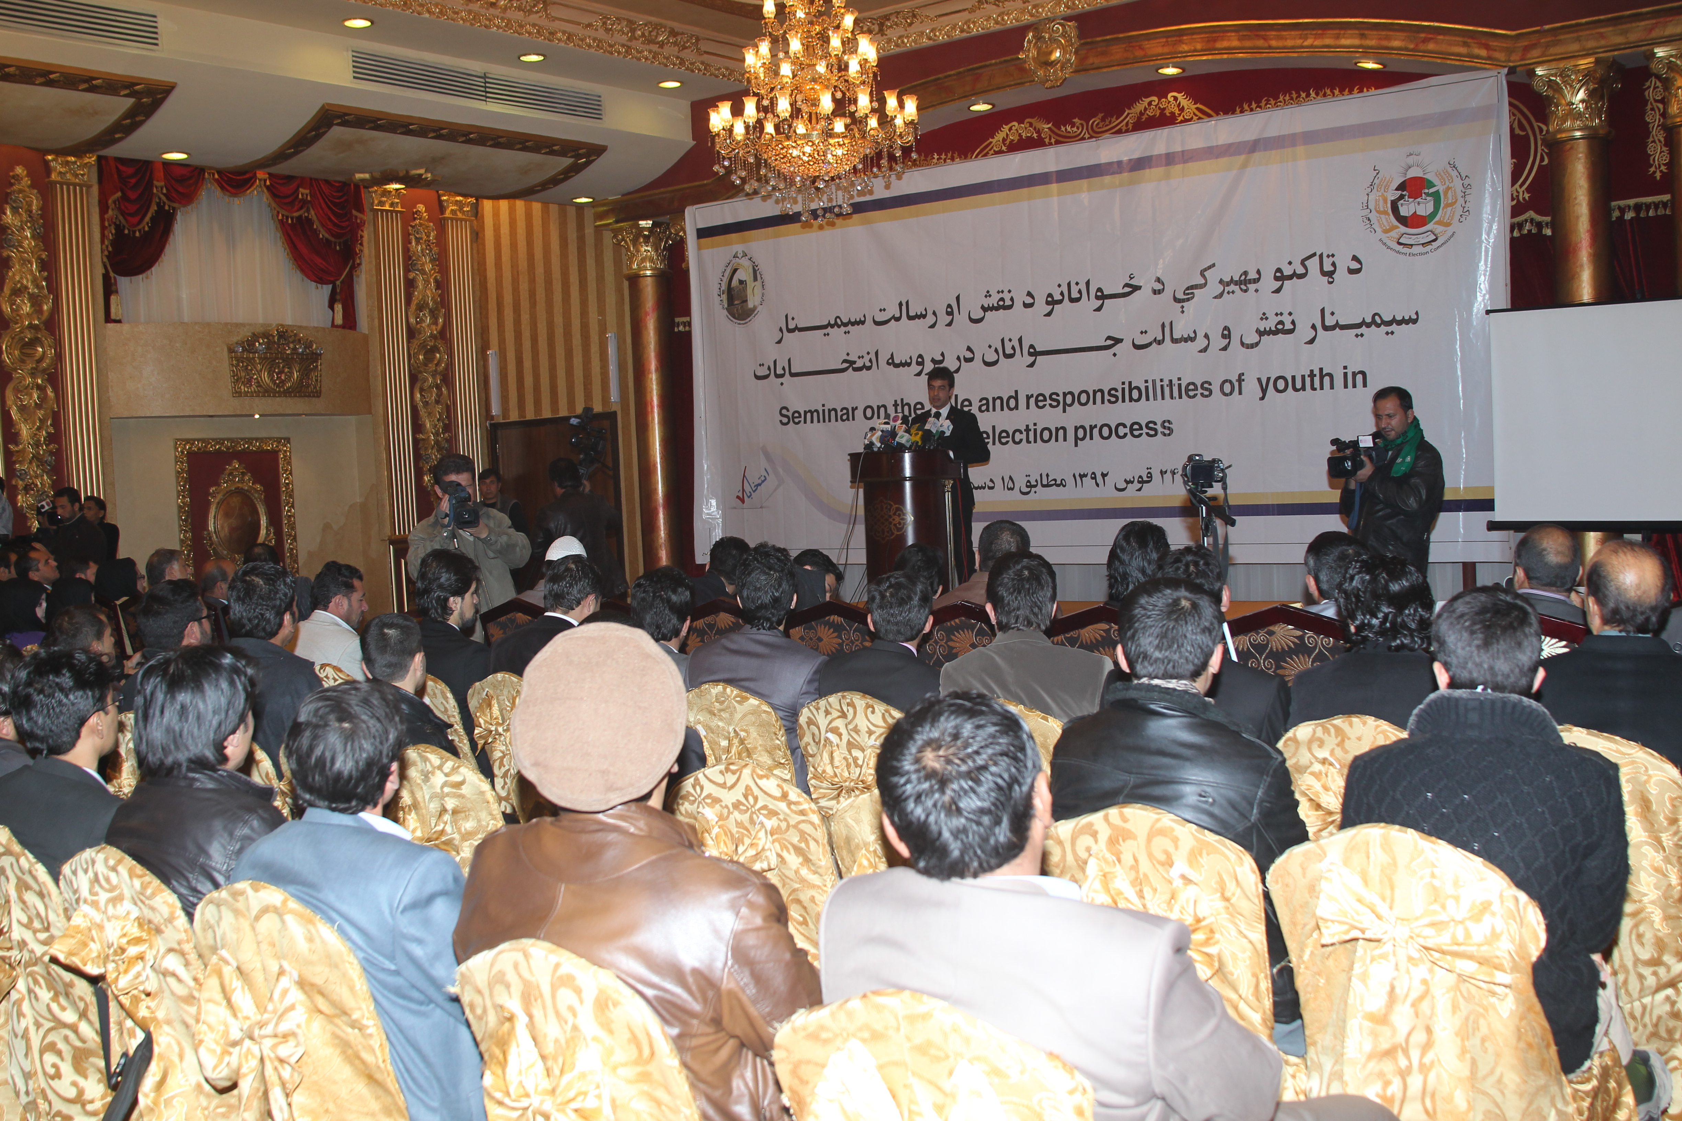
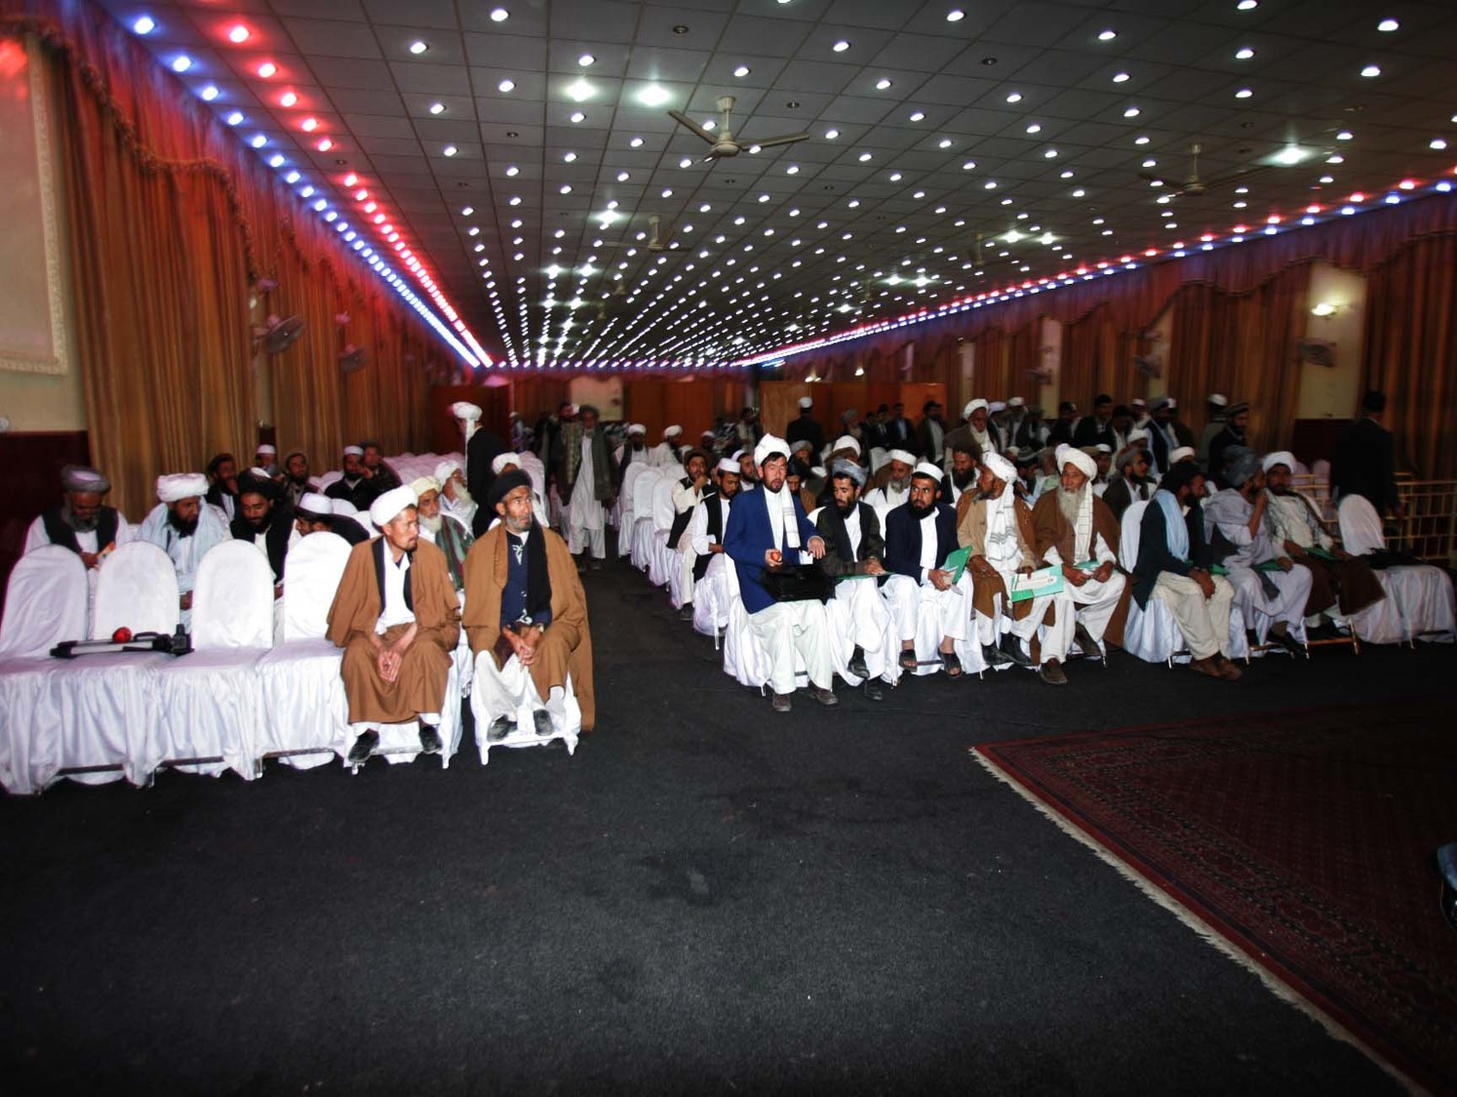
Direct Methods (3) (Contiued)
holding seminars in all provinces;
coordination meetings with CSOs

Slide 13
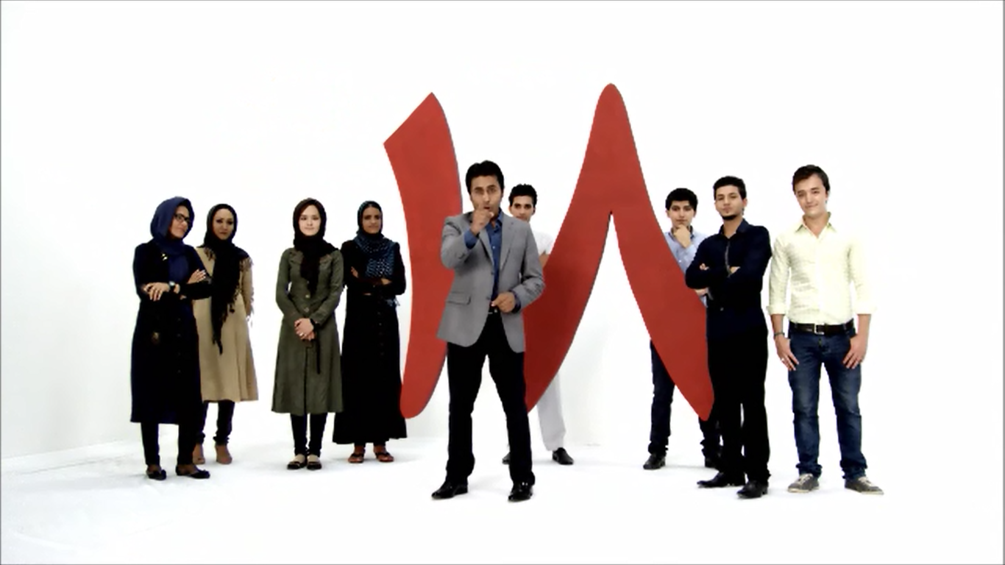
Indirect Methods
30 radio PSAs in Dari and Pashto, broadcast through 47 regional and 3 national stations
20 television PSAs in Dari and Pashto, broadcast through 23 national and 7 regional stations
10,000 pole signs (elections)
851 billboards (elections)

Slide 14
Outcomes
IEC call centre operators responded to approximately 2 million calls, from 16 July 2013 to Dec. 2014
Civic/Voter Educators reached an estimated 6.6 million people
68 mobile theatre performances – an estimated total reached 40,800 (8,030 women)
Estimated 8.4 million reached through televised PSAs
Estimated 16.7 million people reached through radio PSAs
Notes:
Based on a study commissioned by USAID (the most reliable report to date) – However, ownership must have increased since then.
73% of Afghans own a Radio
66% own a Mobile Phone
45% of Afghans own a Television

Slide 15
Outcome (continued)
increased turnout;
Increased female participation;
According to our survey, 82% of Afghans continue to consider elections to be a “good thing".

Slide 16
Challenges
Geography (mountains & cold weather)
Ethnic and linguistic diversity
Security
Cultural barriers to reaching key target audiences (i.e., women)

Slide 17
Thank You

