Slide 1
VOTER EDUCATION FOR INFORMED
AND
ETHICAL VOTING
THE MAURITIAN EXPERIENCE
M.I. Abdool Rahman
Electoral Commissioner

Slide 2
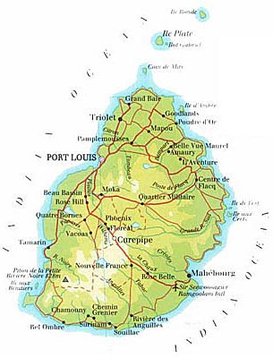
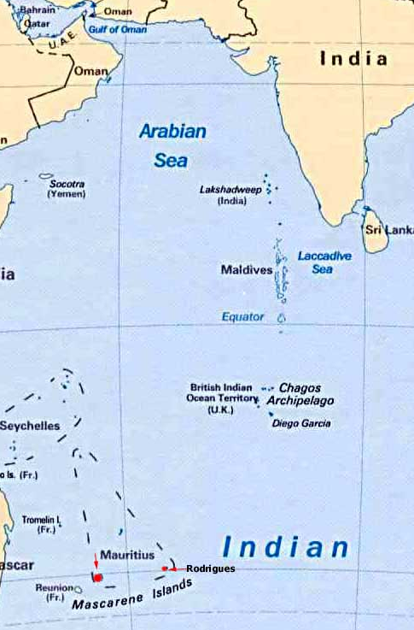
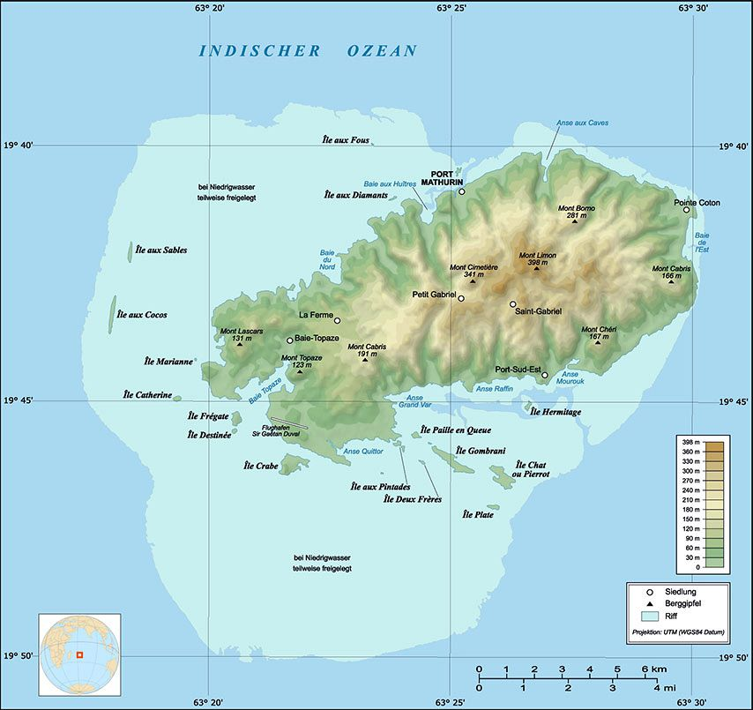
Mauritius & Rodrigues are located on the South West of India Mauritius is divided into 20 constituencies - The island of Rodrigues is the 21st Constituency Mauritius Rodrigues Surface area - 2,040 km² - 108 km² Population – 1,265 m - 41,700 Hindu, Muslim, Chinese & Creole No of Registered electors - 888,514 - 28,797

Slide 3
Mauritius. Indian Ocean
The official languages are English and French but Bhojpuri is spoken mainly in the rural areas

Slide 4
Comparative Figures – Population and Electors

Slide 5
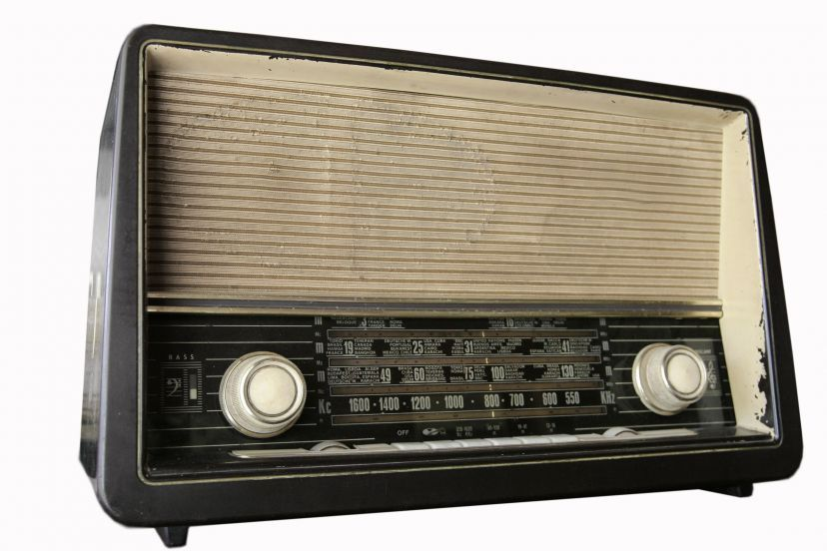
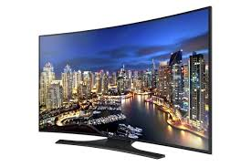
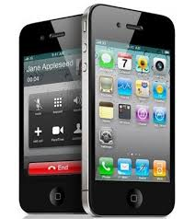
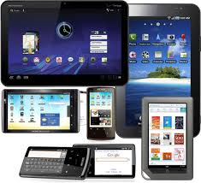
Information and communication devices in Mauritius
Radio and Television
Mobile phones
Computer based devices
The internet

Slide 6
ICT in Mauritius
1976 – free education in Mauritius
literacy in Mauritius – 90 %
ICT literacy – 83%
Access to telephone and radio – 92 %

Slide 7
Election year | Main Parties/Alliances | Winning party/Alliance | Change in Govt.
1967 | Independence Party (39) PMSD (21) | Independence Party (39)
1976 | MMM (30) Independence Party (25) PMSD (7) | Independence party (25) & PMSD (7) | No
1982 | Alliance MMM-PSM (60) Parti de L’Alliance National (PAN) (0) | Alliance MMM-PSM (60) | YES
1983 | MMM (19) MSM/PTR (37) PMSD (4) | MSM/PTR (37) | YES
1987 | L’Union MMM-MTD-FTS (21) Alliance MSM-Mauritius Labour Party (35) PMSD (4) | Alliance MSM-Mauritius Labour Party (35) | NO
1991 | Alliance MSM-MMM (57) Alliance PTR/PMSD (3) | Alliance MSM-MMM (57) | YES
1995 | Alliance PTR-MMM (60) Alliance MSM-RMM (0) | Alliance PTR-MMM (60) | YES
2000 | Alliance MSM-MMM (54) Alliance PTR-PMXD (6) | Alliance MSM-MMM (54) | YES
2005 | Alliance MSM/MMM (22) Alliance Sociale (38) | Alliance Sociale (38) | YES
2010 | Alliance MMM-UN-MMSD (18) Alliance PTR-PMSD-MSM (41) | Alliance PTR-PMSD-MSM (41) | NO
2014 | L’Alliance Lepep (47) Alliance PTR/MMM (41) | L’Alliance Lepep (47) | YES

Slide 8
As soon as the writs of election are issued by the President of the Republic our EMB engages in a series of interaction with political parties and candidates at each and every step of the election process

Slide 9
ELECTION CALENDAR IN A NUTSHELL
Writs of election issued by the President of the Republic for the 21 constituencies
Largest constituency – 62,260 registered electors
Smallest constituency – 21,763 registered electors
Notice of election at Nomination Centres
Application for registration of Political Parties and Party alliances
[71 registered political parties and 3 party alliances]
Approval of symbols of identification allocated to political parties and candidates
Printing of ballot papers at the Government Printing Office
Election Day
Counting

Slide 10
Publicity spots
Mauritius is divided into 20 Constituencies, Rodrigues being the 21st Constituency
National Assembly Elections – vote for 3 candidates per constituency
Municipal Council Elections – vote for 4 candidates per Ward
Village Council Elections - Vote for 9 candidates per village
Rodrigues Regional Assembly Election - vote for 2 candidates per Local Region
(6 Local Regions + PR System)
One (1) Municipal City Council (8 wards)
Four (4) Municipal Town Councils (22 wards)
Seven (7) District Councils ( 130 Village Councils)
Canvass 2014 - Registration of electors for a fortnight in January
How to vote

Slide 11
Proof of identity –
Production of proof during NAE 2014
New ID Card - 85.5 %
Old ID Card - 10.54 %
Bus Pass - 2.09%
Driving Licence - 0.91 %
Passport - 0.7 %
No proof - 0.26 %
SNVR
Hours of Poll

Slide 12
Percentage of voters during last NAE
Year – National Assembly Elections | % of voters | % of invalid votes
2000 | 81.1 | 1.08
2005 | 80.4 | 0.89
2010 | 78.2 | 0.84
2014 | 74.1 | 1.13

Slide 13
There is no one interaction that is a magic wand for voter turnout, as there are many factors that can influence voter turnouts
Technology will not change human behaviour but it is believed that it is a powerful tool to facilitate human behaviour in any process.

