Slide 1



A paper presented at International Conference on Voter Education
for Inclusive, Informed and Ethical Participation,
19th to 21st October, 2016, New Delhi, India
Theme:
Voter Education for Informed and Ethical Voting: Building awareness for
quality electoral participation among voters and other stakeholders like
political parties, candidates, CSOs
Facebook.com/IEBCKenya
@IEBCKenya
www.iebc.or.ke

Slide 2
IEBC Mandate
IEBC is responsible for conducting or supervising referenda and elections to any elective body or office established by the Constitution of Kenya 2010, and any other elections as prescribed by an Act of Parliament.
2
Independent Electoral and Boundaries Commission

Slide 3
IEBC MANDATE IN VOTER EDUCATION
Article 88 4(g) of the Constitution of Kenya 2010, mandates the Independent Electoral and Boundaries Commission (IEBC) to conduct voter education in the Country. The Directorate of Voter Education and Partnerships is mandated by the IEBC to carryout voter education in partnership with other agencies.
3
Independent Electoral and Boundaries Commission

Slide 4
Objectives of Voter Education
Voter education is non-formal public education meant to inform and to empower the voters to clearly understand their rights and responsibilities in the electoral process. It strives to improve the process of democracy, mobilize voters to exercise their rights in politics and to enhance voters understanding of participatory democracy. In delivery of voter education the Commission strives to engage partners/stakeholders as a way of creating synergy, enhancing participation and legitimacy.
4
Independent Electoral and Boundaries Commission

Slide 5
Objectives of Voter Education
Empower the people to use their inherent power as citizens to transform their society by electing leaders of their choice based on merit that will protect and promote their interests.
Impart knowledge and develop citizens competence in the process and practice of elections.
Promote ethical behavior in the electoral process.
Promote citizens conviction that have the power and the means the through thee vote to elect a democratic, transparent accountable and competent government that is supportive of their social, economic and political interests.
5
Independent Electoral and Boundaries Commission

Slide 6
Areas of Focus in Voter Education
Pre-Election Phase
  Legal Framework
  Boundaries Delimitation
  Voter Registration
  Voter Register Inspection
Election Phase
    The Elective Positions: qualifications and responsibilities
    Special interest groups(Women, Youth and PWDs)
    Nomination process
    Peaceful campaigns
    Voting Process
    Marking the Ballot
    Vote counting and tabulation of results
    Diaspora voting
    Presidential run-off
    Acceptance of results
3. Post election Phase
6
Independent Electoral and Boundaries Commission

Slide 7
Voter Education & Partnerships Strategies
Direct Voter Education outreach through IEBC field staff.
Partnership with International, National and community voter education providers, FBOs, Youth organizations, Women Organizations, Village elders and the general public.
Empowering IEBC accredited Community Based Organizations, Private Sector and Civil Society.
Media engagement (TV, Radio, print, Social Media).
Roadshows at County and Constituency levels.
Participate in educational, social and cultural events.
7
Independent Electoral and Boundaries Commission

Slide 8
Voter Education & Partnerships Strategies
Active involvement of school children and their parents.
Simulation of the voting Process at the ward level.
Engagement of Voter Educators and mobilizers at ward level.
Stakeholder engagement forums at all National, County, Constituency and Ward levels.
Active involvement of Faith Based Organizations.
Engagement of respected influential personalities and celebrities.
Conducting Annual Voter Education Week (AVEW).
Partnership with State and Non-state Actors.
8
Independent Electoral and Boundaries Commission

Slide 9
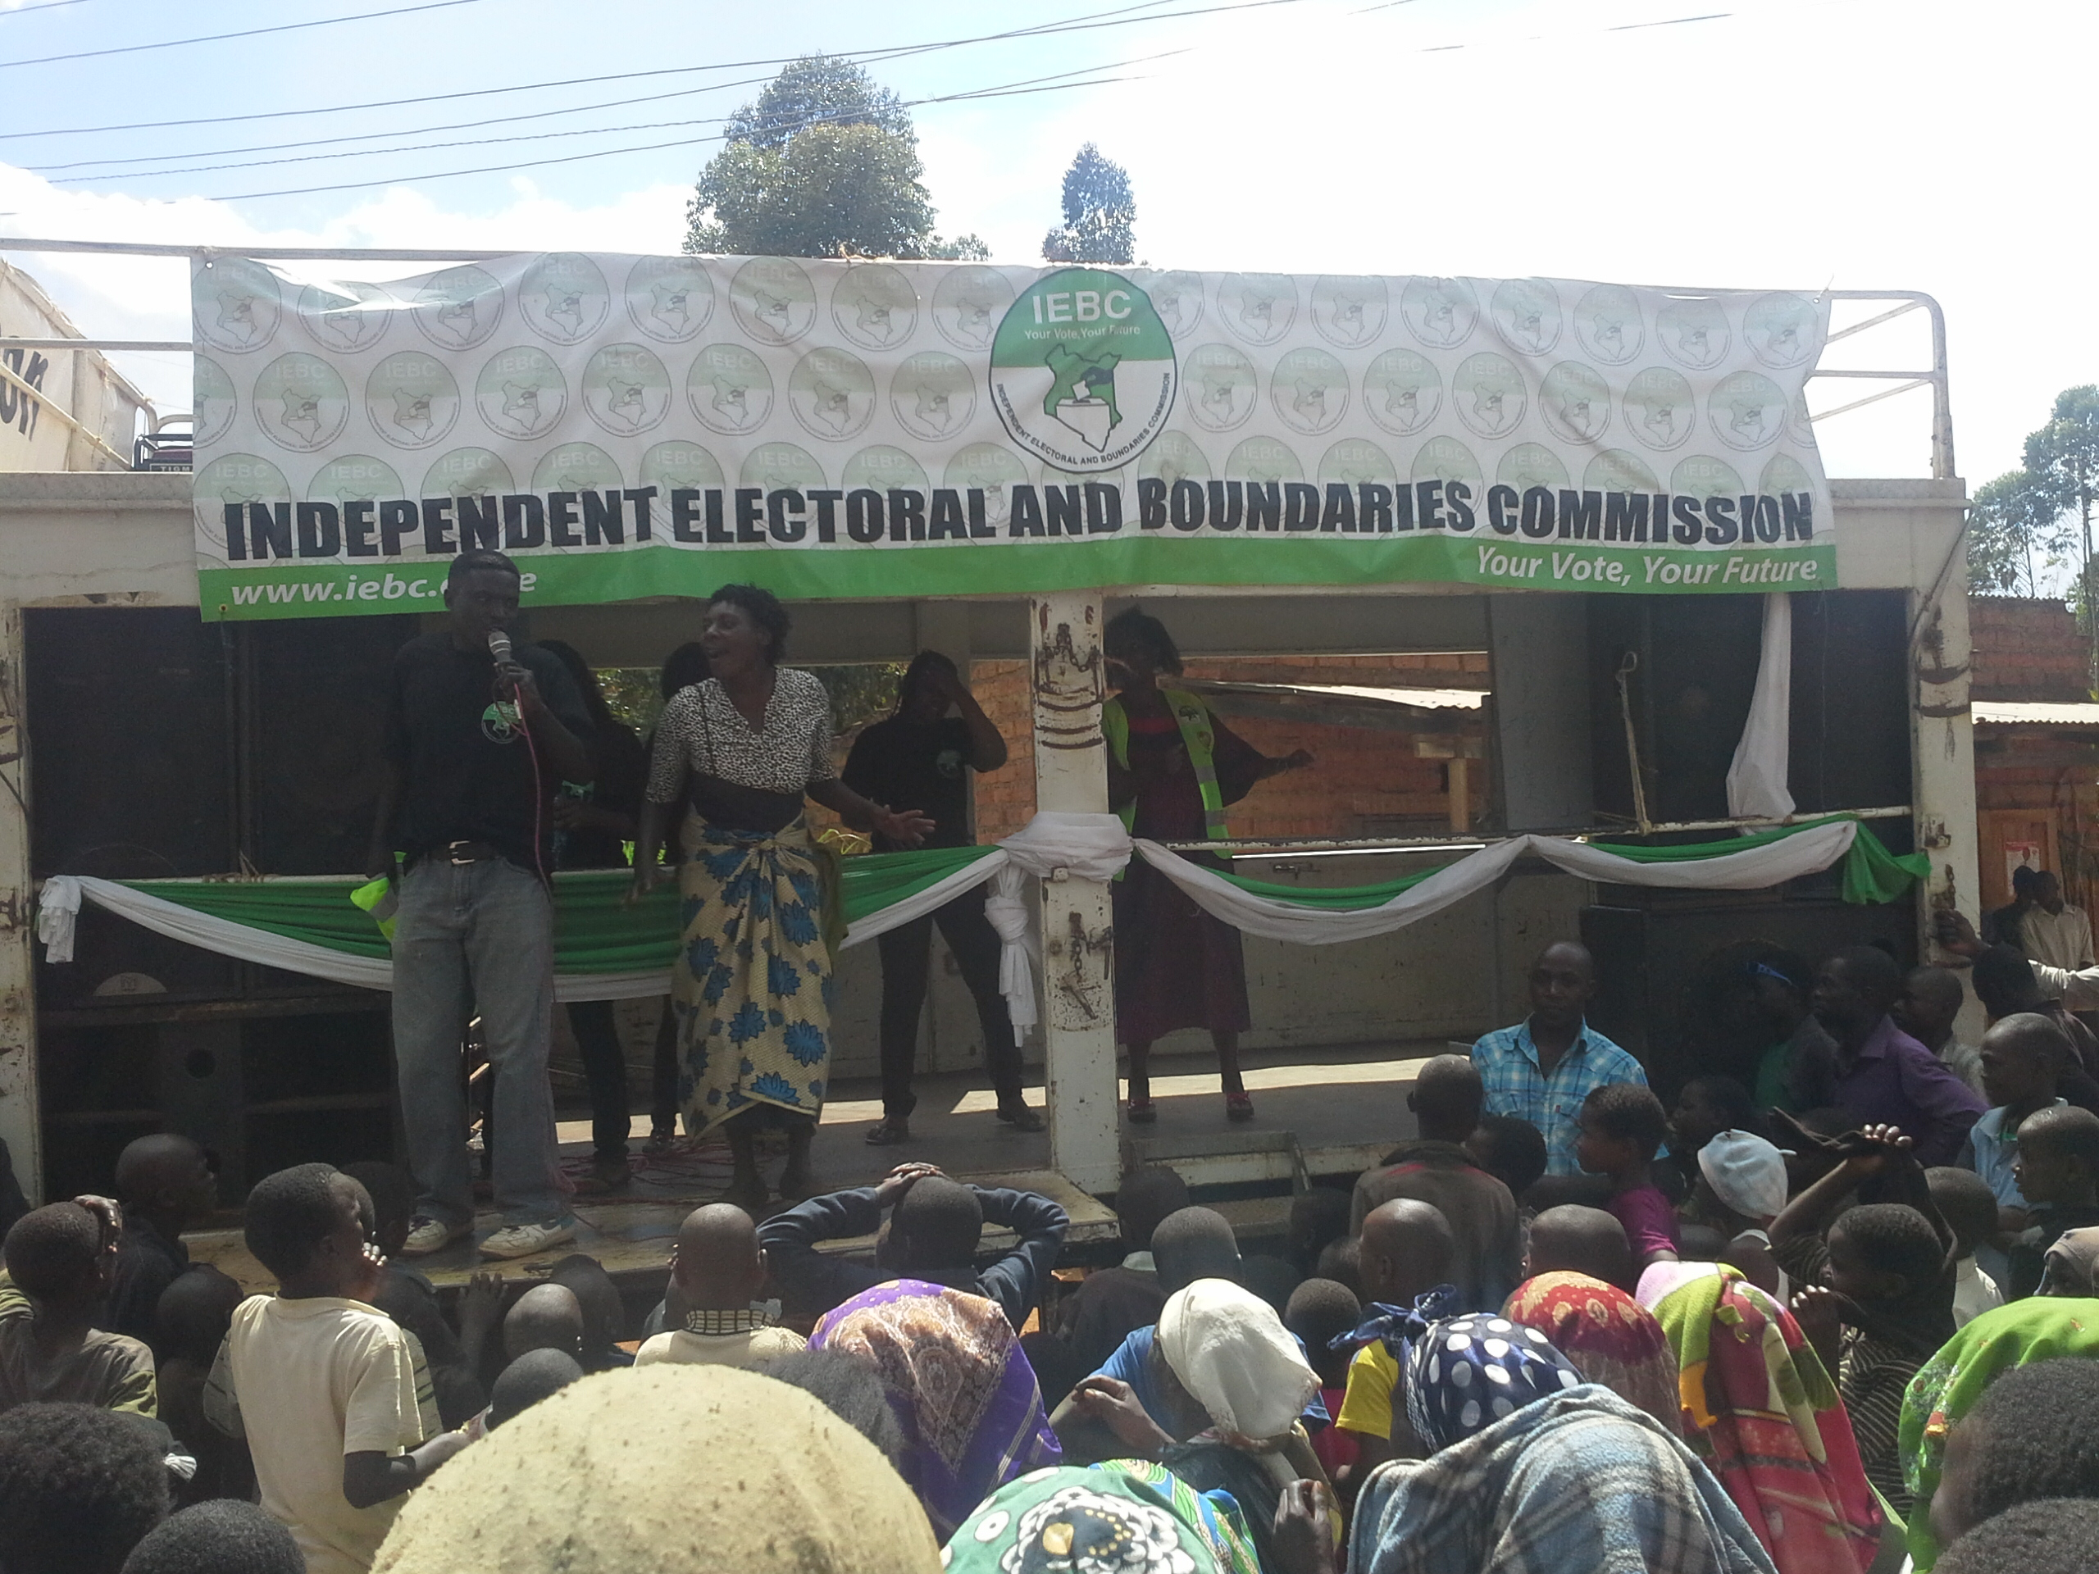
Voter Education &Partnerships Strategies
9
Independent Electoral and Boundaries Commission

Slide 10
Voter Education Expected Outcome
Increased participation of registered voters in the polls;
Reduced cases of electoral violence and fraud;
Reduced cases of spoilt/rejected votes;
Increased participation of the youth, women and marginalized in the electoral process;
Enhanced secrecy of the ballot and freedom of choice;
Informed voters and informed choices.
10
Independent Electoral and Boundaries Commission

Slide 11
Platforms of Voter Education
Activity | Description
SMS | All the four existing mobile operators namely Safaricom, Airtel, Orange and Yu.
IEBC Website | Platform operational.
Radio Announcement | Standard radio spot for all the national and community radio stations.
Newspaper Advert | Advertisement in the top 3 newspapers.
Television | TV spots at prime times
Posters/fliers/stickers/brochures/ | Poster, fliers, brochures and stickers printed and distributed countrywide.
11
Independent Electoral and Boundaries Commission

Slide 12
IEC Materials on Voter Education
Activity | Description
Handbook/ Booklets | i) Yes, I Can Vote: A User Friendly Guide to Voting in Kenya – This booklet uses direct and personal approach that is easy to read and follow.
 | Handbook on Elective Positions (being reviewed for compliance)
Posters | Kugombea si Kugombana
 | Voting Procedure
 | Youth(Mavijana)
 | Sample Ballot Paper
 | Come out and Vote
 | Say no to Bribery
Brochures | On Election Day (Run-off included)
 | Elective Positions
Stickers | Your Vote Your Future, Kenya-My Choice-My Vote, Cast Your Vote on 4th March & be on the Right Side of History, Am proud I voted on 4th March 2013, Peaceful Campaign Starts with Me, Unleash your vote on 4th March 2013, Be a Guardian of our Country - vote on 4th March 2013, Our future is in Our votes – vote on 4th March 2013, Don’t turn your back on our future-vote on 4th March 2013,
12
Independent Electoral and Boundaries Commission

Slide 13
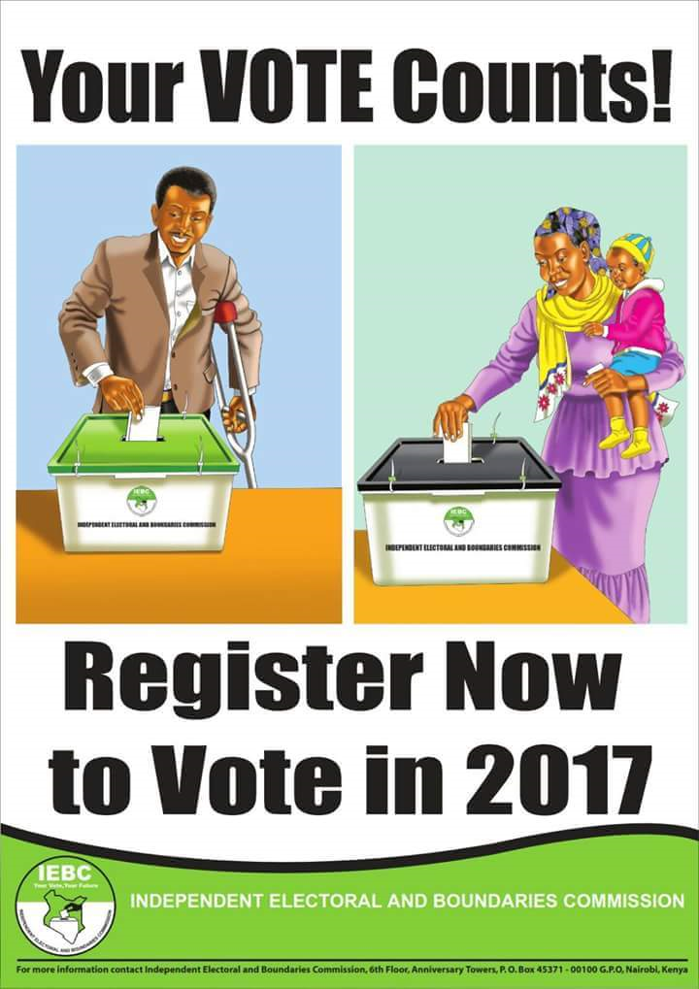
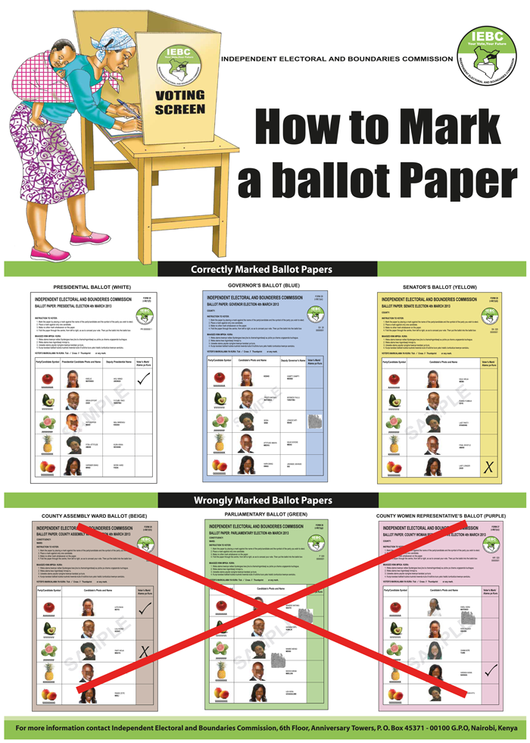

Slide 14
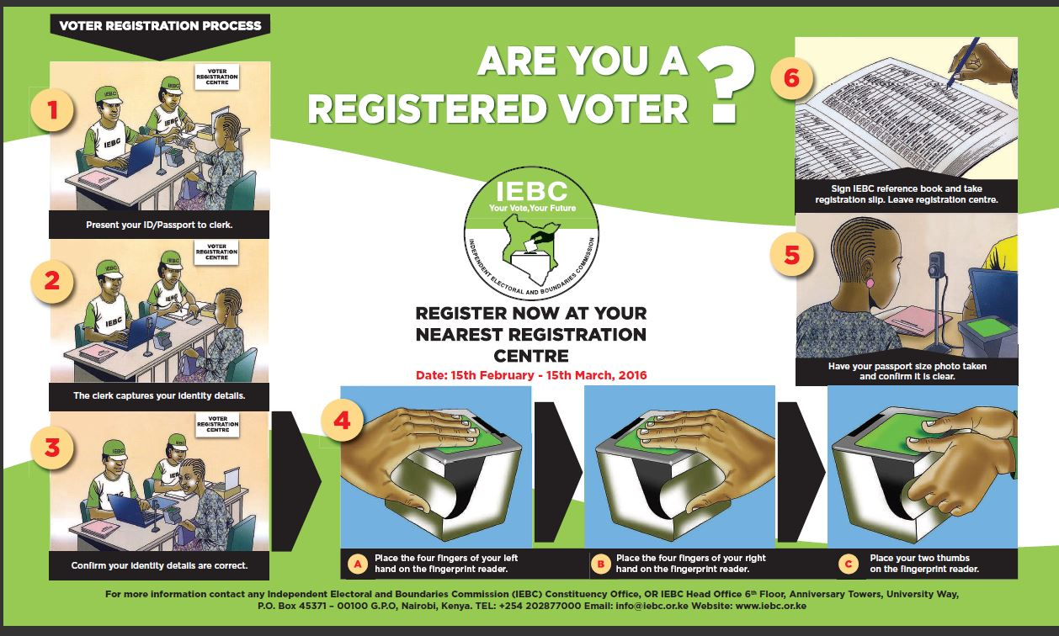

Slide 15
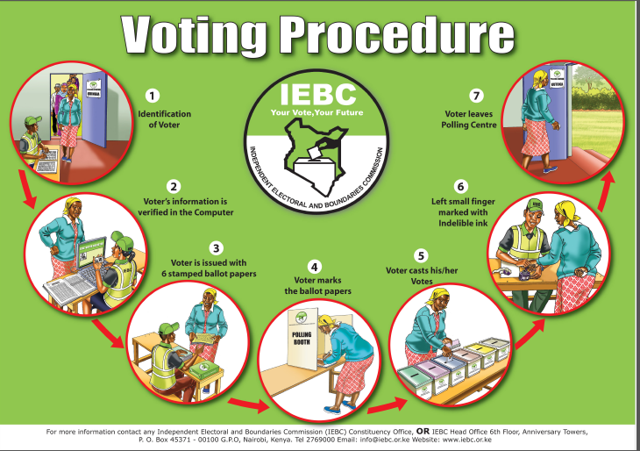

Slide 16
Voter Education/Partnerships for Diaspora
Voter Education Strategies for Diaspora
Country | Outreach Channel
All Countries | Nation Online, IEBC website, Standard Online, East African newspaper
Uganda | Monitor Newspaper
Tanzania (Dar es Salaam) | Mwananchi and Citizen Newspapers
Tanzania (Arusha)
Rwanda | Rwanda Today
Burundi | Local dairies
16
Independent Electoral and Boundaries Commission

Slide 17
Voter Education in Schools
School Children Leaflet
A special brochure was prepared for students in primary schools to carry home to their voting age parents/guardians. This strategy targeted 9.5M school children in both public and private schools. In conjunction with the Directorate of Children Services organized a successful Kenya Children Assembly Elections.
Voter Education Curriculum for Schools
A Voter Education Curriculum for schools has been prepared in collaboration with Ministry of Education.
17
Independent Electoral and Boundaries Commission

Slide 18
Voter Education & Partnership with Universities
During the 2013 General Election, the IEBC partnered with Kenyatta University on the entertainment platform
Universities have been inviting IEBC to:-
  Educate on Democracy Election Management and Election Operations.
  Conducting elections for student bodies.
  Participating and educating public during cultural events.
  Sharing voter education materials.
18
Independent Electoral and Boundaries Commission

Slide 19
Voter Education/Partnerships on Gender
The Commission through the Directorate has partnered with many stakeholders e.g UN Women which conducts the voter education and empowerment to women and youth who are aspiring to be leaders. The project normally targets the marginalized groups.
19
Independent Electoral and Boundaries Commission

Slide 20
Role of University Students and Staff
To be examples to all other youths that Kenya is a democratic country.
By exercising your right in election.
    e.g by registering as a voter,
    reaching out for peace,
    participating in civil/voter education as volunteers,
    participating in politics,
    shunning tribalism.

Slide 21
Thank You
Independent Electoral and Boundaries Commission (IEBC)
Address: University Way, Anniversary Towers, 6th Floor
P.O Box 45371 - 00100, Nairobi, Kenya.
Phone: (254) 020 2769000, fax: (254) 020 2219185
Email: info@iebc.or.ke | website: www.iebc.or.ke | facebook/IEBCKenya |@IEBCKenya

