Slide 1
VOTER EDUCATION AND ICT
Najia Hashemee
Regional Electoral Policy Specialist
Notes:
Funded by the government of Spain
Contribution from Canada

Slide 2
Elections are the ultimate means through which citizens voice their political preferences and choose their representatives.
Elections are regularly conducted in almost all countries. Yet, many countries continue to face challenges related to the integrity and credibility of their elections.
Electoral processes are also important benchmarks in peacebuilding processes, particularly in severe post-conflict contexts. Elections can also, however, fuel existing conflicts and divisions in society.
Hence, inclusive and credible electoral cycle support is an integral tool for democratic governance and peaceful development.
Notes:
Adviosry services too
Stronger UN/EU relations on electoral assistance - joint projects & trainings
Develop knowledge products and electoral indicators framework
UN policy development on electoral assistance

Slide 3
UNDP’s Electoral Assistance
Provides support to approximately
65 countries
per year
Notes:
Focus of UNDP electoral assistance
Strengthen the capacities of independent and permanent EMBs
Support civic outreach and voter education
Prevent electoral violence and support peaceful transitions
Promote electoral reform
Promote women´s participation as voters, candidates and electoral administrators
Encourage political participation of vulnerable and marginalized groups (youth, women, persons with disabilities, indigenous people)
Facilitate South-South Cooperation and peer to peer learning
Adviosry services too
Stronger UN/EU relations on electoral assistance - joint projects & trainings
Develop knowledge products and electoral indicators framework
UN policy development on electoral assistance

Slide 4
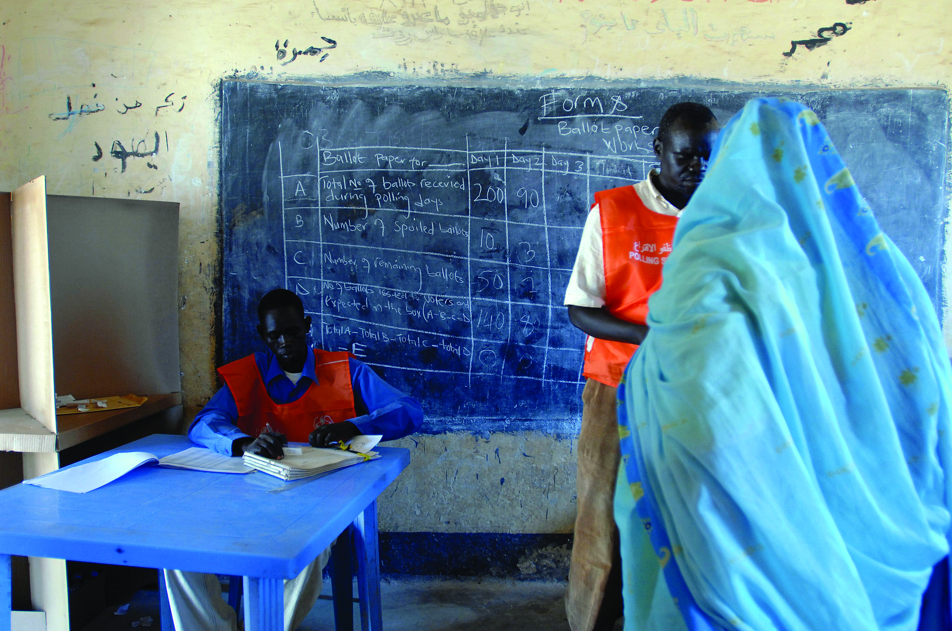
UNDP’s Electoral Assistance
In the Strategic Plan 2014-2017, UNDP adopts an integrated approach to supporting inclusive political processes (IPP) that aims to strengthen political processes and institutions for improving citizen participation, voice and accountability and (re-) build a strong(er) and more inclusive social contract.
Notes:
UNDP provides electoral support through its country offices in about 60 countries per year.
GPECS is complementary to CO programming – ensuring regional and global linkages, synergies with other areas of democratic governance as well as ensuring a political beyond just technical approach to electoral assistance.
Main area of work is strengthening the institutional, technical and operational capacity of EMBs and other stakeholders and promoting inclusive elections.
UNDP provides electoral assistance in diverse socio-political contexts, ranging from post-conflict countries to established democracies

Slide 5
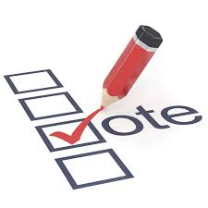
NATIONAL
Strengthen the capacities of independent and permanent EMBs
Support civic outreach and voter education
Prevent electoral violence and support peaceful transitions
Promote electoral reform
Promote women´s participation as voters, candidates and electoral administrators
Encourage political participation of vulnerable and marginalized groups (youth, women, persons with disabilities, indigenous people)
Facilitate South-South Cooperation and peer to peer learning
Notes:
Providing electoral cycle support from legislative reform to operational assistance to voter and civic education programming
Working directly with EMBs, civil society organizations, relevant ministries and other electoral stakeholders

Slide 6
NATIONAL: VOTER EDUCATION AND ICT
Tunisia
Twitter: supported the election commission to develop an online game called DemocraTweet
Youtube: election song went viral inspiring youth throughout the country
https://www.youtube.com/watch?v=8nSyO5Jd1Oo
Jordan
Facebook: the election commission used Facebook to disseminate voter education messages
https://www.facebook.com/EntikhabatJO/videos/565087833616318/
Libya
SMS: key messages on the electoral process sent to all subscribers
voter education tool as text messages were sent to all subscribers to explain to citizens why they should register and how to do it very easily via SMS.
Notes:
E-learning for EMBs, civil society organizations, other electoral stakeholders including the general public

Slide 7
REGIONAL
Provide policy advice and programming support to country level projects
Facilitate exchange of good practices, per networking and knowledge creation and dissemination
ARAB STATES
enhancing regional electoral knowledge
Establishing the Organization of ArabEMBs
Strengthening electoral capacities of regional organizations (i.e. League of Arab States)
Promoting the participation of women and youth
Notes:
Adviosry services too
Stronger UN/EU relations on electoral assistance - joint projects & trainings
Develop knowledge products and electoral indicators framework
UN policy development on electoral assistance

Slide 8
REGIONAL: VOTER EDUCATION AND ICT
Game App
Arabic, French, English Lexicon of electoral terminology
Facebook
Pilot course on electoral systems with St. Joseph University Beirut
Whatsapp
Regional online group of voter registration expertstizens why they should register and how to do it very easily via SMS.
Notes:
E-learning for EMBs, civil society organizations, other electoral stakeholders including the general public

Slide 9
GLOBAL
Produce innovative knowledge products that advance the electoral cycle approach in identified gap areas
Strengthen policy and programming support
Notes:
Adviosry services too
Stronger UN/EU relations on electoral assistance - joint projects & trainings
Develop knowledge products and electoral indicators framework
UN policy development on electoral assistance

Slide 10
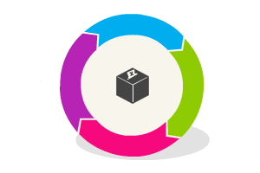
GLOBAL: VOTER EDUCATION AND ICT
E-Learning courses on topics such as:
Electoral Results Management
Sustainability in Electoral Administration
Credibility and Acceptance of Electoral Processes
http://elearning.ec-undp-electoralassistance.org/
why they should register and how to do it very easily via SMS.
Notes:
E-learning for EMBs, civil society organizations, other electoral stakeholders including the general public

Slide 11
VOTER EDUCATION AND ICT:
ISSUES FOR CONSIDERATION
why they should register and how to do it very easily via SMS.
Know your voters: different voters have different learning styles. Understand how to best reach your voting public
Real time information: use of mediums like social media require capacity to have and disseminate information instantaneously
Sustainability: use of ICT in elections, including in voter education, has financial and human resource implications
Notes:
E-learning for EMBs, civil society organizations, other electoral stakeholders including the general public

Slide 12
Thank you!

