Slide 1


PHILIPPINE COMMISSION ON ELECTIONS
Chairman J. Andres D. Bautista
October 2016

Slide 2

OBJECTIVES FOR 2016 ELECTIONS
CREDIBLE ELECTIONS
ENHANCING THE VOTING EXPERIENCE
=
Should not
only be
honest
+
But also
perceived to
be honest
Credible
Elections
Looking out for the comfort & convenience of the voter
High voter turn-out strengthens credibility

Slide 3
GENERAL STRATEGY
ICE TEA
Inspire
Transparent, Efficient, and
Accountable
the COMELEC Workforce
BE
Consult
and
Engage
our stakeholders (and critics)
in the way we do things

Slide 4
SPECIFIC APPROACH
Key Performance Indicators
Decide what to measure
Collect the data
Analyze the data
Report the results
Take Action
Improve upon 2010 and 2013 performance
Identify key result areas / performance indicators (KRA/KPIs)
Create performance scorecard

Slide 5
COMELEC PERFORMANCE SCORECARD

Slide 6
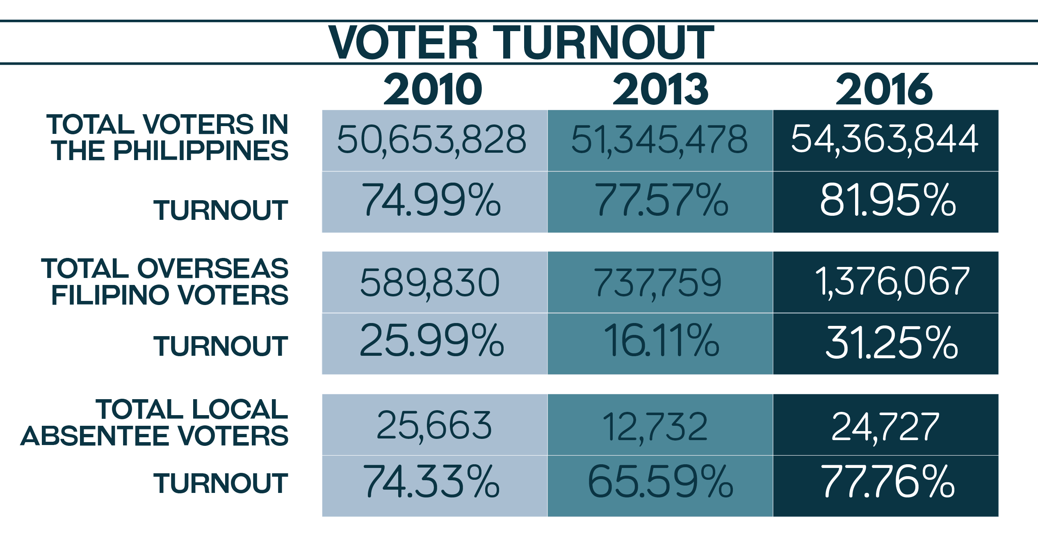

Slide 7
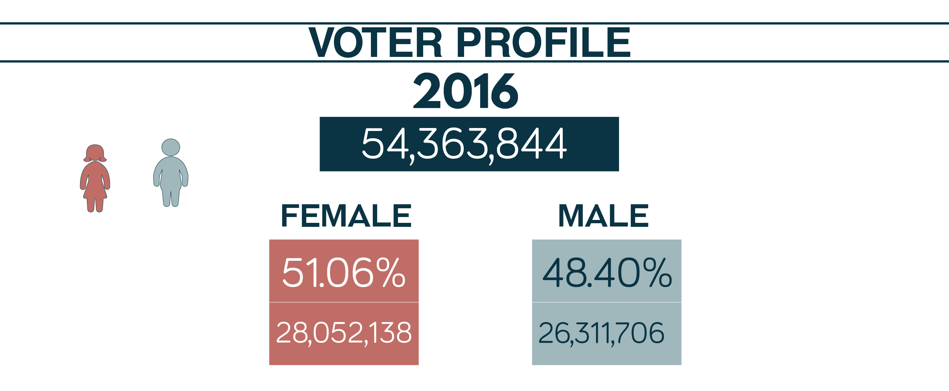
48.40%
51.06%

Slide 8
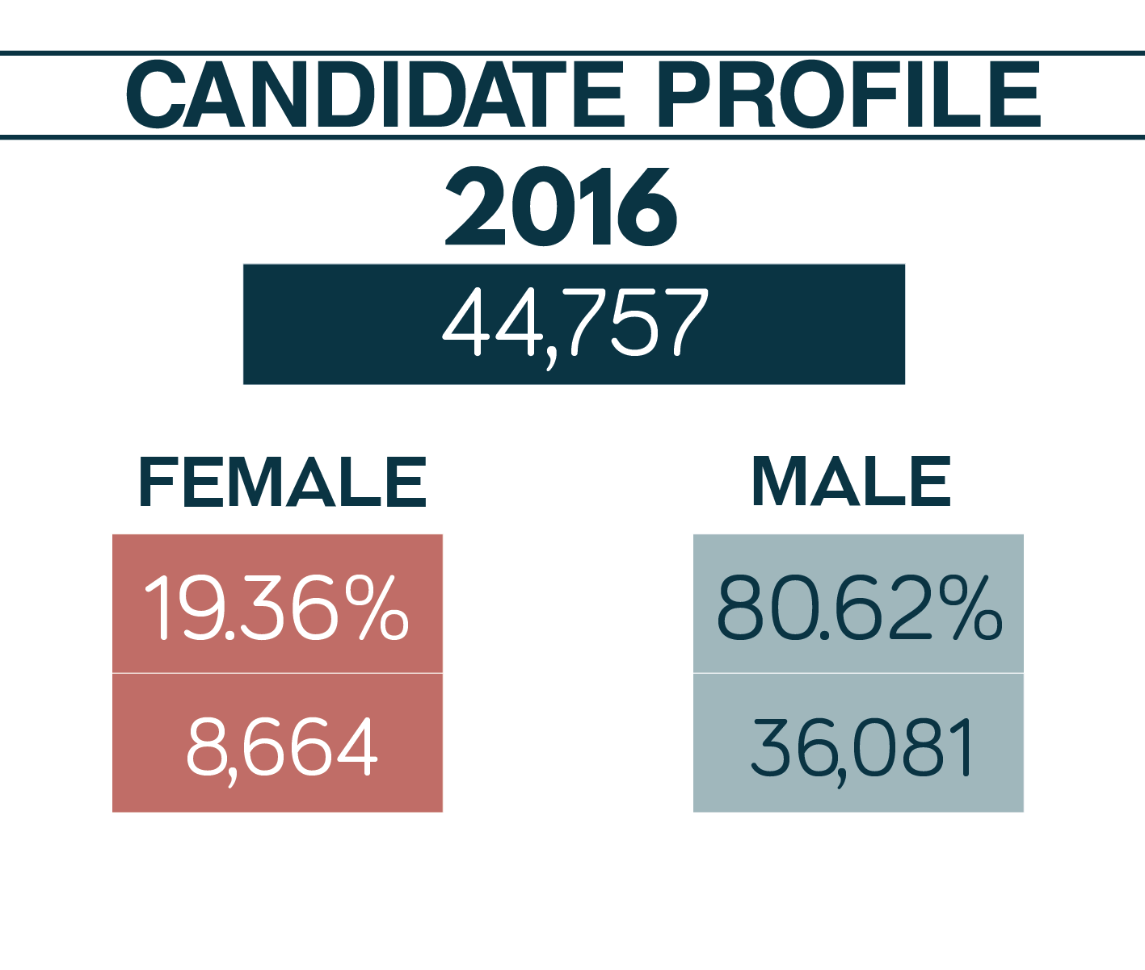

Slide 9
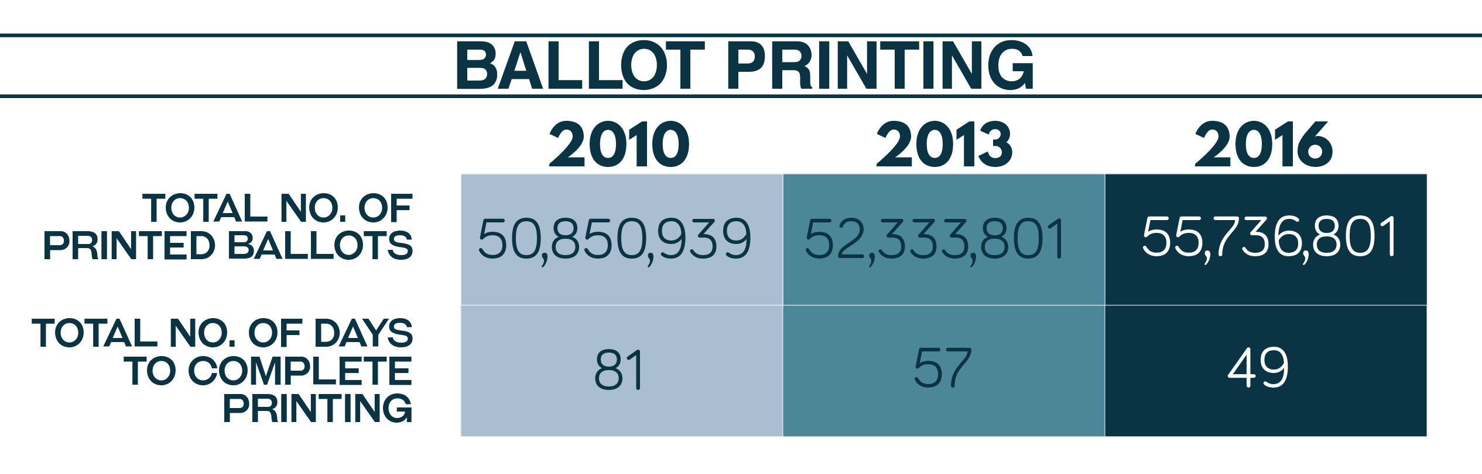

Slide 10
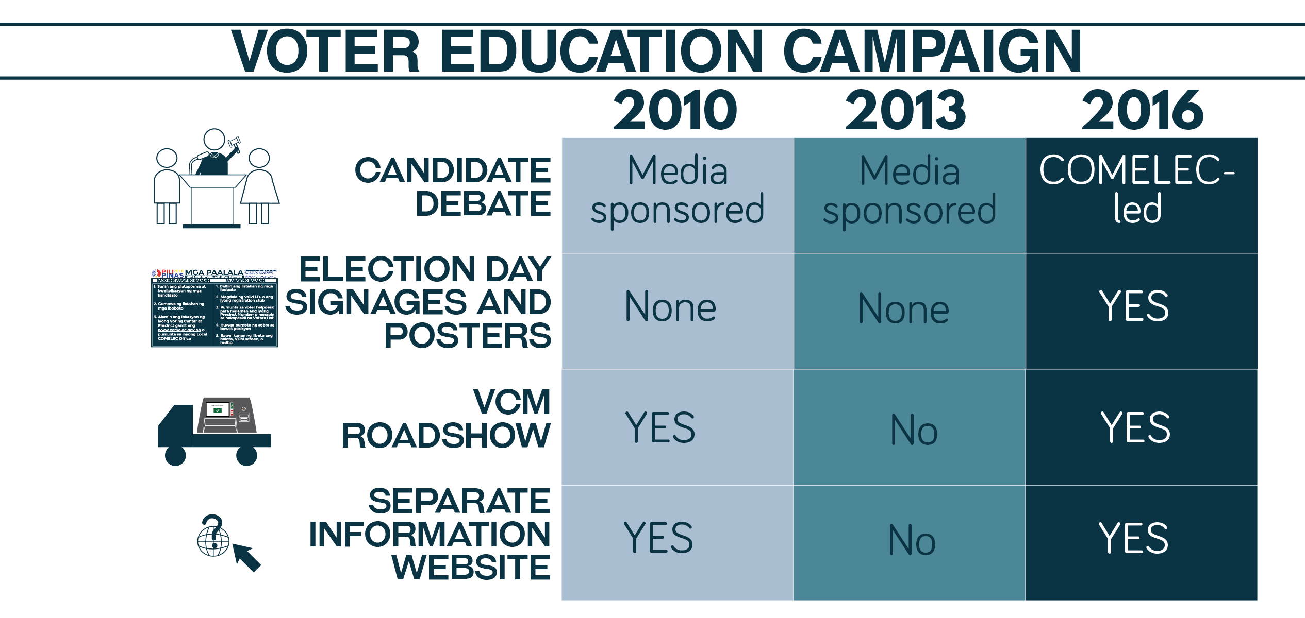

Slide 11
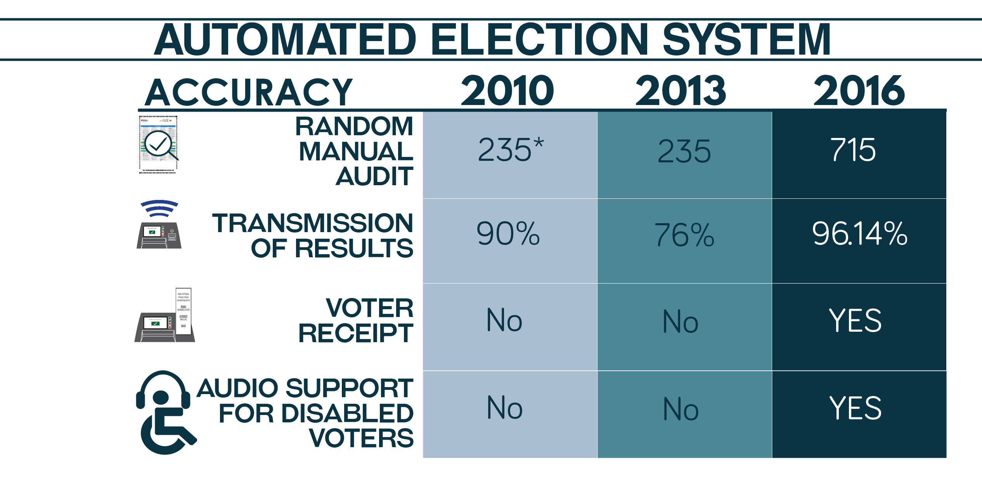

Slide 12
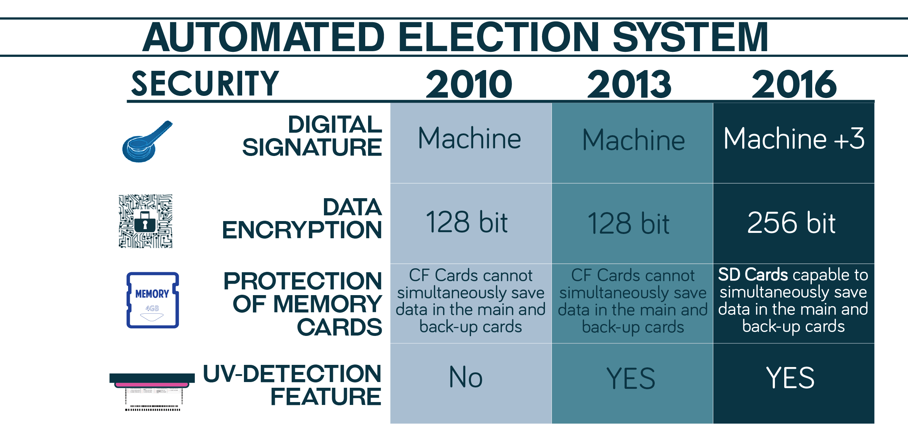

Slide 13
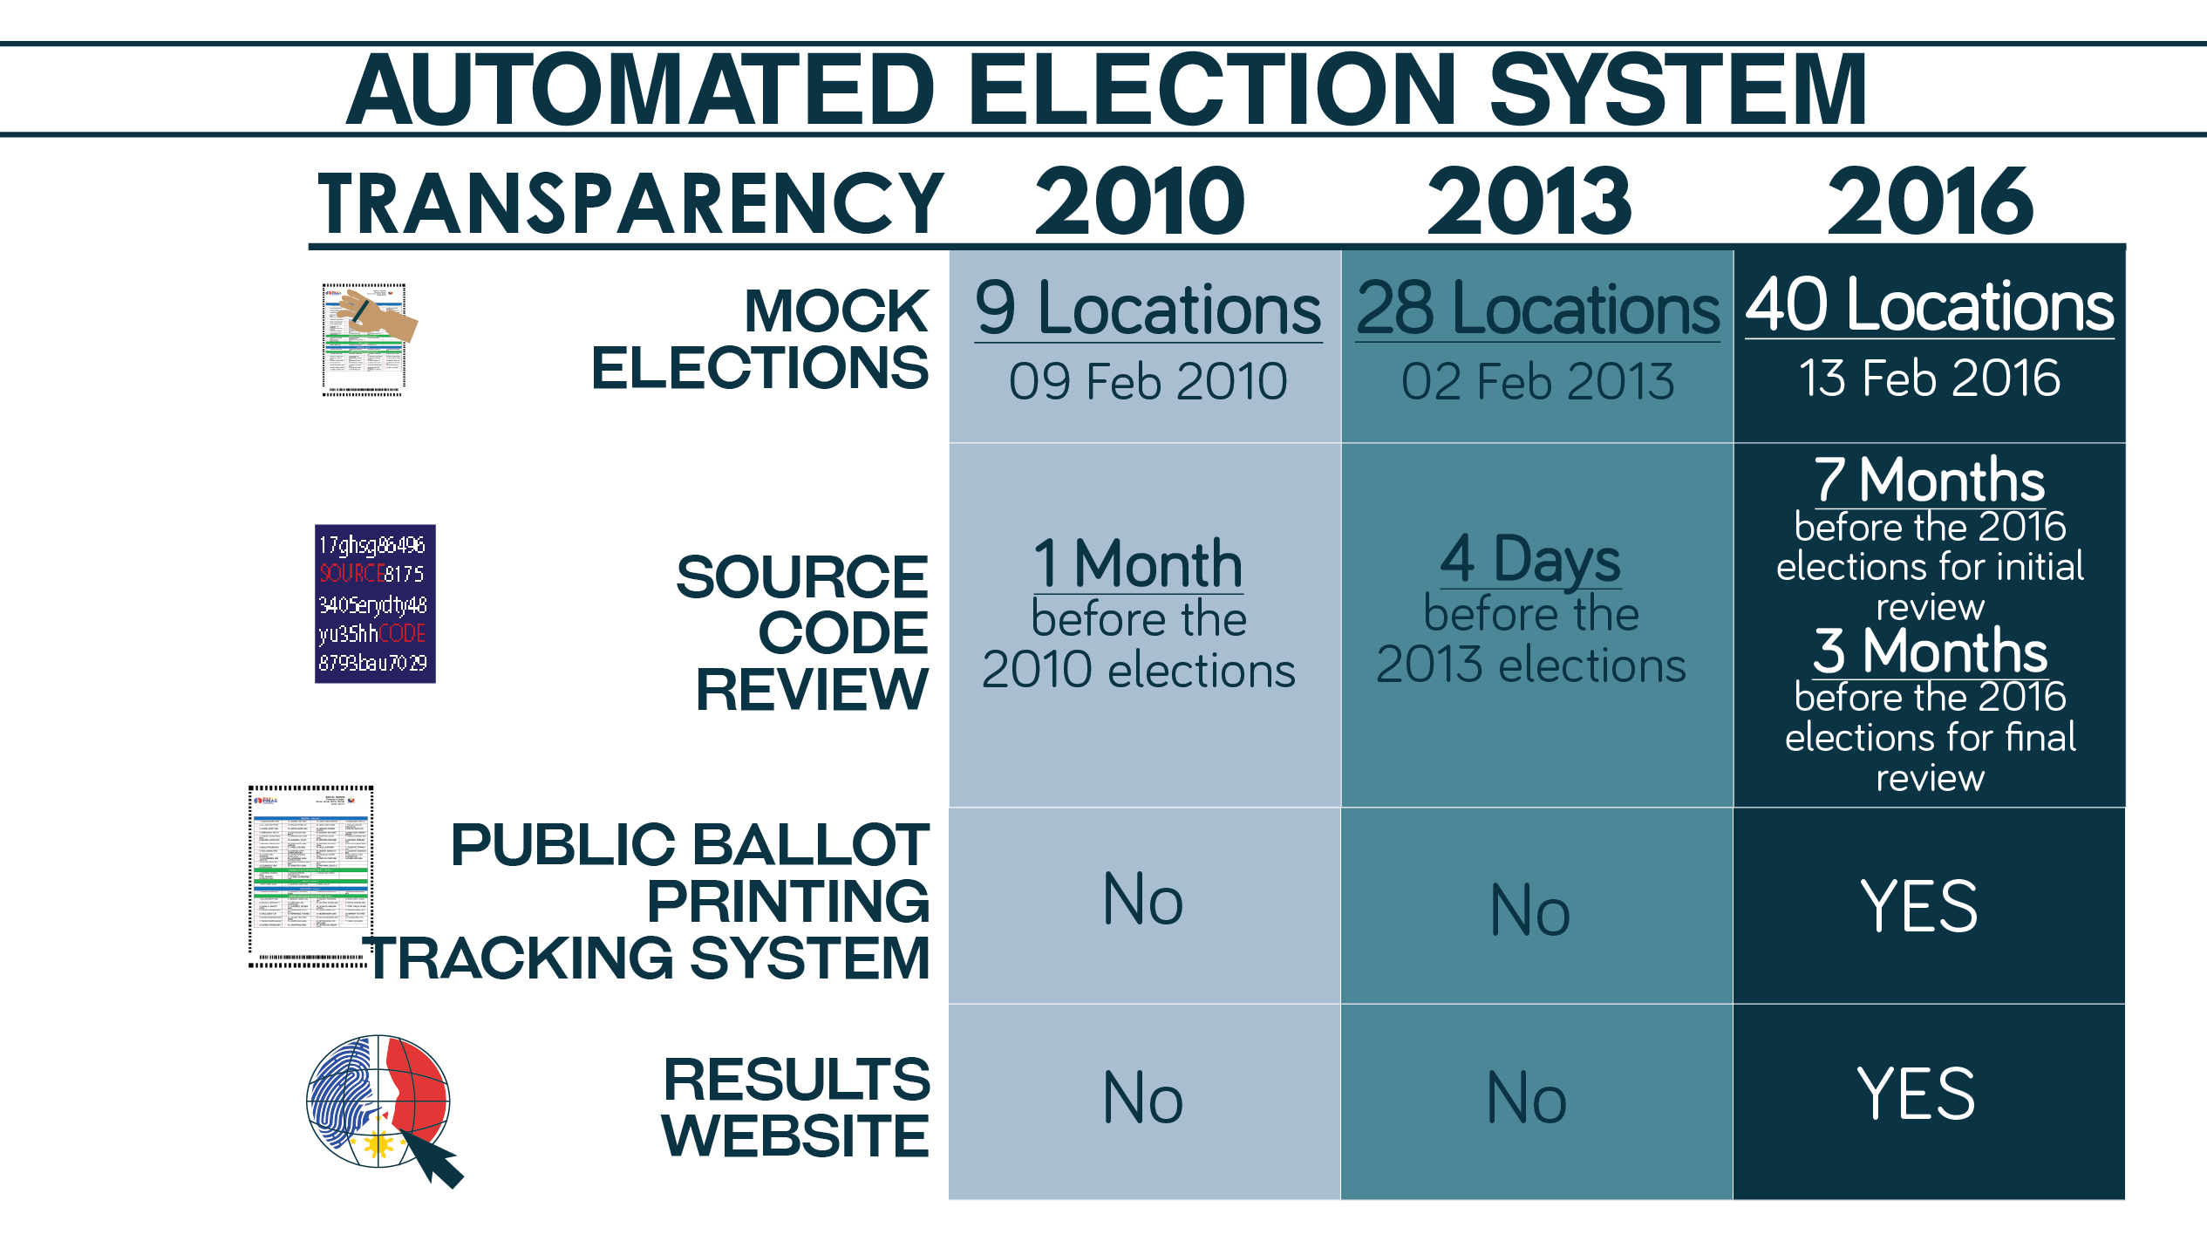

Slide 14
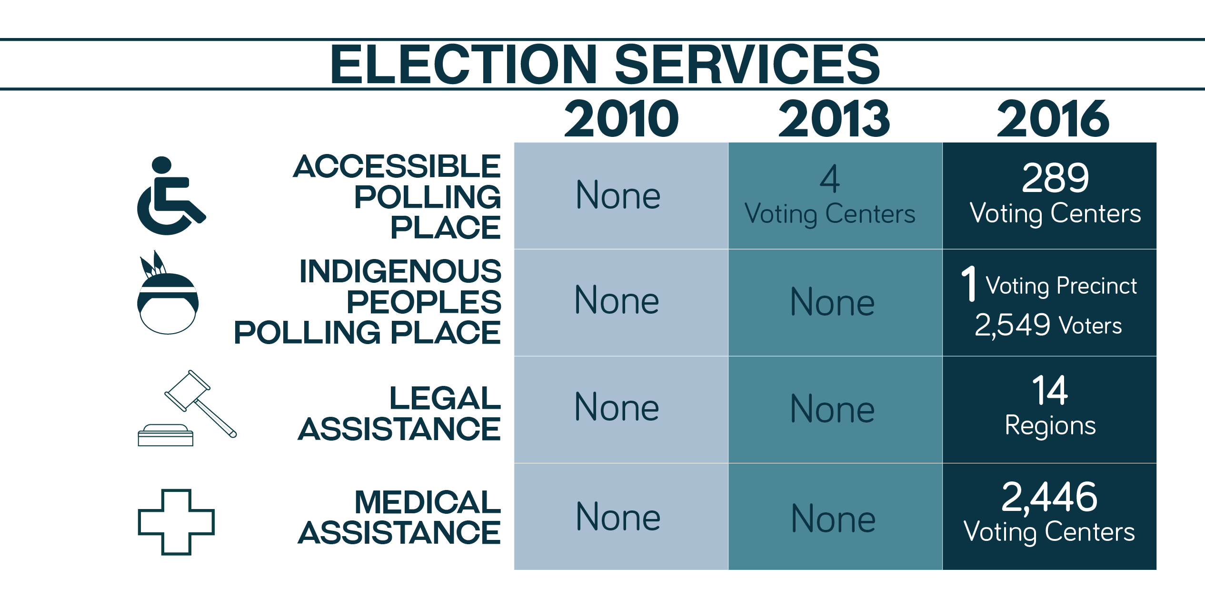

Slide 15
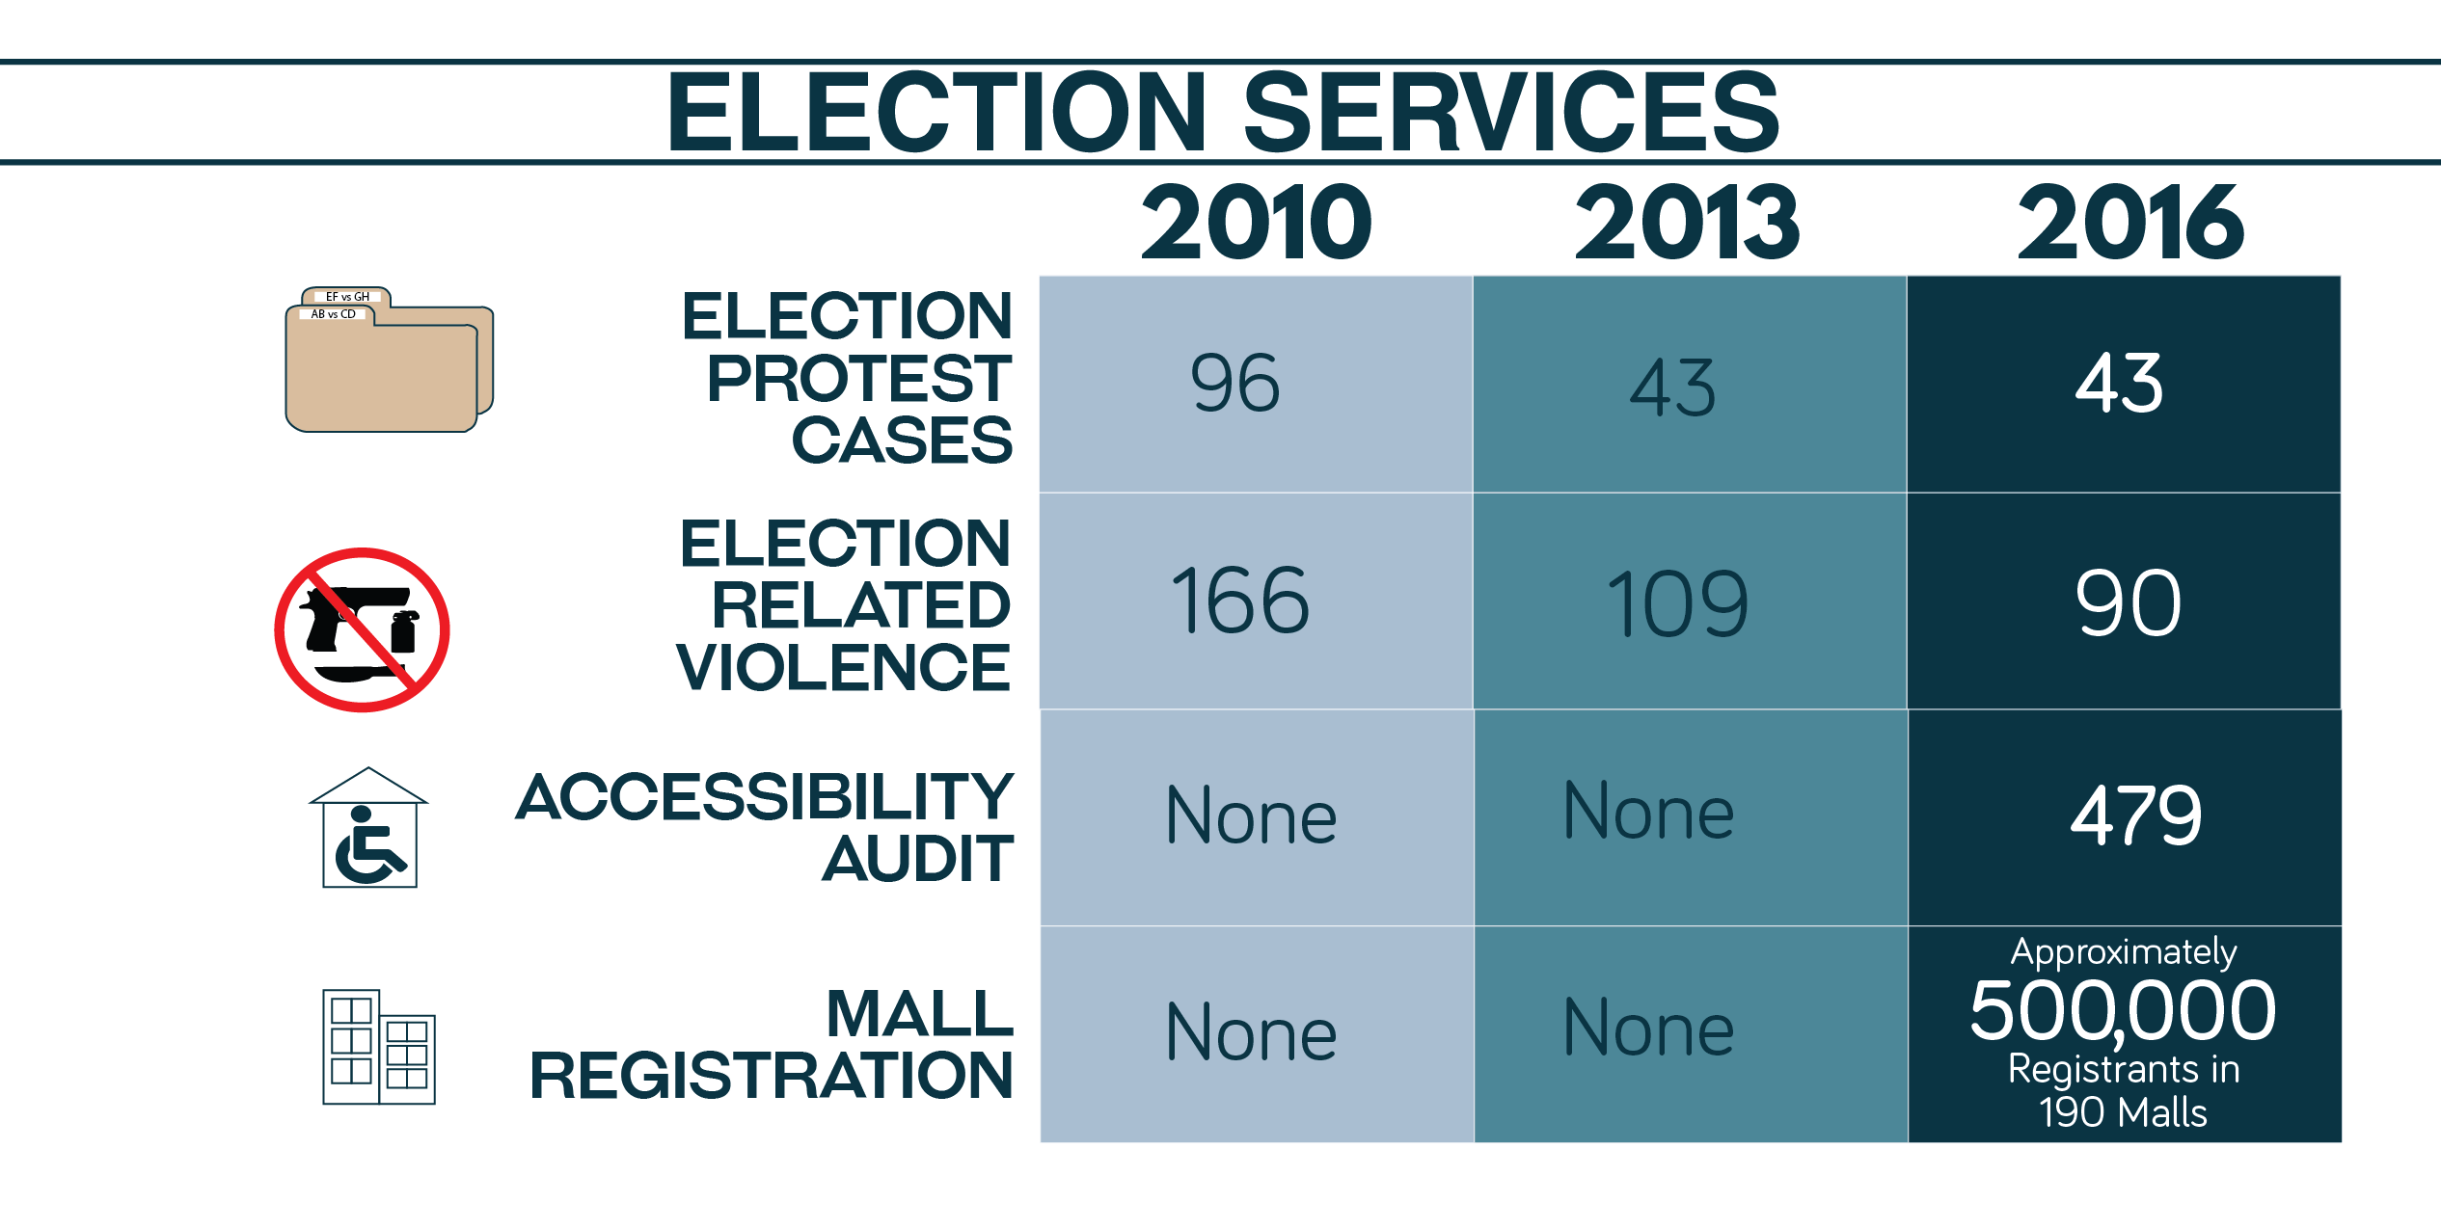

Slide 16
Strengths of Technology
Ballots used are precinct-specific
Voting remains manual
Machine scans every ballot fed to it and saves images in the SD Cards
Machine has an “audit log”
Machine prints 30 copies of the Election Returns (ERs)

Slide 17
Transparency Features and Public Engagement
COMELEC Advisory Council composed of Government and CSO Representatives
Source Code Review by interested parties
Mandatory Random Manual Audit of the System
Observation of facilities and consultation with political party representatives during election preparation
Election results website

Slide 18
“Most electoral stakeholders seemed to feel that the automated elections of 2016 marked significant improvement over previous Philippine elections”
-The Carter Center

Slide 19
“Better managed than the past two automated elections held in 2010 and 2013”
-National Movement for Free Elections

Slide 20
“The NLE 2016 was a shining moment for the elections, COMELEC, and for PPCRV. It was by far the best of the three automated elections since 2010”
-Parish Pastoral Council for Responsible Voting

Slide 21
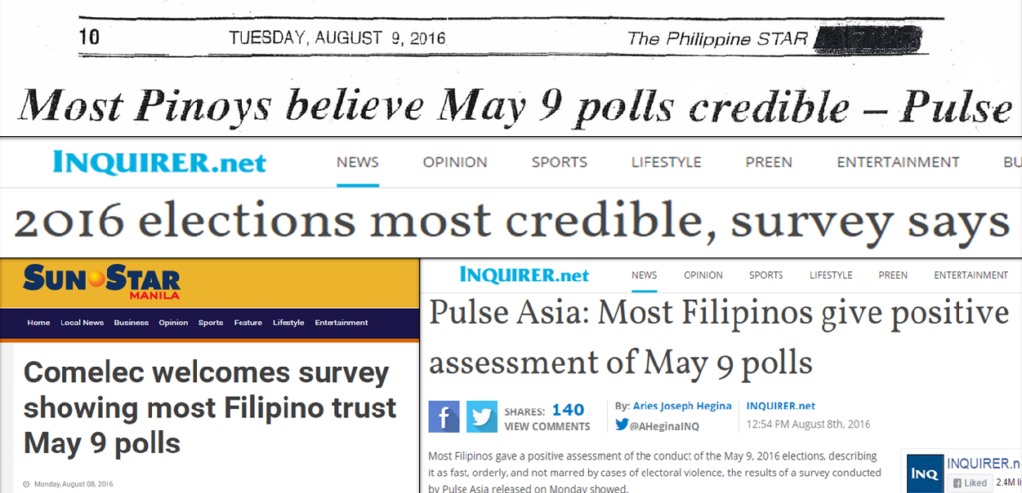

Slide 22
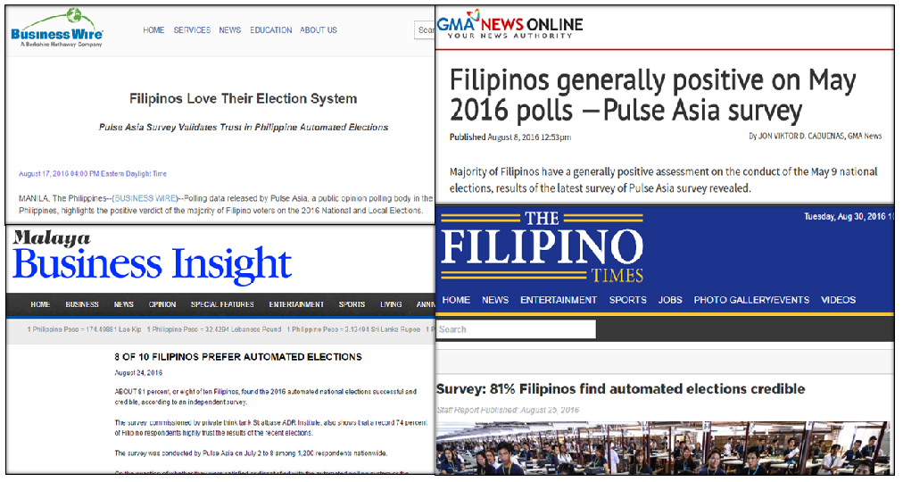

Slide 23


The 2016 international study entitled “Rethinking Debates”, by the U.S. based Civic Hall and Democracy Fund, cited the Philippine Commission on Elections for its innovative use of social media on the first Presidential Debate after 24 years.
303
MILLION ELECTION-RELATED POSTS
268 MILLION FACEBOOK POSTS
35
MILLION TWEETS
The study recorded a total of
303 million election-related posts
and the hashtag #PiliPinasDebates2016
registered 1.9 million tweets which resulted to the highest engagement on Twitter for a presidential debate.

Slide 24
A Way Forward
Continue with the assessment, consultations, and dialogue with stakeholders
Enhance the independence of COMELEC
Adopt international best practices
Push for the necessary legislative reforms

Slide 25
THANK YOU!

