Slide 1
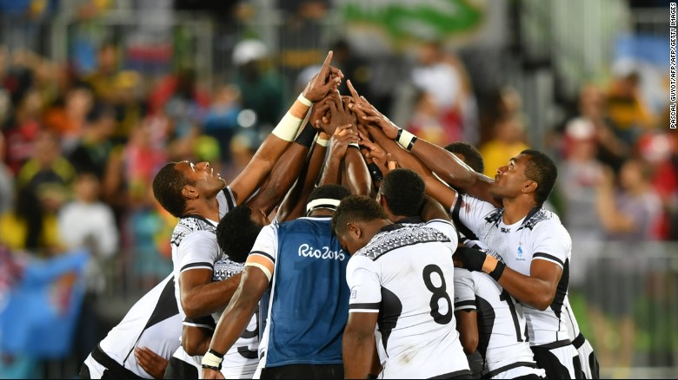

Slide 2
Role of Information and Communication Technology for Voter Education and Feedback
FEO’s 545 Text platform in the 2014 General Elections
Case Study - Fiji
Presented by : Mohammed Saneem, Supervisor of Elections
Notes:
Title: Cambria 44 Bold Center
Text: Cambria 28 Non-bold Align Left

Slide 3
Fiji
Fiji is an island nation in Melanesia archipelago of more than 332 islands amounting to a total land area of about 18,376 square kilometres (7,095 sq mi).
Fiji consists of two major islands, Viti Levu and Vanua Levu. From a population of almost 850,000, most people live on the largest island, Viti Levu, where the capital, Suva, is located.
Source: National Geographic
http://travel.nationalgeographic.com/travel/countries/fiji-islands-facts/

Slide 4
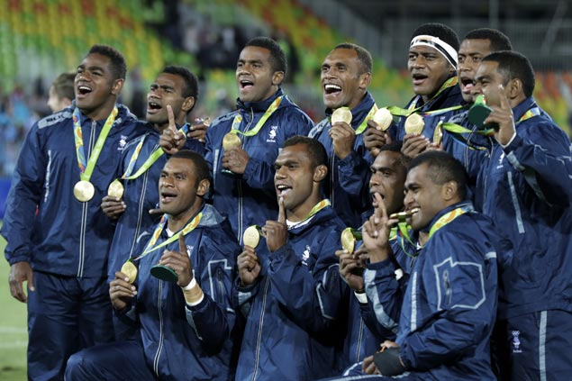

Slide 5
Best Practice/Case Study
545 Text Platform for Voter Information
Period of Implementation
Text Service: 28th June – 17th September 2014
Area Of Coverage
Up to 97 % of the population

Slide 6
Objectives
Introduce the 545 Text Platform
Explain its application
Discuss its effectiveness
Explore ways to enhance the Platform

Slide 7
Background – 2014 General Election Unique features
Electoral Laws finalized 28 March – Election 17 September
One Day elections with prepoll
Voters were assigned Polling Stations
Not permitted to vote except where assigned
Polling Stations to have maximum of 500 voters (multiple stations in a venue)
Voters needed to know where they were assigned
2014 statistics – over 1.4m mobile phones in use

Slide 8
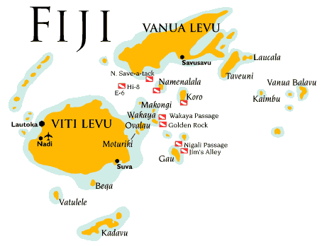
Population Vs Mobile Users in Fiji 2014 Data
Population of 869,458
Vodafone (leading mobile operators) – over 600,000 active subscribers
Digicel (2nd largest mobile operator) – over 160,000 active subscribers

Slide 9
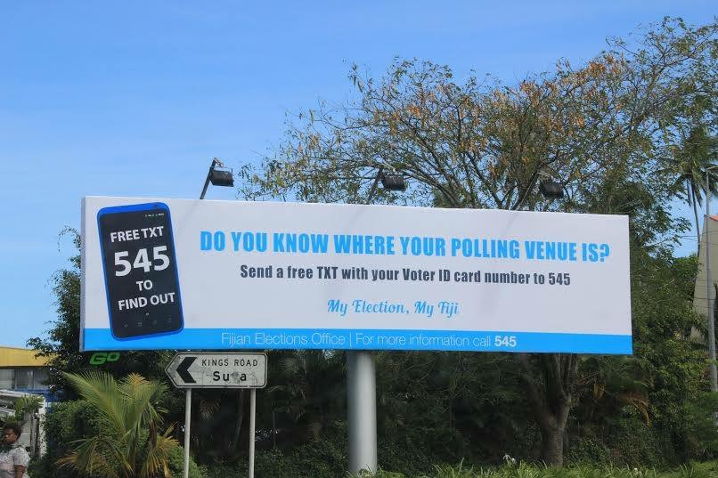

Slide 10
545 Text Platform Utilization
Free SMS platform
Total No. of SMS on Election Day | Total No. of SMS from 28th June- 17th Sept
116,311 | 701,180

Slide 11
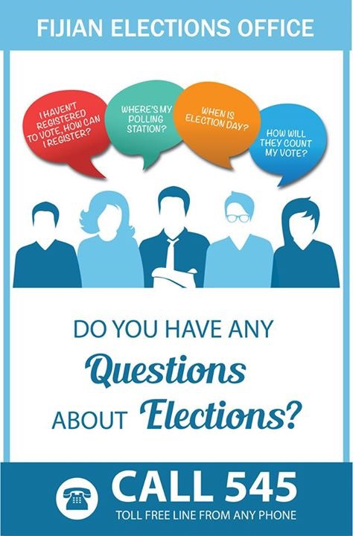
Positive Experiences
Provided an interactive platform for voters and FEO;
Voter queries were dealt with in a timely manner
Free of charge and accessible service to voters;
Voters could always access the information in their phones; and
Had power of penetration.

Slide 12
SWOT Analysis
STRENGTHS Used an existing platform that required little to no training. Flexible platform allowed one person to check the details for multiple voters 24 hr availability Free of charge | WEAKNESSES Not available in areas without network Susceptible downtime due to network failure Data is hosted at network servers (low risk)
OPPORTUNITIES Enhance the platform for more services Build internet based applications to access younger generation of users Allow reporting mechanism directly on the platform to identify incorrect data | THREATS Data is exposed due to hosting on external party servers Information is available to any person who has the EVR Number- risk of being misused.

Slide 13
Use of other Information and Communication Technology
Social Media
YouTube
Radio and Television Advertisements
Talkback Shows
Live Outside Broadcasts
Everything under the sun ☺

Slide 14
General Election 2014
Conducted after a lapse of 8 years
Organised by the FEO for the 50 new member parliament under the 2013 constitution
Lowest number of invalid votes in Fiji History – 0.75%
Demonstrates the strength of the new electoral system
84.6% Voter turnout on a voluntary voting system

Slide 15
VINAKA VAKALEVU

