Slide 1
Role of Information and Communication Technology for
Voter Education & Feedback
Rajesh Lakhani
Chief Electoral Officer
Tamil Nadu India

Slide 2


Slide 3

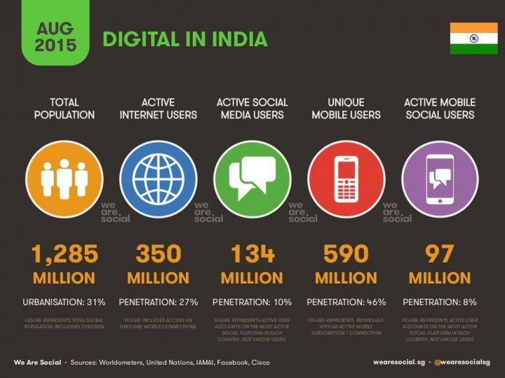
MOBILE AND INTERNET PENETRATION

Slide 4
ICT IN VOTER EDUCATION
Building trust and confidence of voters in electoral processes
Enhanced Voter Interaction - a two way communication
Continuous consultation with all stakeholders of electoral process
Increased transparency, credibility and accessibility over the entire period of elections

Slide 5
Build Trust and Confidence of elector-Registration
Computerisation of electoral roll- 1 Billion electors
  Started in 1999
    Ease of management for EMBs
  Local servers to cloud
  Nation wide unified Database
Voter facilities
  NVSP launched – year 2013

Slide 6
Simplified Search of voter list
Modified online search facility provided in both Web and Mobile applications to search by EPIC number and name / district.
Search by EPIC
Facility provided to electors to search their details in Voter’s List using their EPIC number or Name.
If the EPIC number is provided, the details of the EPIC will be automatically fetched from the electoral database.

Slide 7
Simplification of Online Registration
Launched simplified, easy to use mobile app and web application to deal with the following
Name Inclusion, Correction, Change of address and Display picture
Simplified to 3 minutes from 30 minutes
Tracking the progress of application
Back end improvement ERO Net and BLO net
Eliminated the filling up of paper based electoral forms.
Online forms usage is 100% in Province of Kerala

Slide 8
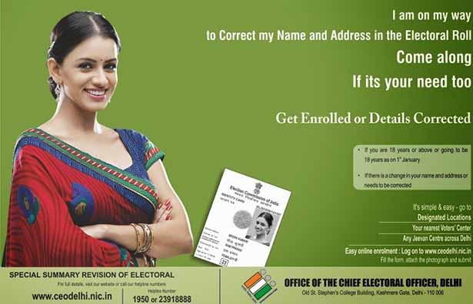
Change Your Display Picture
In Web and Mobile app, the recent photograph of the applicant can be uploaded online.

Slide 9
Mobile Applications
Integrated mobile app was launched in all platforms i.e, android, apple and windows.
The app offers 15 services to the electors and other stakeholders
          11 Voter services
Users include public, political parties, candidates as well as officers and on the day of poll, even the polling personnel.
The applications are developed with plug and play platform that are convenient to re-use and compatible for other states also

Slide 10
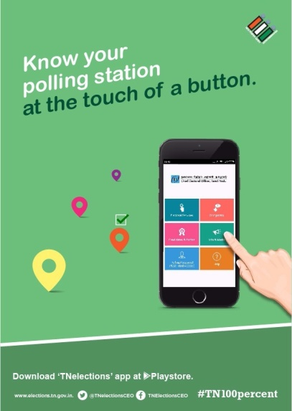
KNOW YOUR POLLING STATION - GOOGLE MAP AND SMS SERVICES
Online portal to get information about the polling station.
For the first time in India, Interactive Google Map services provided in the Mobile App to get the geographical location of the polling station.
SMS facility also provided to get polling station details.
Google Map Service
SMS Service

Slide 11
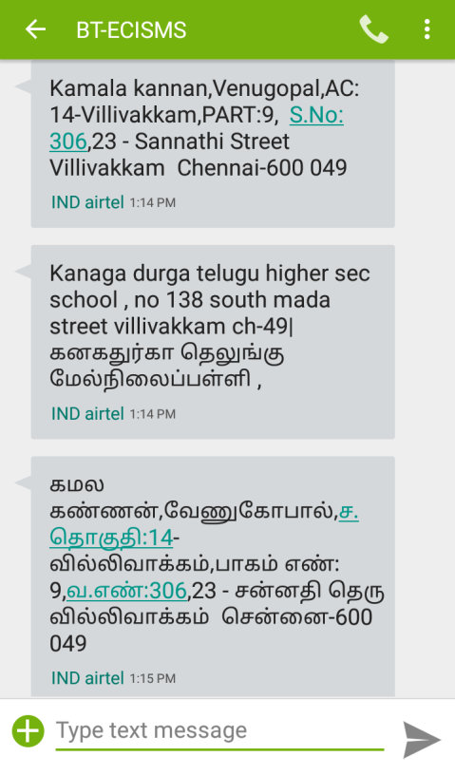
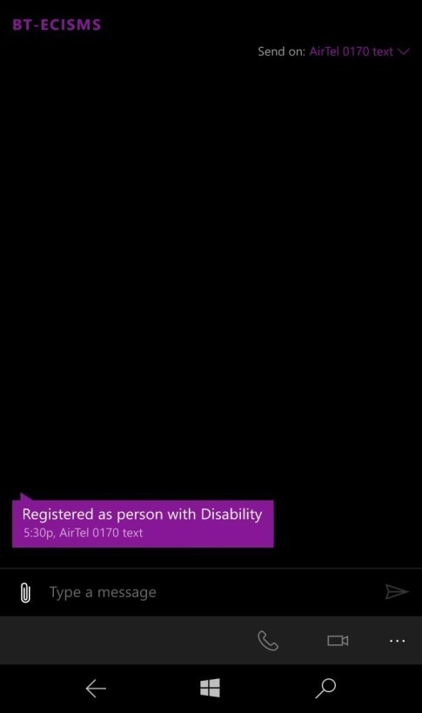
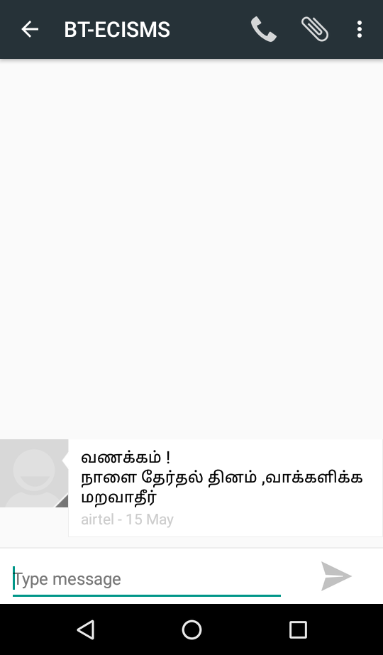
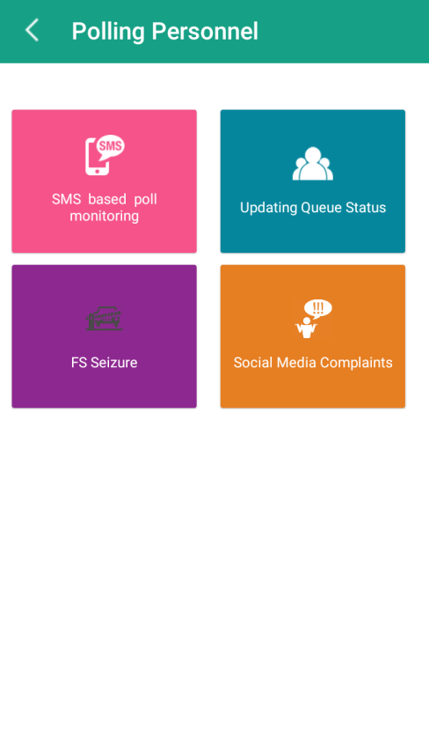
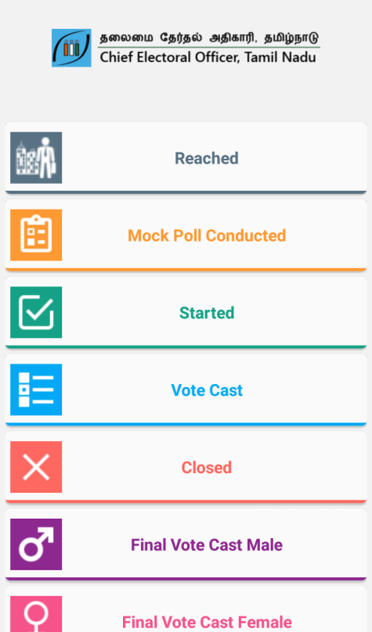
SMS SERVICES- Engaging Voters
SMS based service for E Voter List, Queue status checking, Poll monitoring and marking people as disabled were launched.
SMS were sent to all 2 crores registered electors informing and involving them in poll process from nomination to poll day. The list of contesting candidates based on their AC was also sent through SMS. 6 crores SMS were sent.
E Voter List
Mark People as Disabled
Awareness SMS
Poll Monitoring – Mobile app

Slide 12
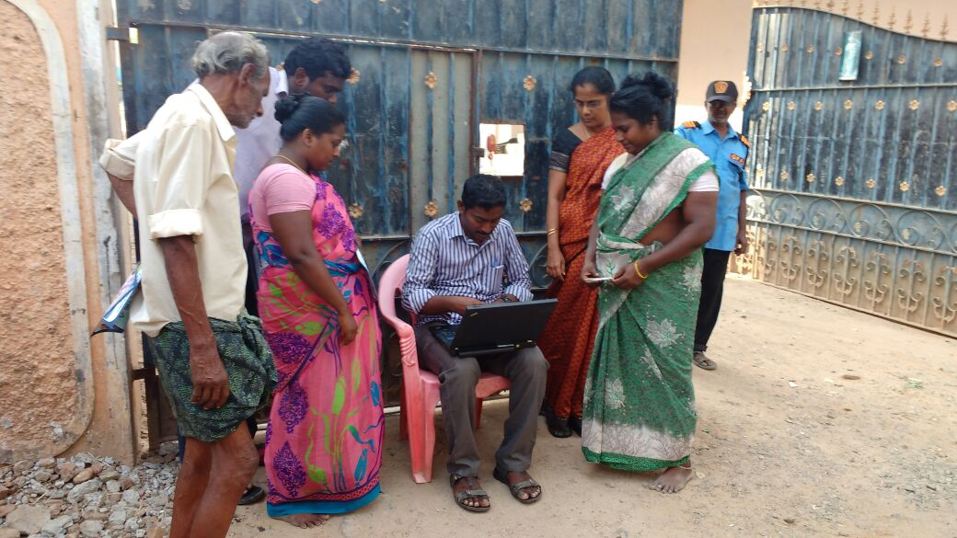
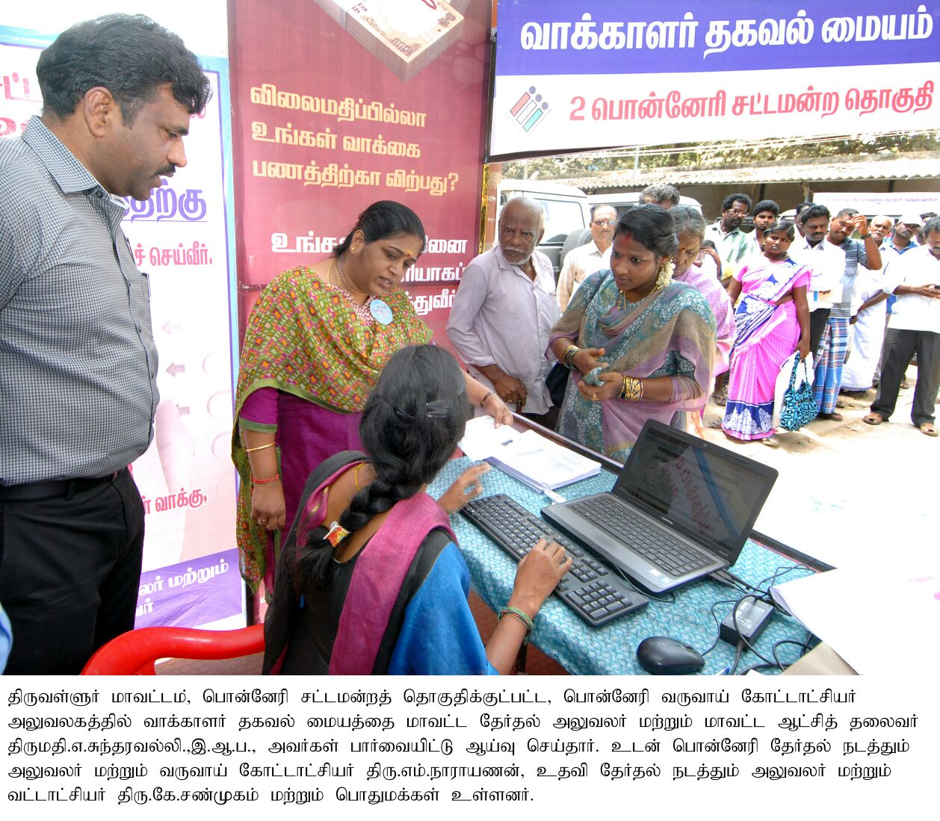
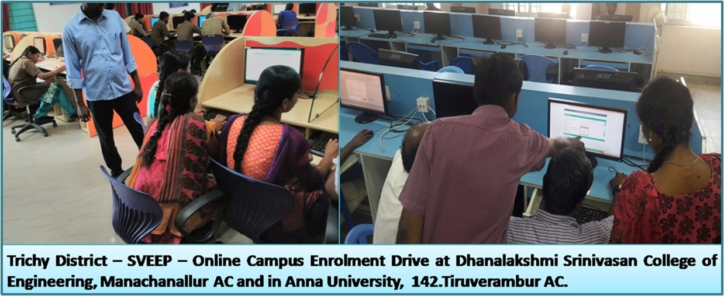
ENROLLMENT FACILITATION CENTER WITH WIFI CONNECTIVITY

Slide 13
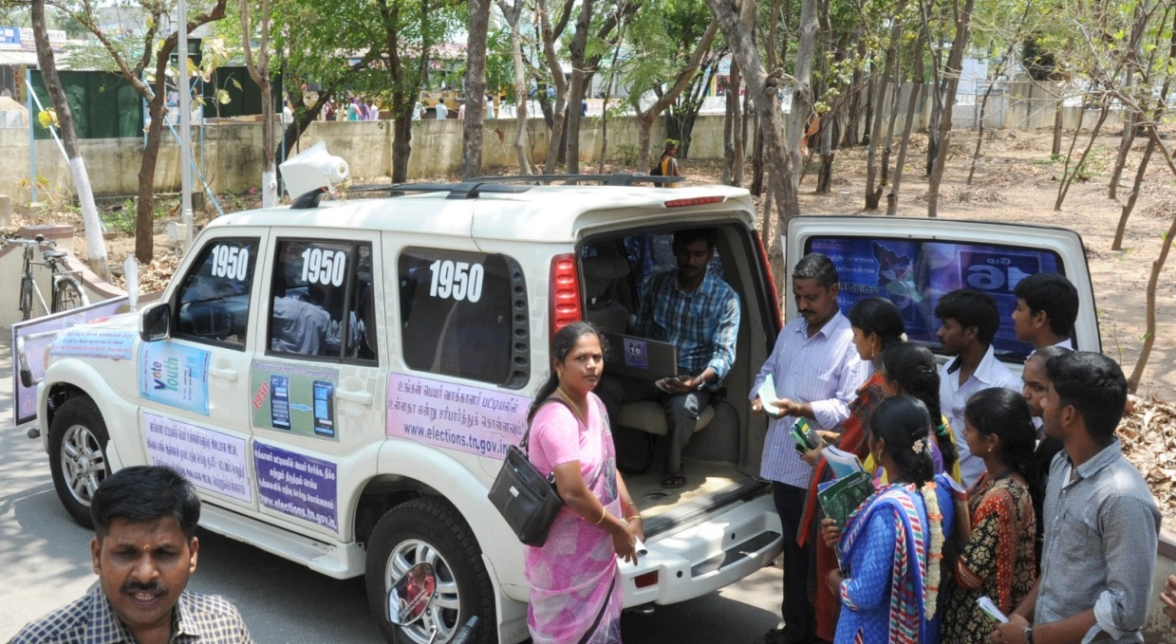
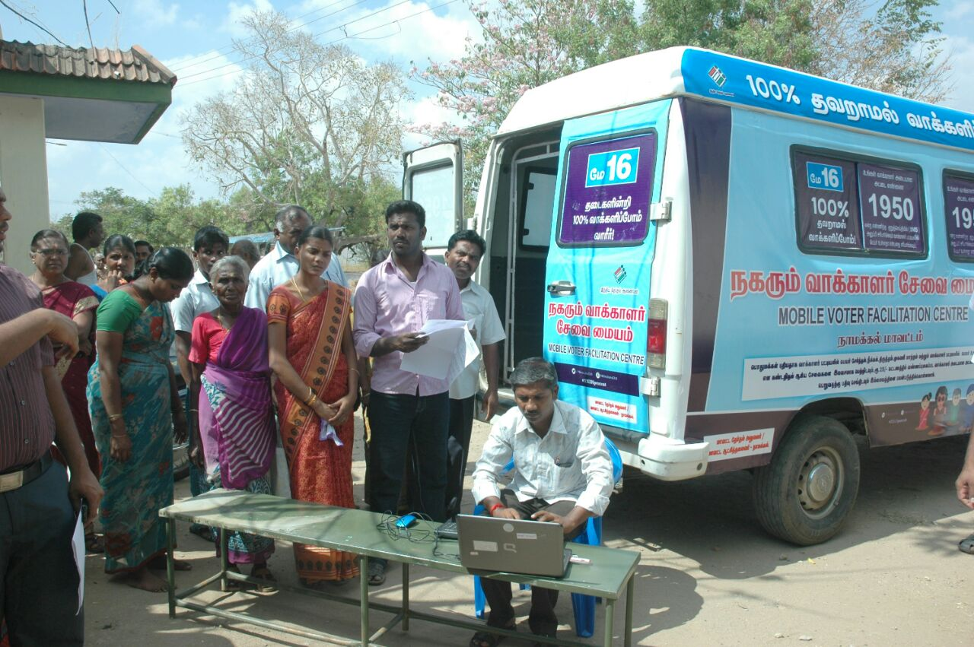
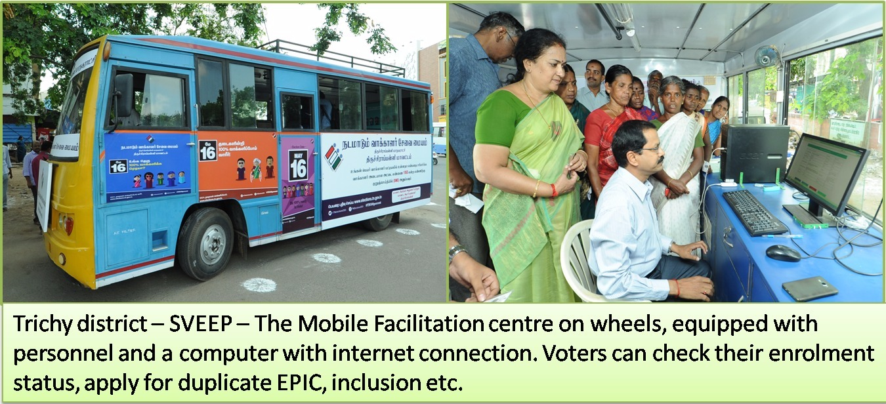
MOBILE FACILITATION CENTERS WITH WIFI CONNECTIVITY

Slide 14
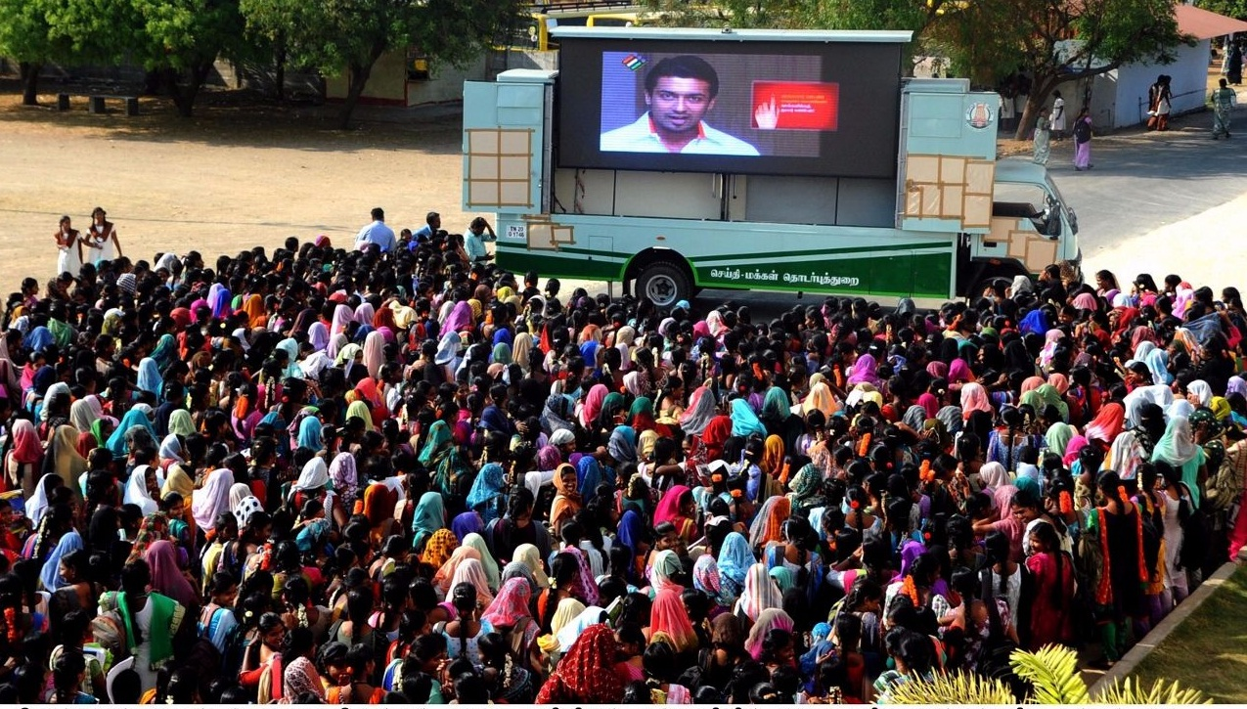
Digital Publicity Vans- Cinema Theatres
Direct Content up-linking

Slide 15
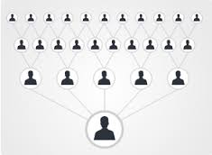
Whats App- Messaging application
MAXIMUM REACH
First post 250
First forward – 62 Thousand
Second Forward 15.6 Million
Third Forward 3.9 Billion

Slide 16
SOCIAL MEDIA IN VOTER EDUCATION

Slide 17
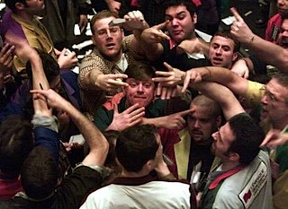
Social Media – Every One wants to speak

Slide 18



SOCIAL MEDIA IN VOTER EDUCATION
Universality
  Most interactive and broad based public outreach platform.
  Immediate Feedback
  Stake holders engagement in a two way communication.
Impartiality
  Transparency leading to credibility

Slide 19
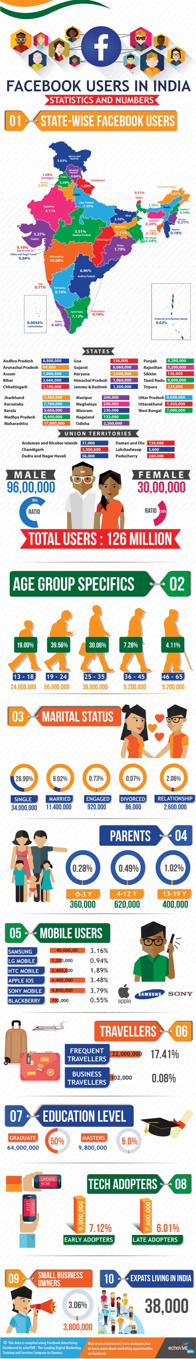

FACEBOOK USER’S GENDER
AND AGE DISTRIBUTION
22.2 million – Twitter users in India
Expected to grow by 16.5 per cent in 2018.

Slide 20

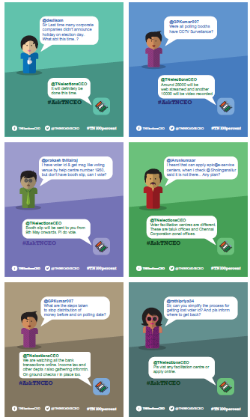
LIVE TWITTER CHAT- PERISCOPE
Supported by Live tweet sessions and Facebook Live video chats with the CEO to dispel myths, and address any doubts the public may have with the electoral process.

Slide 21
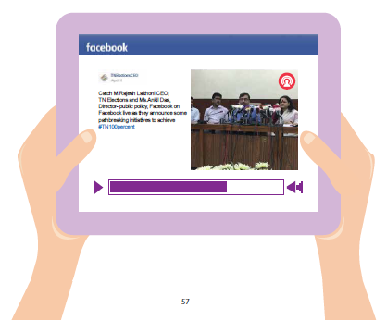
FACEBOOK LIVE- Press Conference

Slide 22
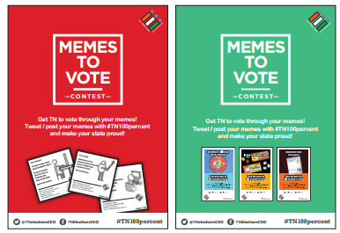

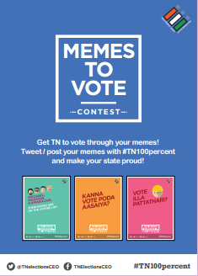



MEMES TO VOTE

Slide 23
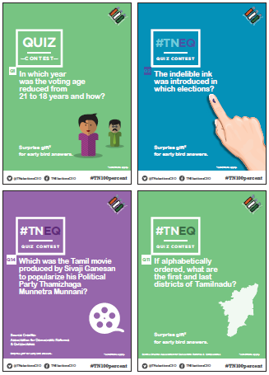

Content Is Most Important-ELECTION QUIZ

Slide 24
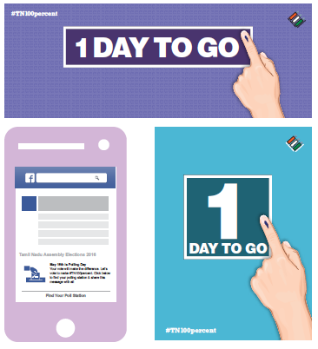
REMINDERS AND NEWS FEEDS ON PROMOTION
Online Reminders sent on Facebook and Twitter to all residents of the state 1 day before the elections.

Slide 25
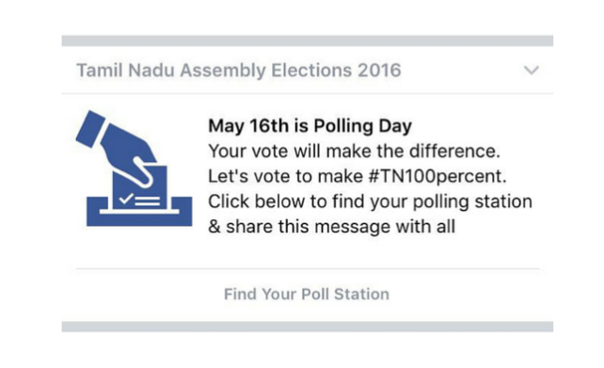
FACEBOOK REMINDER

Slide 26
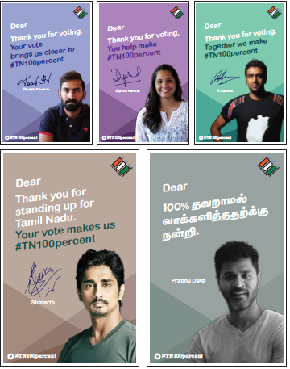
TWITTER E-CARDS

Slide 27
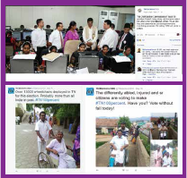
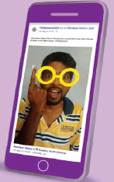
LIVE UPDATES FROM POLLING STATION

Slide 28
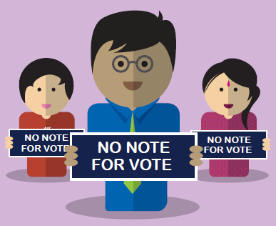
NO VOTE FOR VOTE

Slide 29
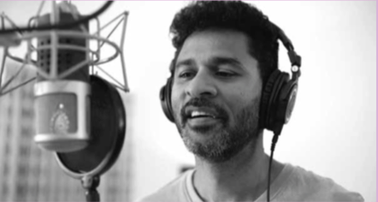
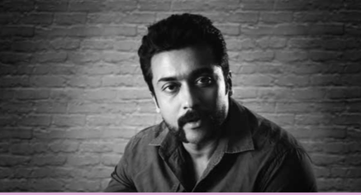
ETHICAL VOTING
Leveraging celebrities
Citizen Videos

Slide 30
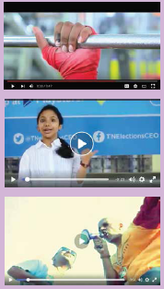
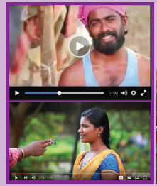
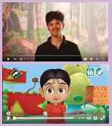
CITIZEN PARTICIPATION

Slide 31
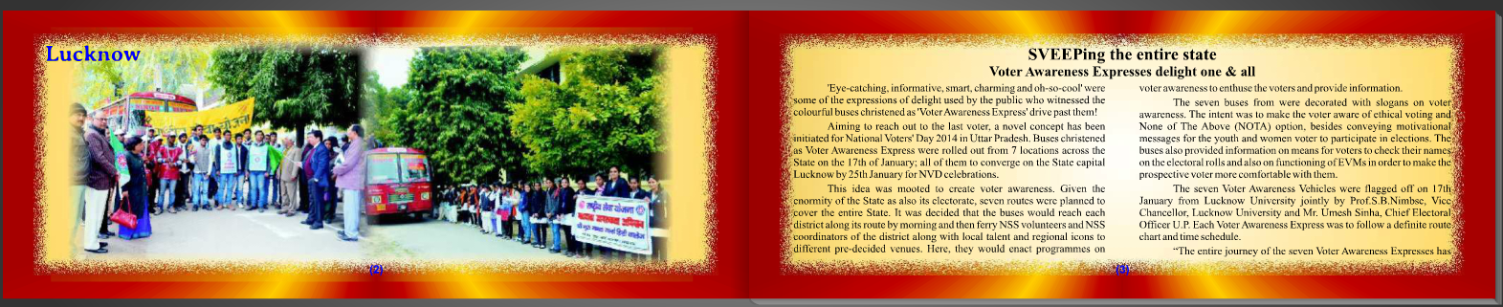
UTTAR PRADESH – E PUBLICATION

Slide 32
Other Initiative
  Creation of Youth Corner – providing variety of information like hosting winning entries from Young Voter festival, creations for social media interventions, contact details of BLOs, Campus Ambassadors and Nodal Officers
  Special caller tunes created for Elections
  Dedicated YouTube channel and Digital Library for access to audio-visual creatives on elections and voting

Slide 33
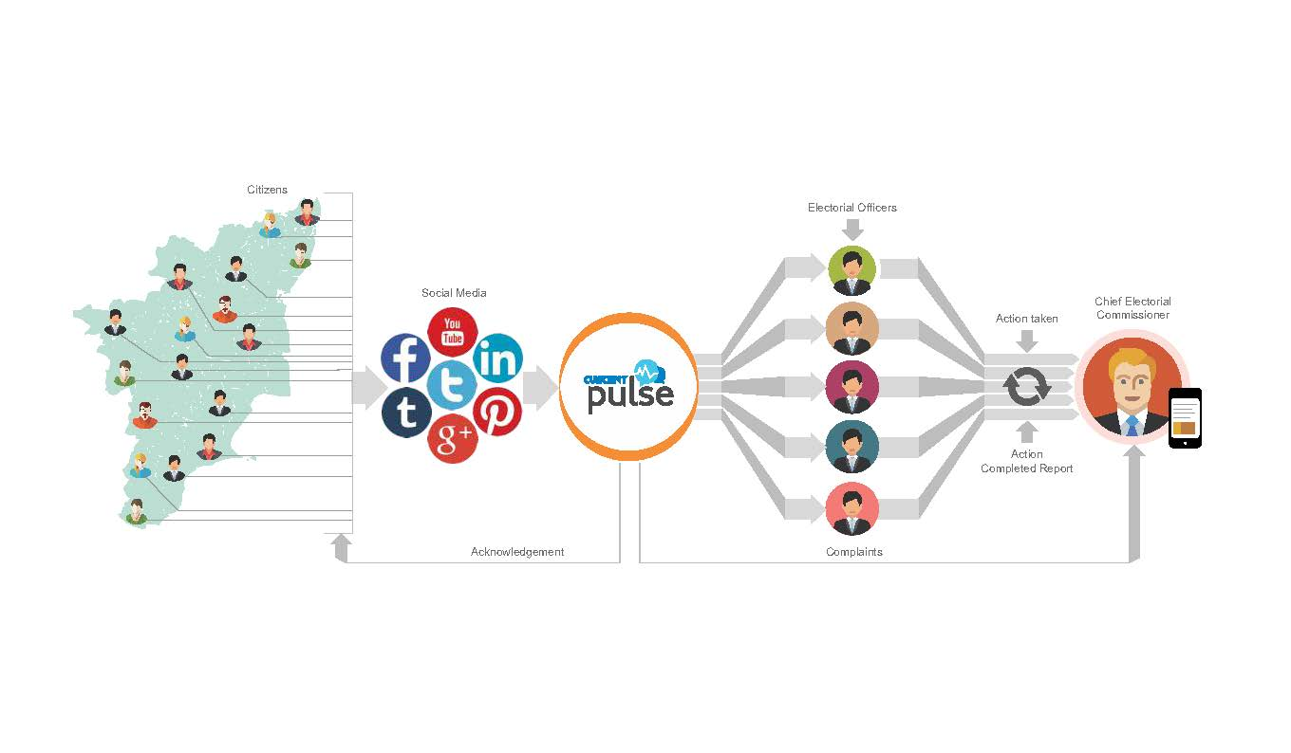
ELECTION WATCH
Launched fine tuned mobile app and web application to monitor poll-related posts on various platforms such as Facebook, Twitter and other social media channels.
Monitors texts, images, audios and videos on all social media platforms.
Automated social listening-cum-analyzing software that senses sentiments also.

Slide 34
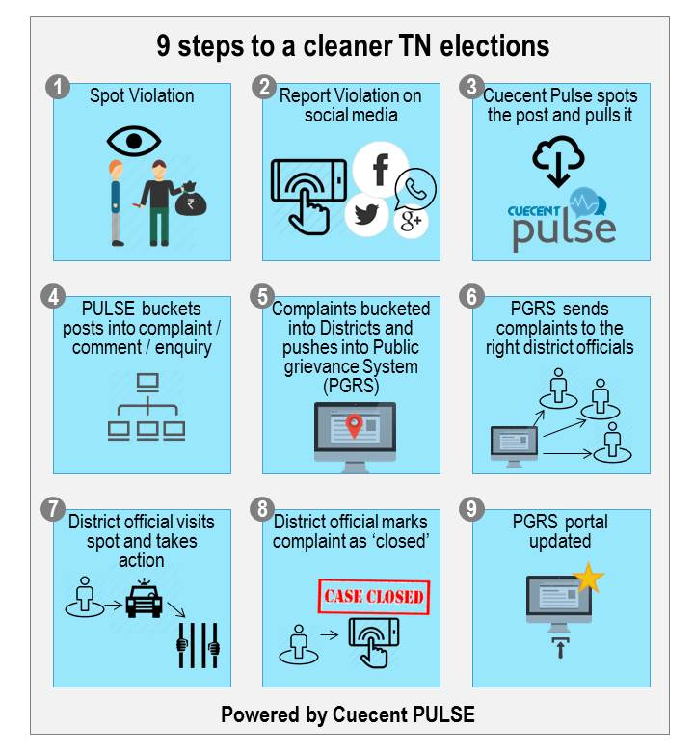
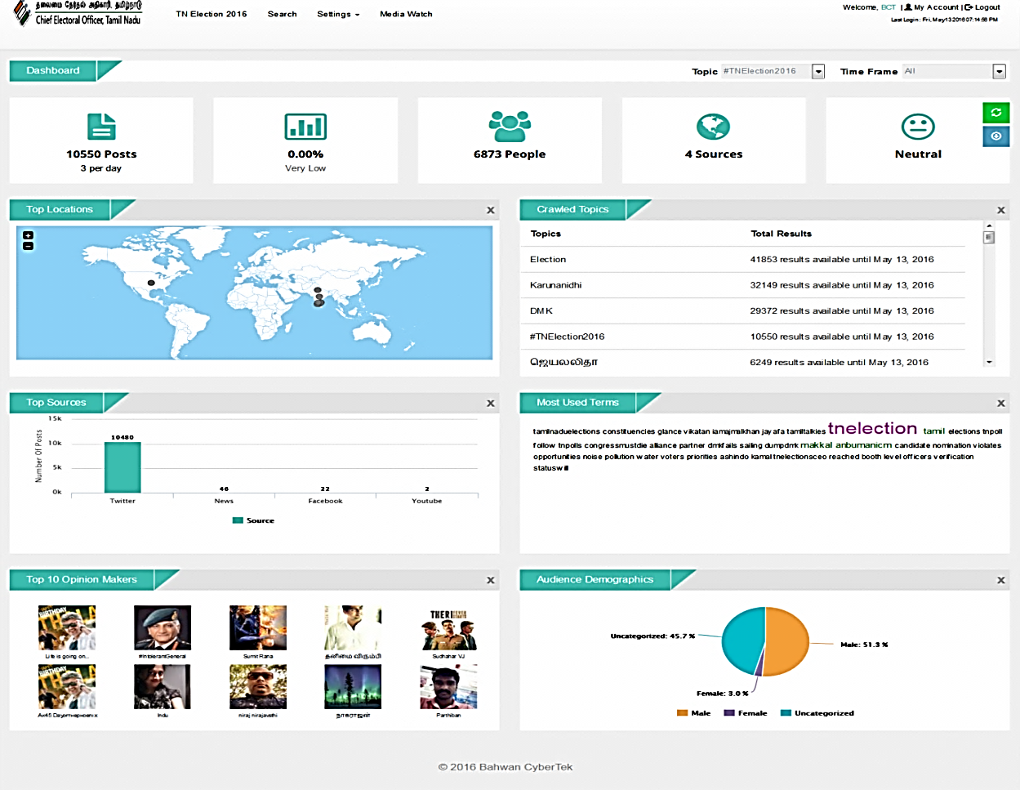
PULSE – SOCIAL MEDIA LISTENING SOLUTION
Live dashboard provided to see the incoming feeds/complaints/enquiries on a real-time basis.
The complaints were automatically registered with PGRS to ensure immediate action and qualitative disposal.

Slide 35
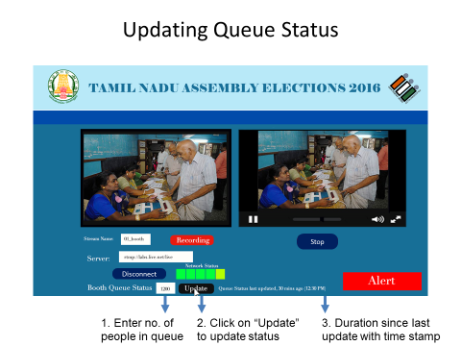
QUEUE MANAGEMENT SYSTEM
Online service was provided to the public to know the current queue status at the polling station.
SMS Facility – SMS Q<EPIC NUMBER> to 1950 to know the queue status through SMS.

Slide 36
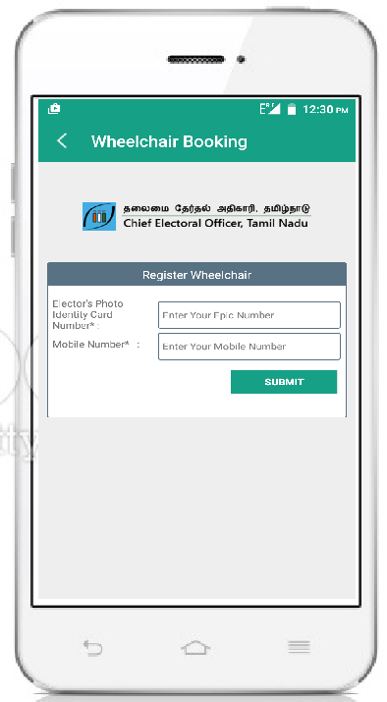
WHEELCHAIR BOOKING
Online facilitation provided through both web and mobile applications to book a wheel chair for a person with disability or old aged people to get accessible polling stations and required support.
Wheelchair and required people’s help were provided at polling stations to the disabled people.
12,000 wheel chairs were arranged by the DEOs. This marks the highest in any elections across India.

Slide 37
360 degree Grievance redressal system
Unification of all complaint channels
  Web, E mail, Mobile, messaging applications
Using mobile technology and back end mapping for instantaneous communication to grievance redressing officer
Online tracking and feedback by complainant
Transparency – Details available for every one to peruse
Automatic escalation to next higher officer in case of delay

Slide 38
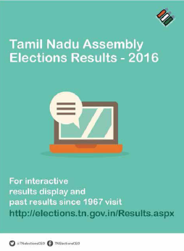
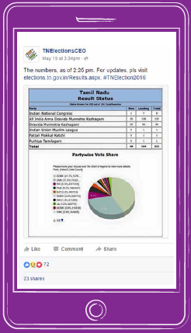
ELECTION RESULTS

Slide 39
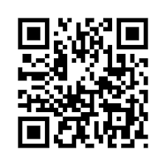
ICT for Convenience and Engagement
Pl scan this QR code and Give us your feed Back

Slide 40
  THANK YOU

