Slide 1
Voter Education Challenges in Out of Country Voting (OCV) International Conference on Voter Education for Inclusive, Informed and Ethical Participation 20 October 2016

Slide 2
Universal Declaration of Human Rights
Article 19: Everyone has the right to freedom of opinion and expression; this right includes freedom to hold opinions without interference and to seek, receive and impart information and ideas through any media and regardless of frontiers.

Slide 3
International Convention on Civil and Political Rights
Article 19: (1) Everyone shall have the right to hold opinions without interference. (2) Everyone shall have the right to freedom of expression; this right shall include freedom to seek, receive and impart information and ideas of all kinds, regardless of frontiers, either orally, in writing or in print, in the form of art, or through any other media of his choice.

Slide 4
Countries with Provisions for External Voting
Africa 28
Americas 16
Asia 20
Europe 41
Pacific 10
Total 115

Slide 5
Return voting In person oversees polling station Embassy voting Postal voting Internet voting Fax voting
Major methodologies for OCV:

Slide 6
Key Information Challenge
Informing eligible voters of:
timelines
eligibility criteria, and
mechanisms for registering and casting ballots

Slide 7
Who are these Voters?
150 million migrant workers (2013, ILO)
65.3 million refugees (2015, UNHCR)
Diplomats, defense personnel or other members of a professional group usually in some form of state service

Slide 8
Key Considerations
Framework
Conflict dynamics
Diversity
Host Country Limitations
Literacy
Gender
Mode of Outreach
Social Media
Mass Media
Telephones
Fact to Face
Instructional Videos

Slide 11
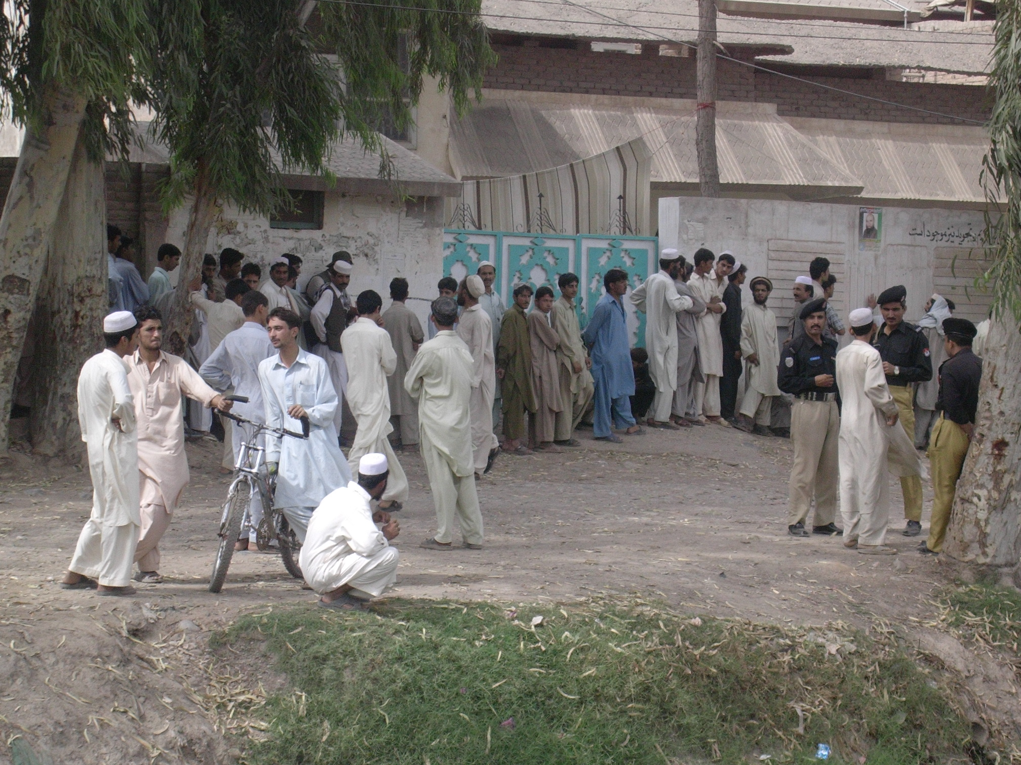

Slide 12
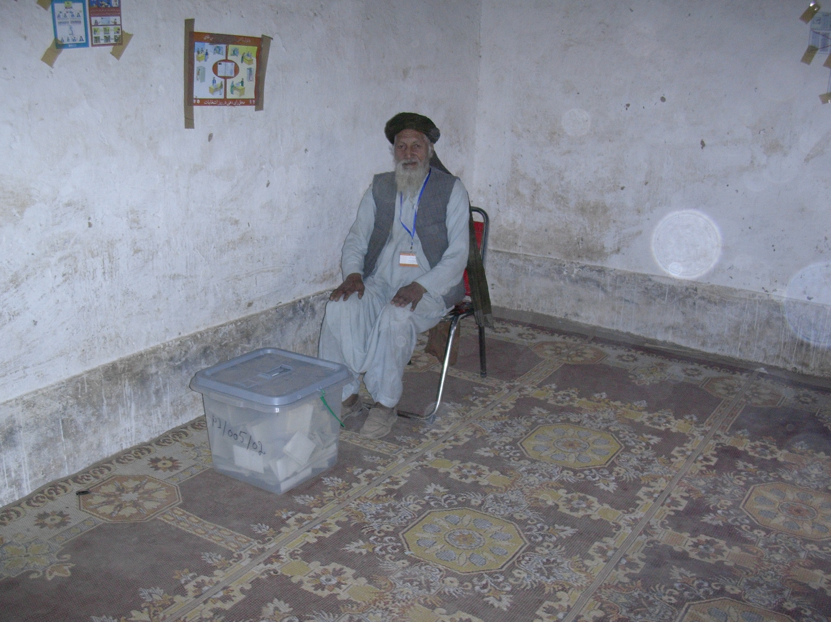

Slide 13
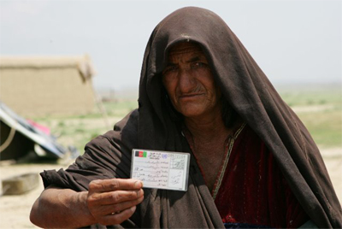

Slide 14
