Slide 1


The U.S. Election Assistance Commission
The Honorable Thomas Hicks, Chairman

Slide 2
EAC’s Chartering Legislation - Help America Vote Act (HAVA)
HAVA enacted by the United States Congress to make sweeping reforms to the nation's voting process.
HAVA addresses improvements to voting systems and voter access that were identified following the contested 2000 presidential election.
HAVA creates new mandatory minimum standards for states to follow in several key areas of election administration.
HAVA Provides Funding to Help States
  Meet The New Standards
  Replace Voting Systems
  Improve Election Administration
havainfo@eac.gov

Slide 3
U.S. Election Assistance Commission (EAC)
Established by the Help America Vote Act (HAVA)
  Signed into law by President George W. Bush, Oct. 29, 2002
  EAC opened its doors on April 5, 2004
Independent, Bipartisan Commission
Consists of Four commissioners
  Two commissioners from each political party
  Presidential appointees that are approved by the senate
  First four commissioners sworn into office on Dec. 13, 2003
3
havainfo@eac.gov

Slide 4
U.S. Election Assistance Commission
Leadership
Nominated by the President and Confirmed by the U.S. Senate
Current Commissioners sworn into office Jan 13, 2015
  Thomas Hicks, Chairman - thicks@eac.gov
  Matthew Masterson, Vice-Chairman - mmasterson@eac.gov
  Christy McCormick - cmccormick@eac.gov
4
havainfo@eac.gov

Slide 5
Help America Vote Act
New Programs and Procedures under HAVA
Provisional Voting
Voting Information
Updated and Upgraded Voting Equipment
Statewide Voter Registration Databases
Voter Identification Procedures
Administrative Complaint Procedures
havainfo@eac.gov

Slide 6
HAVA & EAC
HAVA Established EAC to:
Distribute HAVA Funds to States for New Voting Equipment
Create Voluntary Voting System Guidelines (VVSG)
Operate a voting system testing and certification program
Research and develop guidance to meet HAVA requirements
Assist the states regarding HAVA compliance
Maintain the National Mail Voter Registration Form
Administer a National Clearinghouse on Election Administration
  Shared Best Practices
  Information for Voters
  Other Resources to Improve Elections
havainfo@eac.gov

Slide 7
Military & Overseas Voters – The Law
Uniformed and Overseas Citizens Absentee Voting Act (UOCAVA)
Act provides the legal framework which ensures that military and overseas voters can vote.
U.S. citizens covered by UOCAVA are
  Active members of the Uniformed Services
  The Merchant Marine
  The commissioned corps of the Public Health Service and the National Oceanic and Atmospheric Administration
  The above’s eligible family members and
  U.S. citizens residing outside the United States
havainfo@eac.gov

Slide 8
Military & Overseas Voters – The Law
HAVA-EAC-UOCAVA Interactions
single state office to provide information on registration and absentee ballots.
Report on absentee ballots transmitted and received after general elections
Extension of period covered by single absentee ballot application
Prohibition of refusal of voter registration and absentee ballot for early submission
havainfo@eac.gov

Slide 9
Military & Overseas Voters – The Law
The Military and Overseas Voter Empowerment Act (MOVE)
This amended UOCAVA and other statutes by providing greater protections for:
  Service Members,
  Eligible family members of service members
  and other overseas citizens
Two Important Provisions:
  MOVE Act requires States to send absentee ballots to UOCAVA voters at least 45 days before federal elections.
  Allows UOCAVA voters to submit their ballots electronically
havainfo@eac.gov

Slide 10
Military & Overseas Voters
More Resources
Federal Post Card Application FPCA
Federal Write-In Absentee Ballot
Partnerships between state and local election officials and local military installations
https://www.fvap.gov/citizen-voter/overview
havainfo@eac.gov

Slide 11












Working Together for American Voters
havainfo@eac.gov

Slide 12



Working Together – Policy Working Group
Voter Communication
Use plain language
Make effective user-friendly ballot return envelopes
Communicate to voters when the ballot application is accepted
Provide information to voters about what is on the ballot
Federal Post Card application
Treat the FCPA as a permanent request for voter registration
Establish a default validity period for the FPCA mail ballot request
Online Voter Registration
States that provide online voter registration should incorporate online registration for overseas and military voters
Improved Engagement with U.S. Military Community
Establish partnerships between state and local election officials and local military installations
havainfo@eac.gov

Slide 13
Working Together – EAVS Section B Working Group
What is it?
$3.2 million initiative to improve the return rate of overseas absentee ballots
Partnering with FVAP and working within two working groups on best practices and successful programs.
Who is on it?
State, local and Federal government officials
What are its 2016 Goals
Clarify language and Instructions for 2016
Develop Roadmap for the Future
Understand the role of data standardization
Look to transactional election data for voter success metrics
havainfo@eac.gov

Slide 14
Election Administration Voting Survey
havainfo@eac.gov

Slide 15

#BEREADY16
Election Security Preparedness
Accessibility
Preparing for Election Day
Managing Election Technology
Election Official & Voter Toolkit

Slide 16
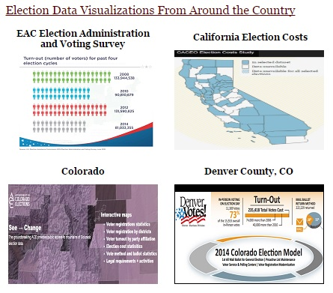
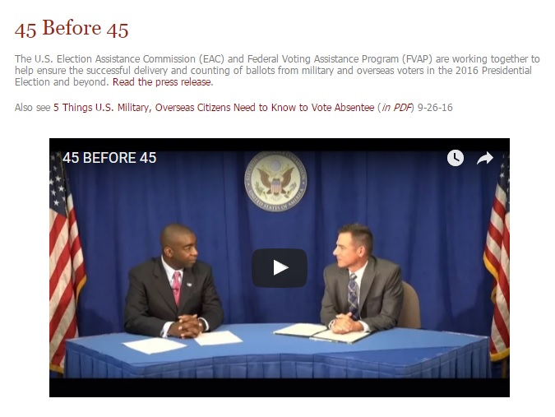
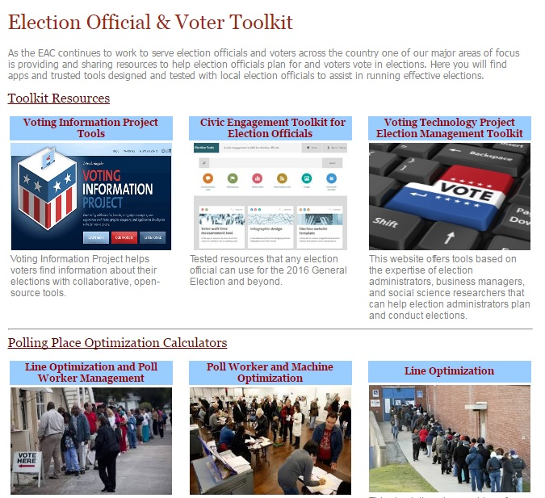
#BEREADY16
havainfo@eac.gov

Slide 17

#BEREADY16
Interview with Matt Boehmer, Director FVAP, on election readiness
Click to Play
contactus@eac.gov

Slide 18
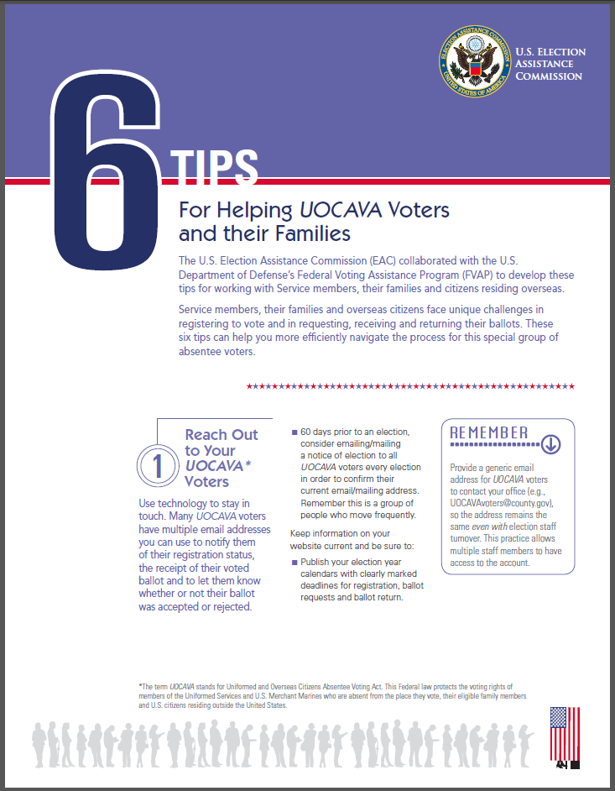
Quick Tips & Guides
Quick Tips
    Guides to aid in the election process
havainfo@eac.gov

Slide 19
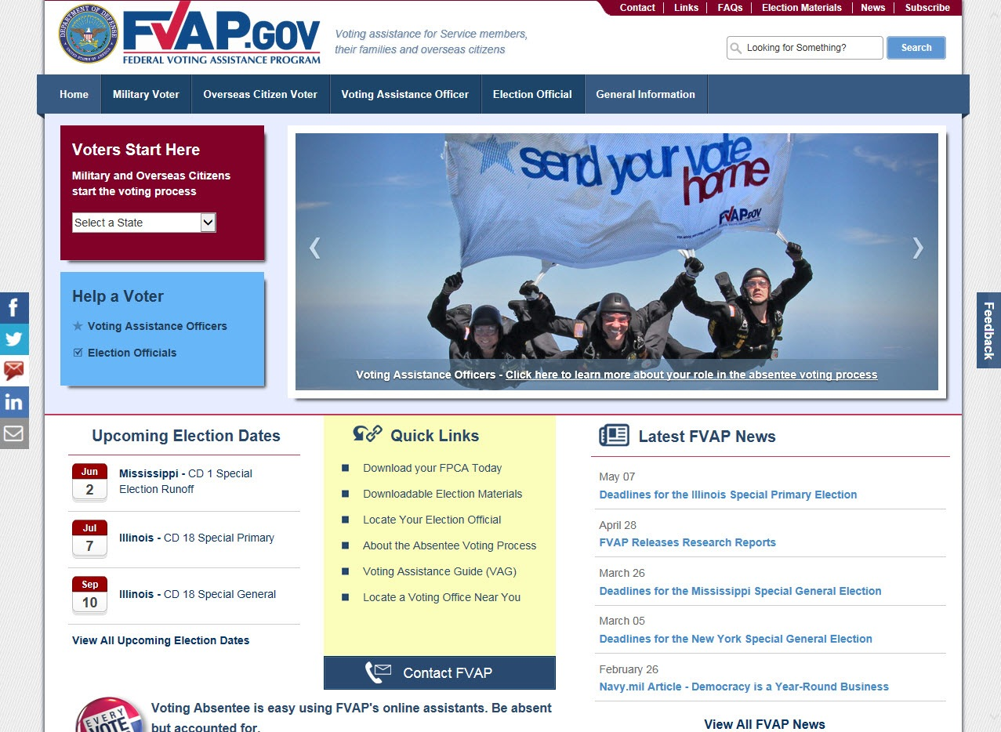
FVAP.GOV
Federal agency assigned within the Department of Defense (DoD) to assist and educate voter on their right to vote.
Anywhere in the world
beyond
havainfo@eac.gov

Slide 20
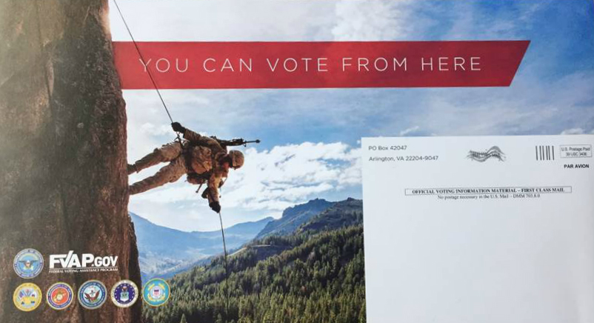
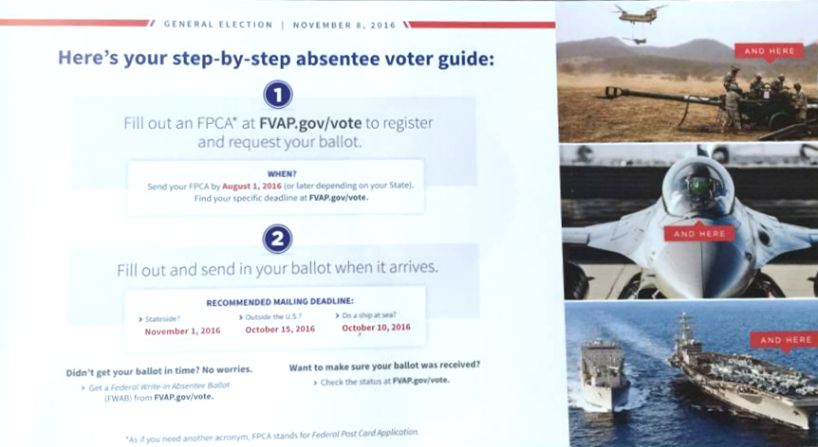
FVAP.GOV
havainfo@eac.gov

Slide 21




Social Media
@EACgov
@Redandblue2024
Facebook.com/eacgov1
BeReady@eac.gov
listen@eac.gov
YouTube Channel:
Election Assistance Commission
www.eac.gov
havainfo@eac.gov

Slide 22
Questions?

Slide 23
Contact Us:
Thomas Hicks
Chairman
Phone: (301)563-3971
Email: Thicks@eac.gov
U.S. Election Assistance Commission
Phone: 1-877-747-1471
Email: havainfo@eac.gov

