Slide 1
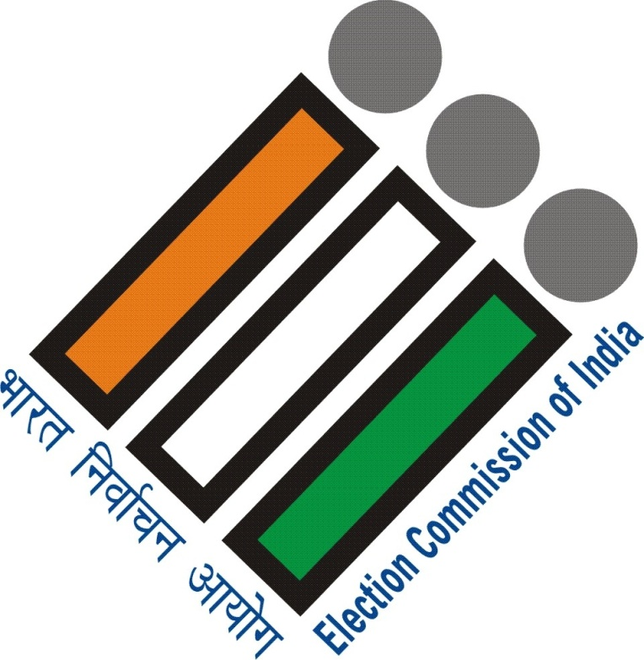
ENHANCEMENT OF PARTICIPATION OF SERVICE ELECTORS & OVERSEAS ELECTORS
PADMA ANGMO, DIRECTOR

Slide 2
...a look at numbers
Defence Personnel
1.5 million
Central Armed Police Personnel
1.29 million

Slide 3
ELIGIBILITY FOR SERVICE VOTER
those serving in the Armed Forces
alternatively can also opt to enrol as General Voter at place of posting, if it’s a peace station
Central Armed Police Force
State Armed Police Force serving outside that state
those employed under the Government of India, in a post outside India
Wife can also be enrolled as Service Voter
Notes:
those serving in the Armed Forces of the Union
those serving in a Force to which the Army Act 1950 applies (Assam Rifles, CRPF, BSF, ITBF; GREF in Border Road Organisation; Central Industrial Security Force etc.)
those employed under the Government of India, in a post outside India
member of an Armed Police Force of a State, and serving outside that state
Alternatively you can also opt to enrol as General Voter at place of posting, if it’s a peace station.
Meaning that you have the option to remain as Service Voter of your native constituency or get registered as the General Voter at the place of posting
But remember when you enrol as a General Voter ensure that you get your name deleted as Service Voter, if you have been enrolled earlier as one

Slide 4
VOTING BY SERVICE VOTERS
through postal ballot
Proxy Vote to Defence and Central Armed Police Personnel (Classified Service Voter-CSV)
Notes:
Form 2 for Armed forces ;
Form 2A for Armed Police Force;
Form 3 for Govt officials serving abroad
Classified Service Voter; Once you are registered as a Service Voter, you can opt for voting through PROXY as a Classified Service Voter, meaning, you can nominate somebody to vote in your place

Slide 5
POLLING PERSONNEL
deployed in LS 2014
Is entitled to an EDC if s/he is on duty in the same constituency where he or she is enrolled as a voter
Is entitled to a postal ballot if s/he is on duty in any other constituency
around 5 Million

Slide 6
POLLING PERSONNEL ORIENTATION
Nodal Officers appointed for various levels of polling officials
Data base created of the 5 million odd polling officials
polling official on duty within their constituency given Election Duty Certificate enabling them to physically vote
Orientation given ahead of elections
Special training given on how to vote through postal ballots
Polling Officials facilitated to apply for postal ballots

Slide 7
LOK SABHA ELECTIONS 2014
ELECTORS – 834 Million
VOTES CAST– 554 Million
SERVICE ELECTORS
1.36 Million
*0.38 women
POSTAL BALLOT
PROXY VOTES
1.1 million
173
0.22 million rejected

Slide 8
ELIGIBILITY FOR OVERSEAS ELECTOR
a citizen of India, absent from the country owing to employment, education etc,
has not acquired citizenship of any other country and is an Indian citizen
has attained the age of 18 years on the qualifying date
is not disqualified to be enrolled as an elector
Notes:
Did not meet the clause of órdinary resident’applicable for general electors; The Representation of the People (Amendment) Act, 2010 (36 of 2010)” w.e.f. 10.02.2011 to insert a new Section 20A to make special provisions for citizens of India residing outside India to get enrolled as an elector in the electoral roll. By the above amendment, it was provided that every citizen of India who has not acquired citizenship of any other country and is otherwise eligible to be registered as a voter and who is absenting from his place of ordinary residence in India owing to his employment, education or otherwise is eligible to be registered as a voter in the constituency in which his place of residence in India as mentioned in his passport is located. The provisions of the Registration of Electors Rules, 1960 were also amended accordingly and a new Form 6A was inserted for making application for such enrolment by NRIs (now described in these Rules as ‘overseas electors’).

Slide 10
LOK SABHA ELECTIONS 2014
Total Electors
Overseas Electors - 13,039;
Voters
Overseas Electors who voted - 8
834 million
554 million
female - 804

Slide 11
the journey of Voter Education in ECI
Started post LS 2009 as IEC
Was renamed VEEP-Voter Education and Electoral Participation; Later renamed SVEEP in 2010 to emphasise ‘Systematic’ in the process
SVEEP in Phase I (2009-2012) covered 17 General Elections to State Assemblies and three revisions of the Electoral Roll
SVEEP-II focussed on Lok Sabha Election 2014 and the Assembly Elections to 15 States and Union Territories besides two revision of Electoral Roll
SVEEP-III
Notes:
Evolution from IEC to VEEP to SVEEP and now the SVEEP-III for 2016-2020

Slide 12
FOCUS AREAS
SVEEP
SVEEP-II
Removing Gender Gap
Fighting Urban Apathy
Overcoming Youth disconnect
Inclusion
Targeted interventions by identifying 10% of the lowest turnout Polling Stations and reasons thereof to make specific interventions

Slide 14
Gender Gap over the Years

Slide 15
SVEEP-III (2016-2020)
Prospective electors
Persons with Disabilities
SERVICE VOTERS
Migrants
OVERSEAS INDIANS
Other Marginalised Groups
Women
Youth

Slide 16
TECHNICAL COMMITTEES
Technical Committees formed for target groups in 2015
Service Voters Committee with representatives from Army, Navy, Air Force, CAPF, AWWA and MEA besides Prasar Bharati
Overseas Indians Committee with representatives from MEA besides others
Recommendations used for chalking out the strategy for SVEEP-III Project Plan

Slide 17
RECENT INITIATIVES
Online Registration Facility for Service Personnel is being taken up
E-postal ballot is in the pipeline
A Guide for Service Voter prepared and shared
A Knowledge, Attitude, Practice Survey proposed to be conducted through a channel approved by the Ministry of Defence

Slide 18
IN THE PIPELINE
In-house trainings at officer’s and at lower levels to have electoral literacy
Awareness through Forces Wives’ Welfare Associations
In-house magazines and newsletters to carry messages
Annual Days to facilitate registration of service personnel and wives
Special camps in cantonments in coordination with the Chief Electoral Officers

Slide 19
IN THE PIPELINE
Major collaboration with MEA to reach out to Overseas Indians
Nodal Officers in Embassies in countries with large population of NRIs/Students
NVSP link on kiosks in Embassies and Indian Missions
Special awareness and registration camps in countries with large no of Indians
Embassies and officials abroad to be sensitized On Service Voting Rights
Embassies to display posters and pamphlets on How to use the Postal Ballot
All training and skill development programmes of the MEA to include a module on Postal
Outreach through NRI Associations

Slide 20
RECENT INITIATIVES
Online Voters Portal for Overseas Indians available on major Government websites
Brochure designed and shared with the Ministry of External Affairs and e-version made available on website
First ever Knowledge, Attitude and Practice Survey to be undertaken online

Slide 21
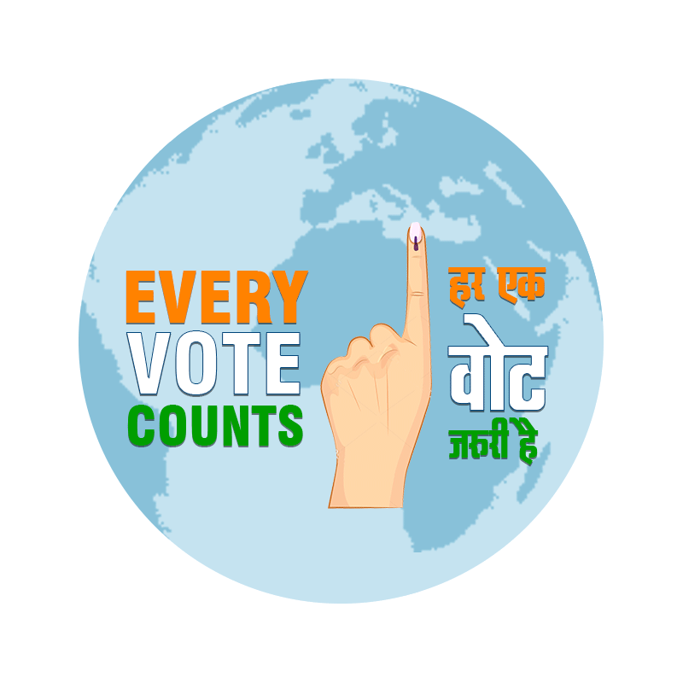
everyvotecounts.in
with Tata Institute of Social Sciences, TISS
and supported by Ministry of External Affairs, GoI

Slide 22
...because every vote counts

