Slide 1
The Australian Electoral Commission

Slide 2
Enrolling to vote is compulsory

Slide 3
Enrolment for those living, traveling or working overseas

Slide 4
Defence and Police personnel

Slide 5
How to vote overseas

Slide 6
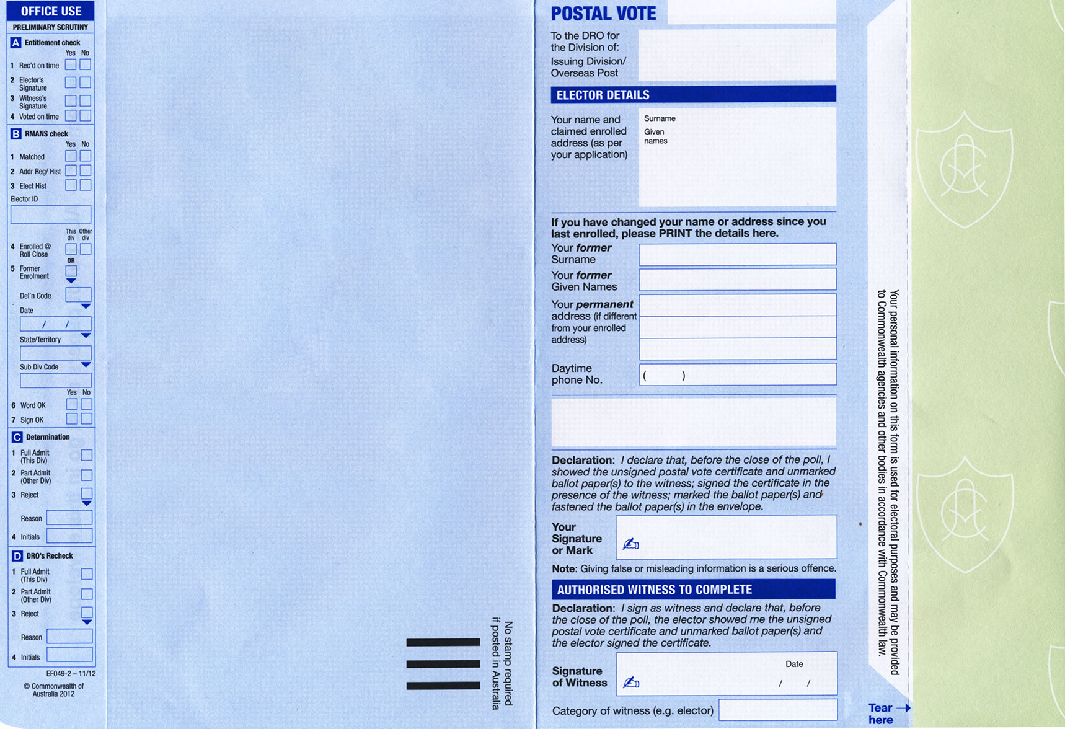
Postal votes and the reduction of postal services

Slide 7
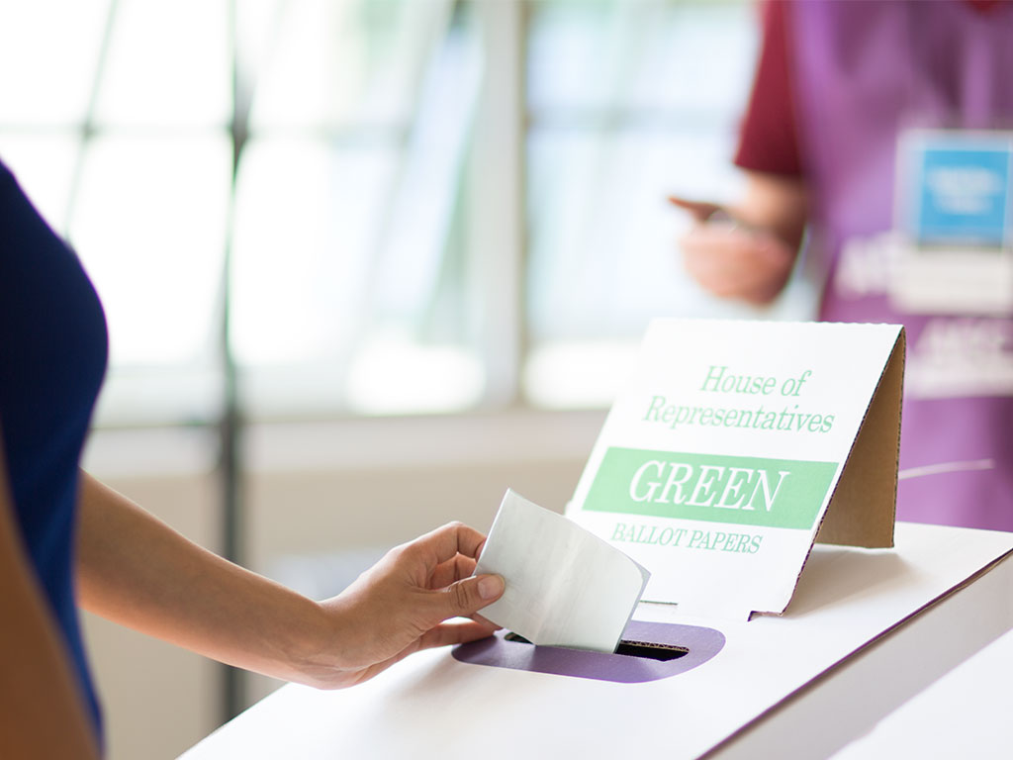
Questions?

