Slide 1
Inclusive Electoral Literacy through informal education channel

Slide 2
Federal Democratic Republic of Nepal at a Glance
Area: 147,181 Sq KM Population: 26,494,504
Population Growth Rate: 1.35 Economic Growth Rate: 3.5
Literacy Rate: 65.9 Life Expectancy: 69 year
Democratic Practice Since: 1950 Socio-cultural diversity: 125 eth gr.
Geo diversity: Terai, Hill & Himalaya No. of States: 7

Slide 3
Presentation Outline
Background
Establishment of Electoral Education and Information Center (EEIC) and its activities
Gender and Inclusion initiatives
Opportunities and Challenges

Slide 4
Background
Introduced an EMB with the Interim Constitution of 1950,
Independent constitutional body since 1966,
5 Commissioners including the Chief Election Commissioner
Activities guided by constitution, electoral laws, strategic plan
Responsibilities of conducting, supervising, directing and controlling the elections of the President, Vice-President, Federal Parliament, State Assembly and members of Local bodies

Slide 5
Cont'd...
The Constitution has made mandatory provisions of using the principle of inclusion in all the electoral systems adopted.
Inclusive Electoral Education is the demand of demographic structure of Nepal
Elections: the mega event and observed from many dimensions by different electoral stakeholders.
Many electoral activities take place during an election following electoral cycle. Electoral and Voter Education is one of them

Slide 6
CA Election 2013
Electoral and voter education activities were carried out
A special Voter Education committee was formed at the central level under the chairmanship of a Commissioner.
A District level Voter Education Committee is formed under the Chairmanship of Chief District Officer
Female : 6,166,829
Male : 5,980,881
Third gender : 155
Number of Voters: 12,147,865
Highest Voters' Participation in Nepalese Electoral History (78.4%)

Slide 7
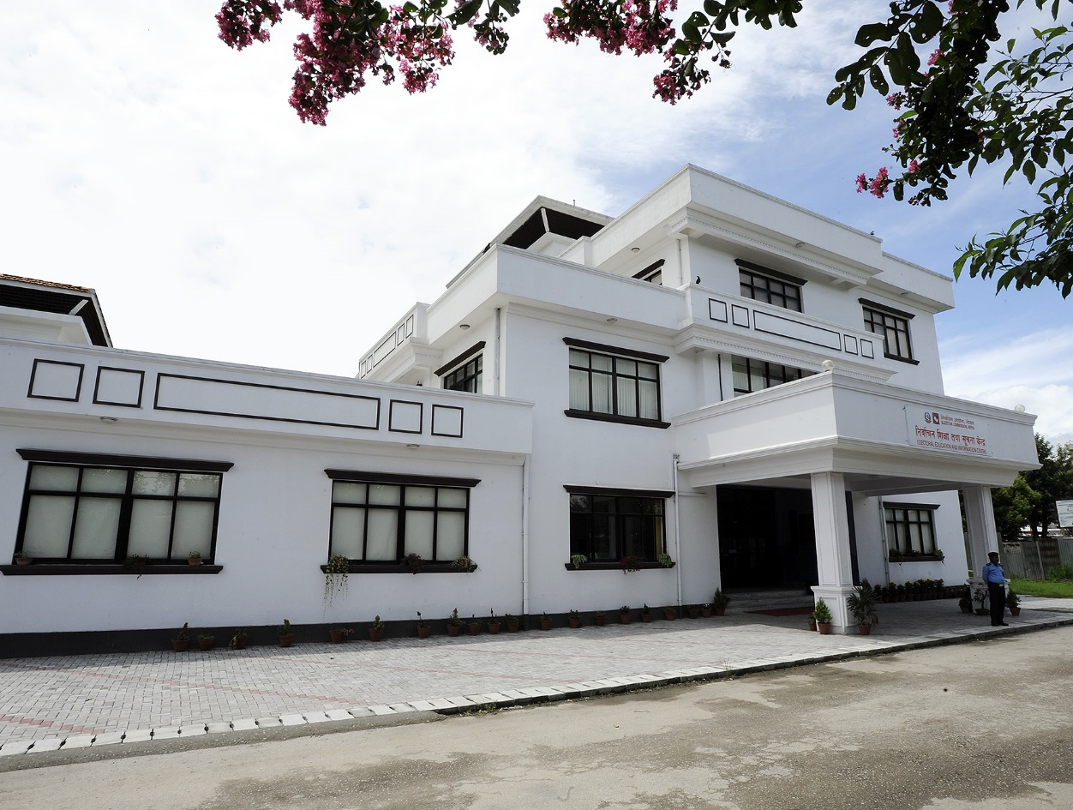
Establishment of Electoral Education and Information Center (EEIC)
Established in 2012 with the objectives of enhancing awareness and participation of voters towards electoral systems, processes and procedures
Expansion of EEIC in Regional Levels

Slide 8
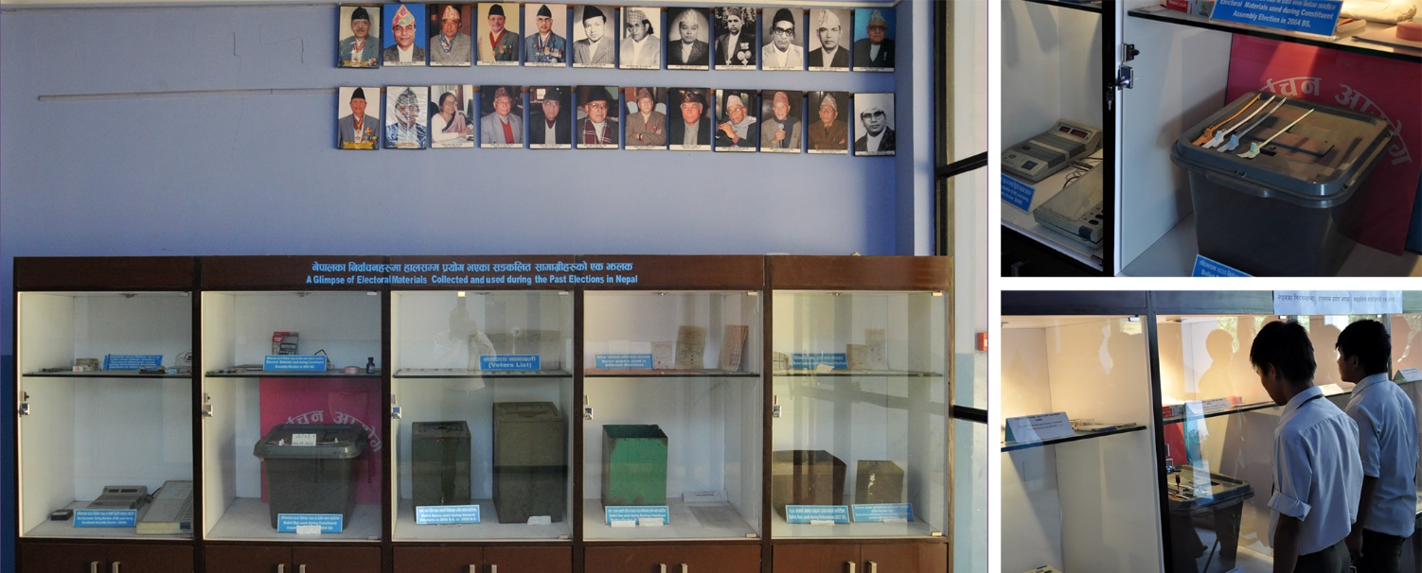
Mini Museum: Displaying Election related materials

Slide 9
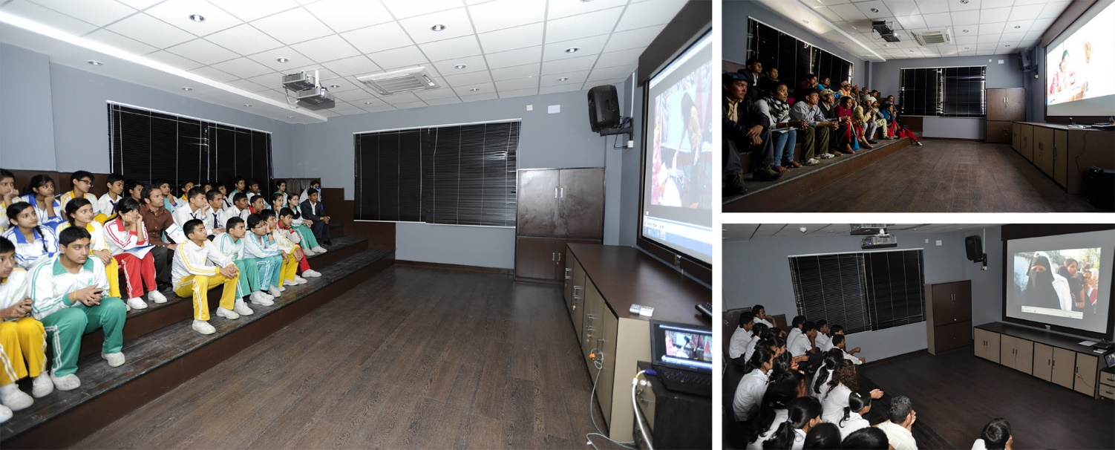
Mini Theater: 25 Minutes Long Documentary on Democracy and Elections

Slide 10
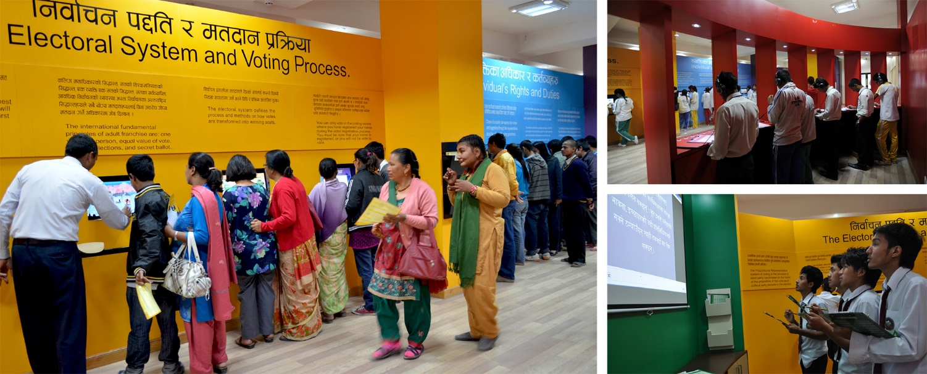
Interactive Room: Interaction on 5 different thematic subjects Using different Technologies and Learning styles

Slide 11
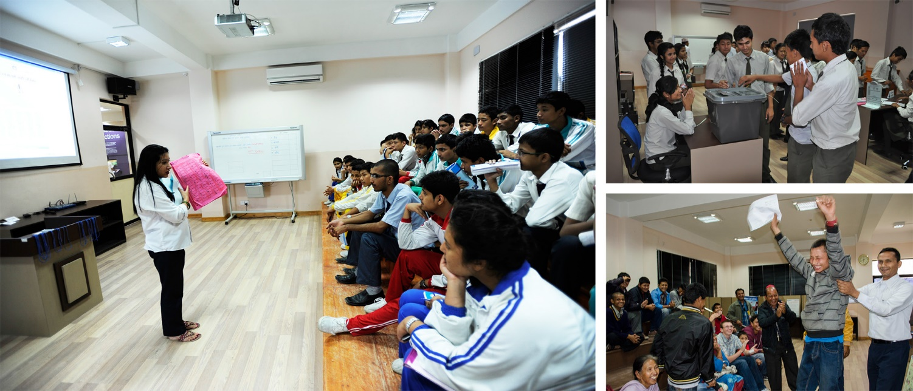
Mock Polling: Practical Knowledge on Polling day activities

Slide 12
Female | Male | Total
11184 | 12633 | 23817

Slide 13
Capacity Enhancement
Election Commission, Nepal is implementing its Second Strategic Plan (2015-2019)
Capacity building program is one of the major pillars of the Strategic Plan
Regular capacity building programme has been conducted to election staff and stakeholders
Specific BRIDGE modular trainings have been conducted (introduction to electoral management, gender and election, access to electoral process, electoral dispute resolution, political finance etc.)
Different Resource Manuals have been developed
Trainings to Deaf Citizen, Disable persons, Women and minorities have been focused

Slide 14
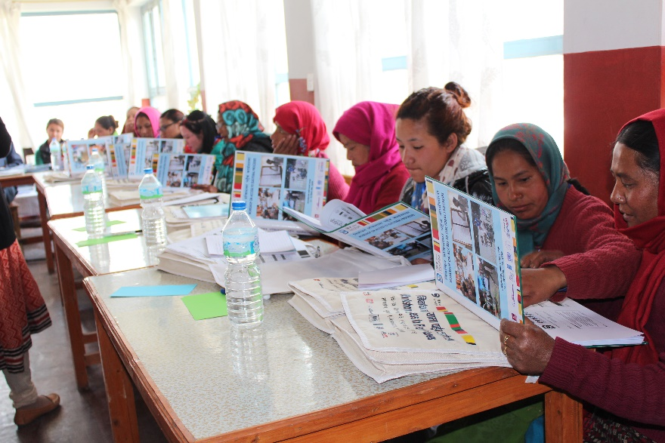
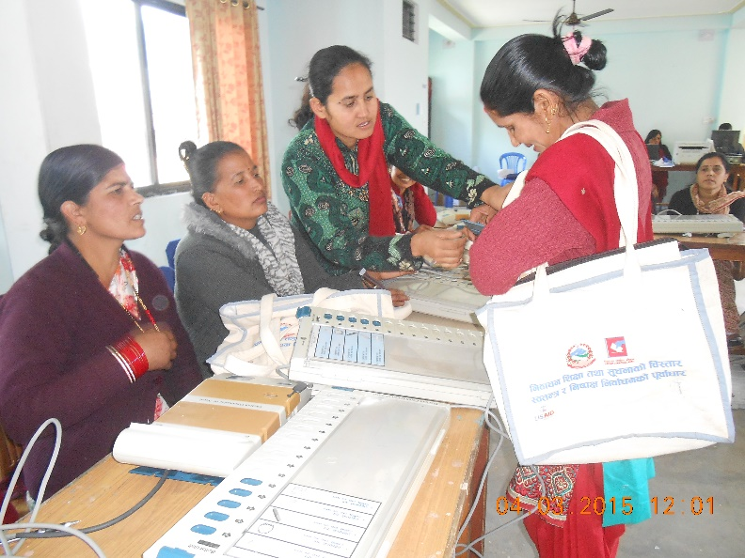
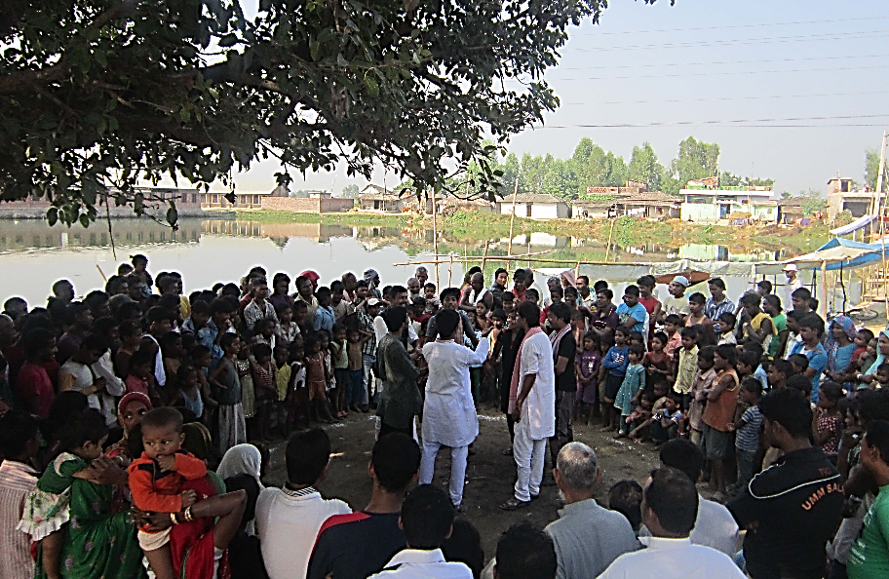
Inclusive Electoral Literacy Activities

Slide 15
Basic Features of Voter Education Program
Voter education program based on traditional practice,
Technology based ,
Outreach based,
Disadvantage and marginalized group focused,
Female group focused,
Based on wider consultation with stakeholders,
Regular updating and upgrading,
Voter education as a continuous process.

Slide 16
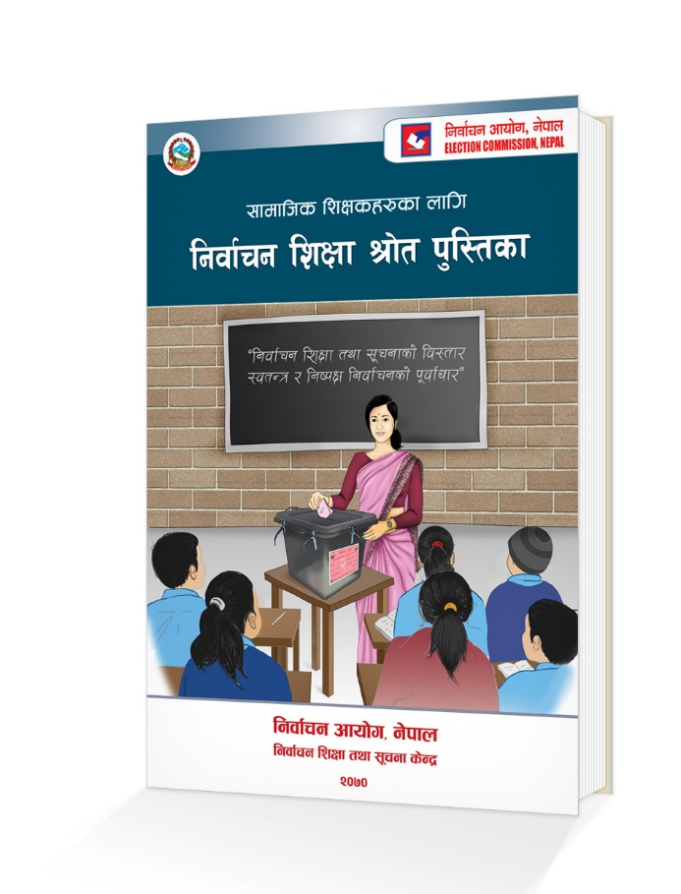
Social studies teachers' training
Realized the scope and influence of the teachers in Nepalese society ECN has conducted Electoral Education to Social Study Teachers of Secondary Level School
Both the community and private Schools' social study teachers are the participants
Piloted in 2013
27 districts out of 75 completed and rest will be completed in 2 years from now
Training to SS Teachers will have a lifelong impact to them
A comprehensive Resource Book developed

Slide 17
Electoral Education in Secondary School
Officials of the Commission visit community and private schools and take sessions
Conducted in all districts by concerned District Election Offices
At present, Election Commission has focused not only in how to vote but also why to vote

Slide 18
Voter Education through different means
Print Materials
Pamphlets, posters, flex, FAQ, broachers, booklets, flip charts
Printed and disseminated in different local dialects
Audio Visual
Focusing to Special Target Group
Applying contextual catchy native folk songs
Using of public figure as an icon
Radio (widest reach due to Nepal’s geography)
All over Nepal, through 100+ radio stations (National and Regional radios)
PSAs/announcements in Nepali + 17 local dialects
TV Channels: Broadcasting TV Program through 14 National TV Channel

Slide 19
Outreach Program
Mobile EEIC
Miniature of the central EEIC
Helping to those people who live in remote areas and out of reach modern means of communication
Street Drama,
Community Awareness program,
Local Cultural Program
Integrated Mobile service

Slide 20
Mobilization of Social mobilizers (Voter Education Volunteers)
Voter Education Volunteers (VEV) from minorities and women group at the local level, at least 2 persons mobilized for a VDC or Municipality Ward
Focused to impart the voter education at local level communities
Major role played in voter registration and voter identification card distribution process in CA Election, 2013
These volunteers were directed to impart the voter education to marginalized groups, first time voters, the illiterate or blinds, Dalit and women.
They were mobilized for 2 months and worked under the supervision of DEO Office.

Slide 21
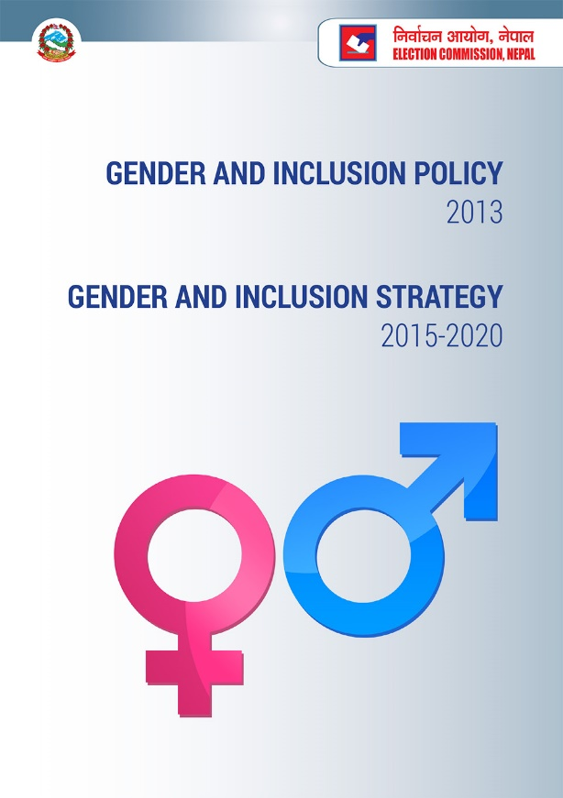
Gender & Inclusion initiatives
Regulatory Framework
GI Policy 2013
GI Strategy 2015-2020
GI action plan I, 2015
GI action plan II (Jan. 2016 to July 2018)
Institutional Framework
GI Coordination Committee
GI Unit
GI focal persons (HQ and 75 offices)
GI related grievances (female officer at HQ)
Developing ECN as a Gender Sensitive Organization
Attempts to ensure gender equality not only in the office but also among the voters and the candidates.

Slide 22
Regular Interface with Stakeholders
Regular consultations with relevant stakeholders: Women, Dalit, Disabled, Excluded and Minorities
Review of formal (School) education curriculum
Updating and developing of electoral education curriculum in consultation with the relevant stakeholders
Orientation to major stakeholders about new electoral provisions: political parties, CSOs, media etc.

Slide 23
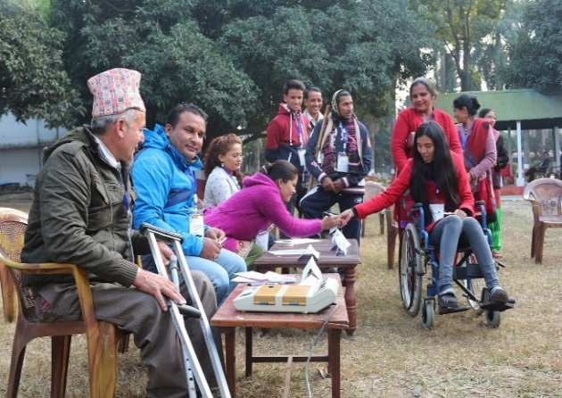
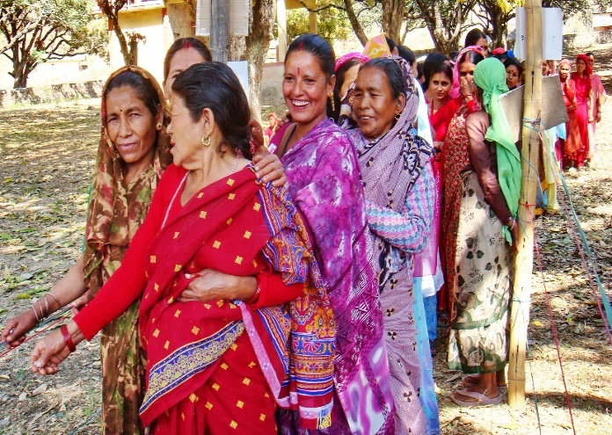
Opportunities
Successfully implemented the first strategic plan and undergoing reforms according to the second strategic plan
Continuation of past efforts to improve inclusive education and participation in elections
In light of Constitutional commitments, address GI-related concerns raised by key stakeholders
Women, Dalits, Backward Communities, Backward Regions, Indigenous and Ethnic Communities, Madhesi, Persons with disabilities, other minorities
Draft electoral laws, policies to be gender-sensitive and inclusive
This could help mainstream GI within political forces

Slide 24
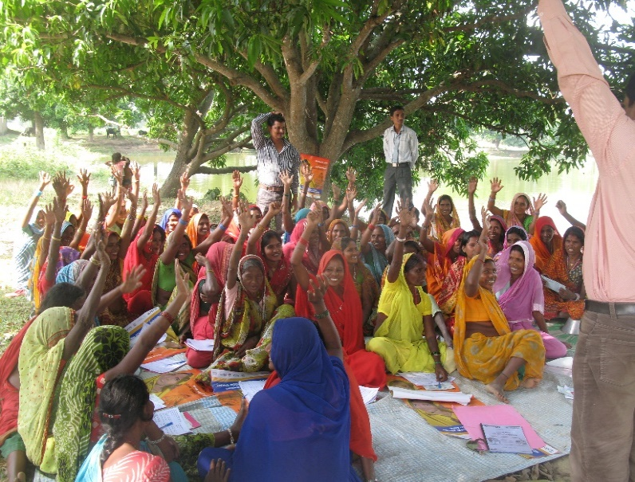
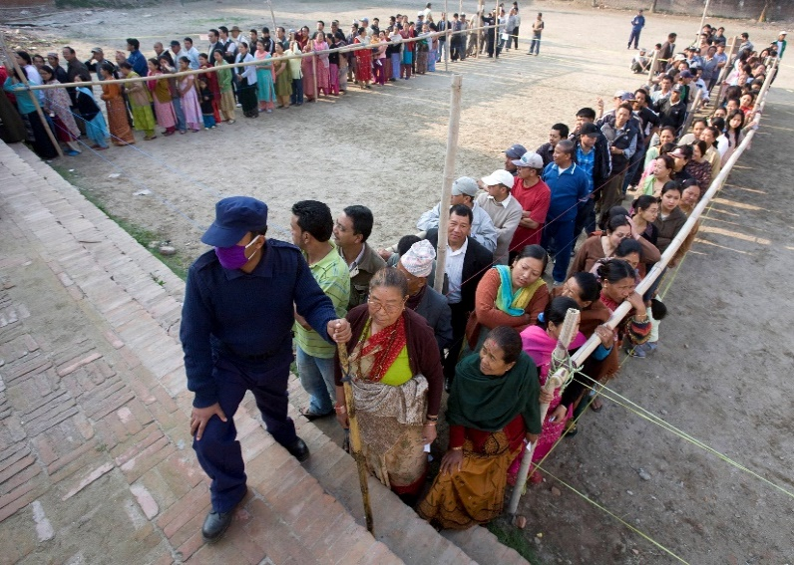
Challenges
Socio-Cultural discrimination and poverty hinder women’s participation in the electoral process
Many communities care more for livelihoods than informed participation in elections
Political parties participating in elections not sufficiently addressing Gender and Inclusion
Lack of adequate gender- and disability-friendly infrastructure for polling

Slide 25
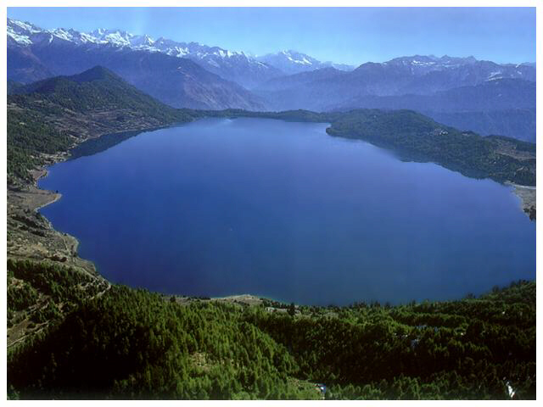
Thank You

