Slide 1
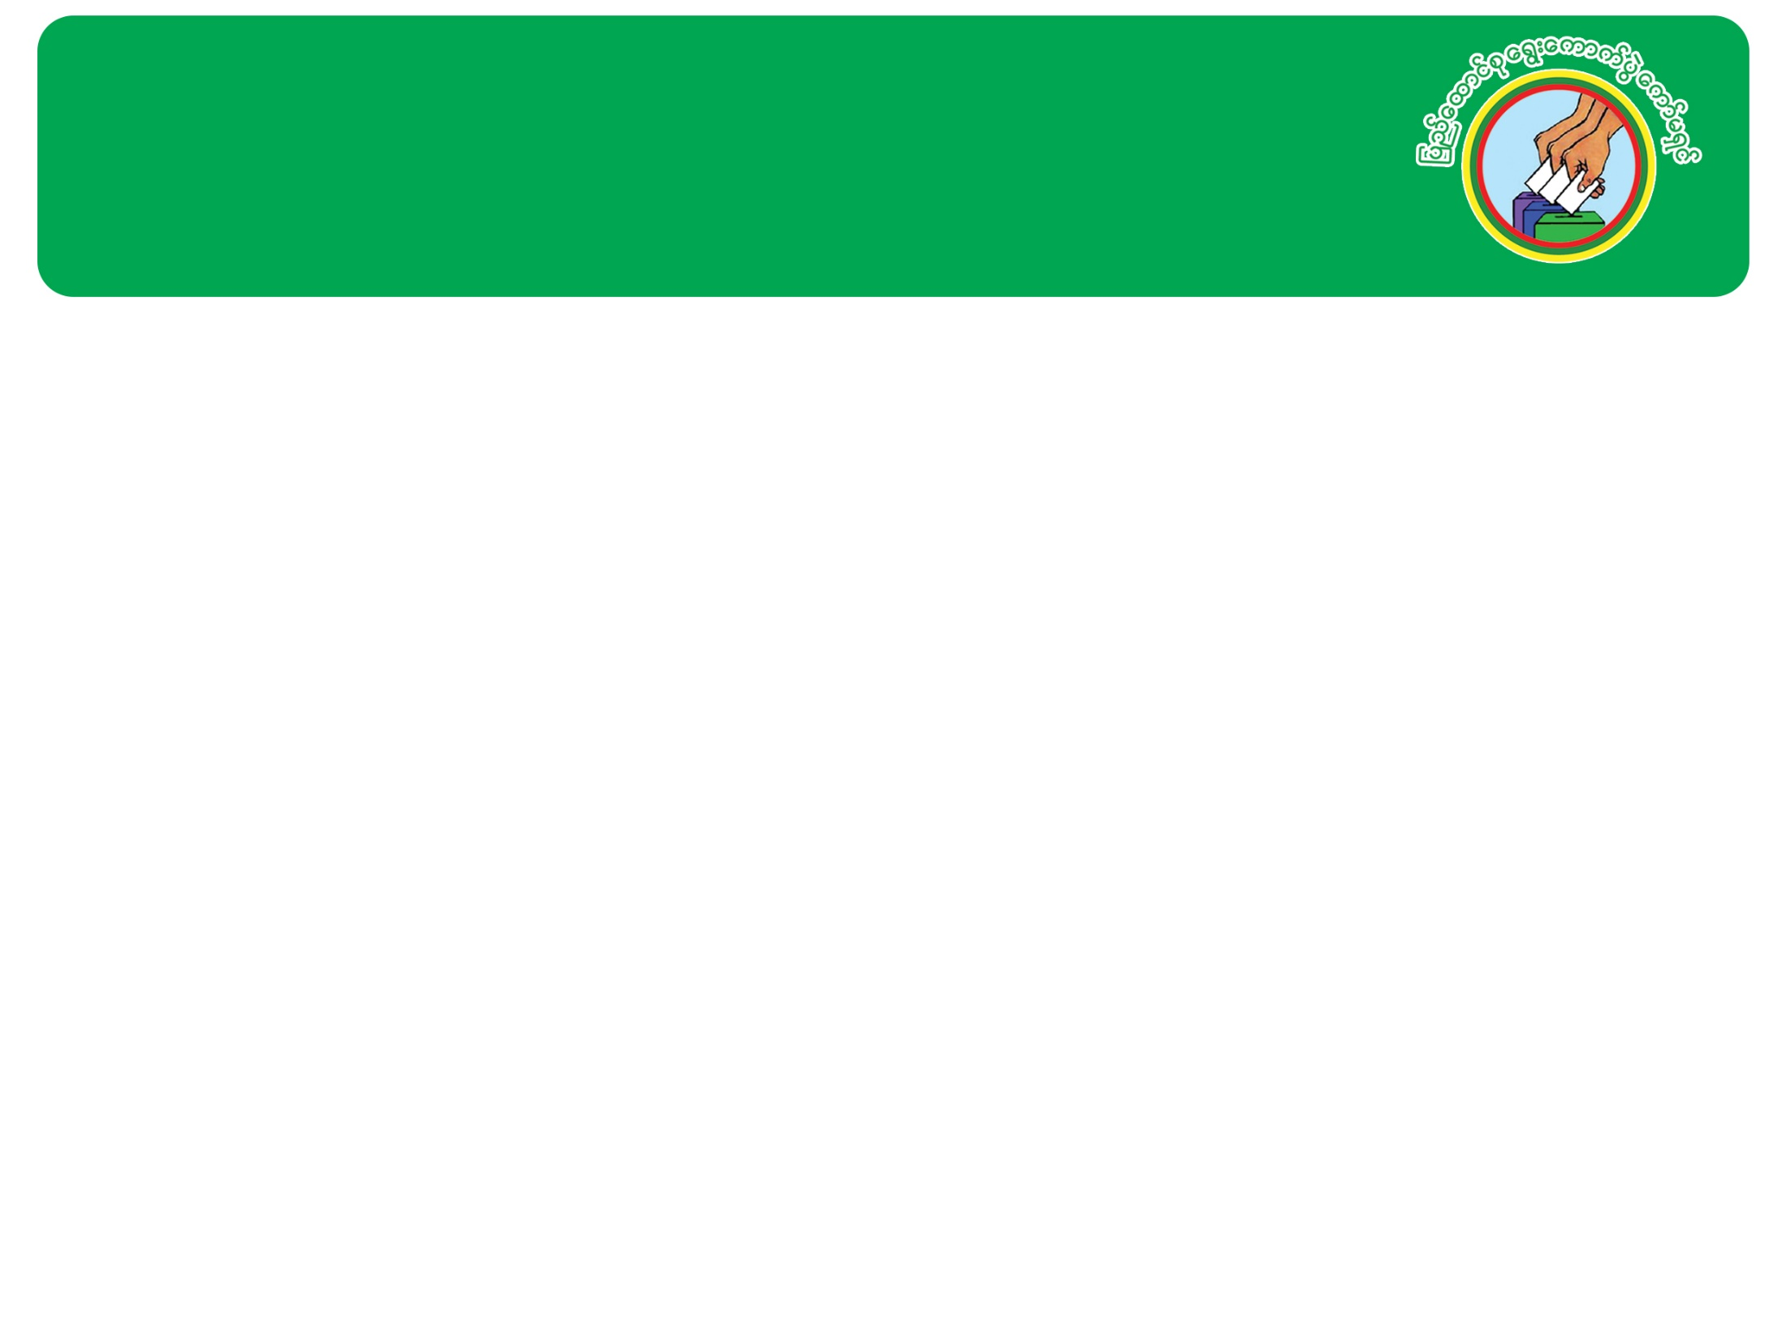
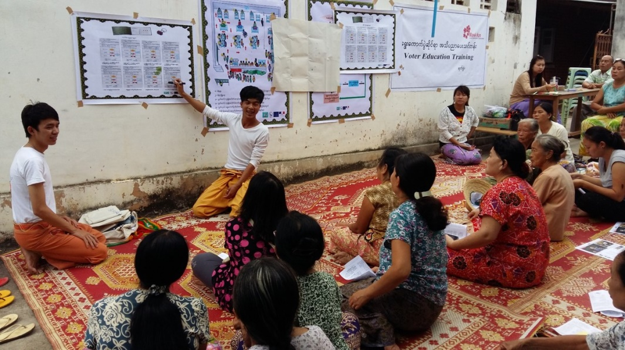
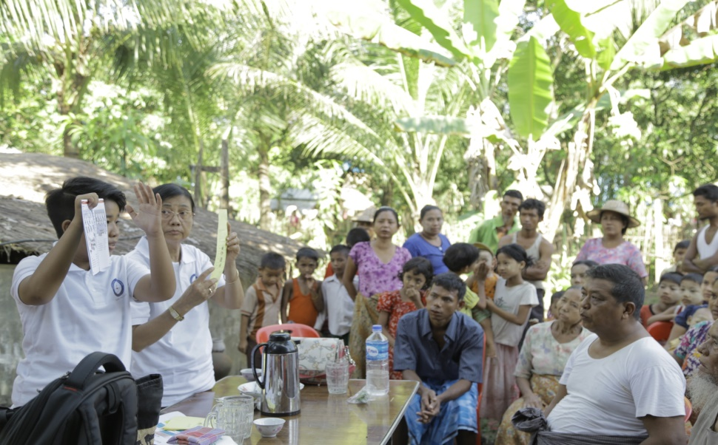
Union Election Commission
Voter Education: Inclusive Electoral Literacy through informal education channel

Slide 2

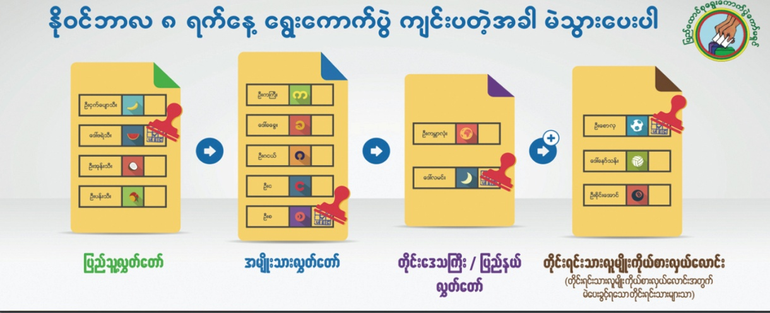
Information Included in Voter Education
Voting Rights and Responsibilities
How to Vote
Voter Registration Procedures
Electoral Events (ie Voter Registration period and Election Day)
Inclusion of women, ethnic minorities, and persons with disabilities in the electoral process
Transparency and credibility of elections
Government System
Electoral System

Slide 3

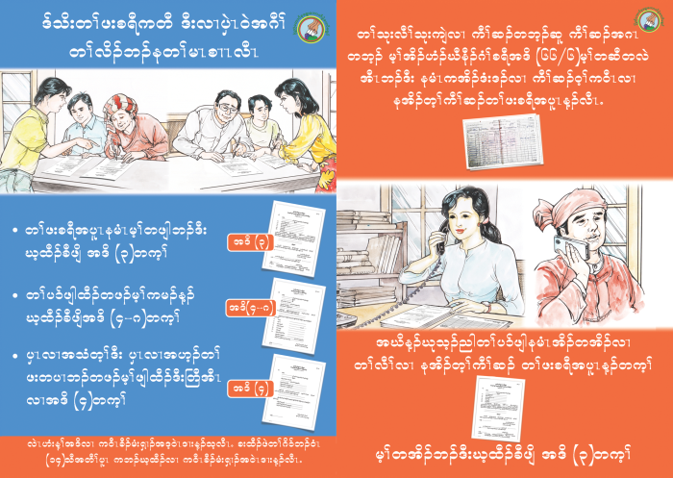
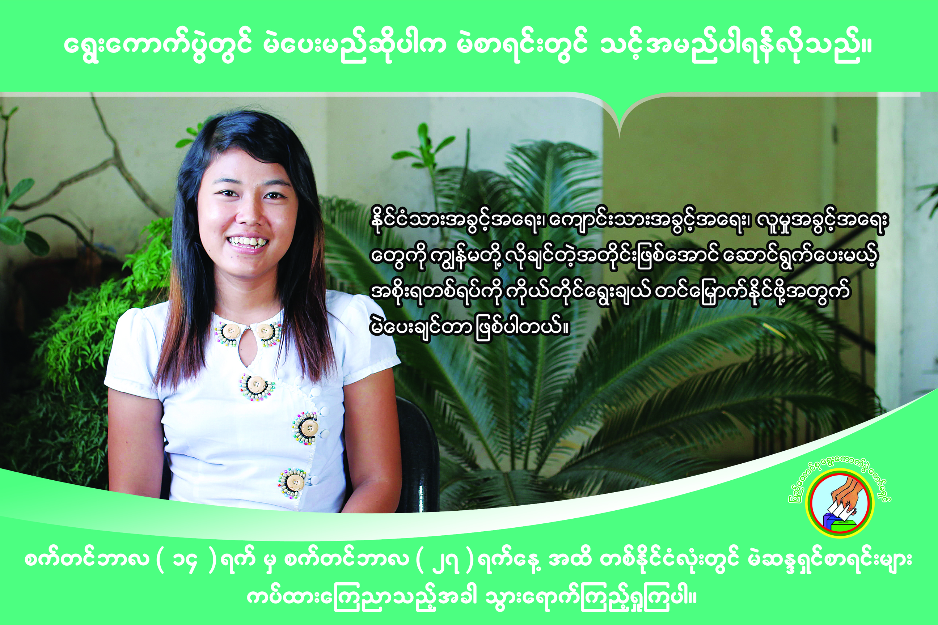
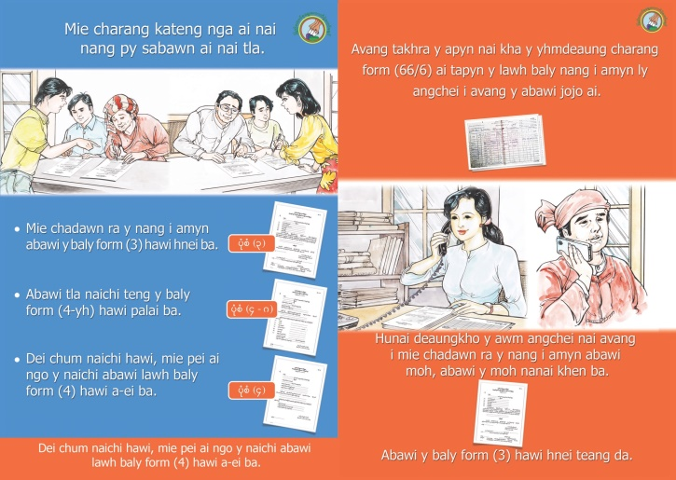

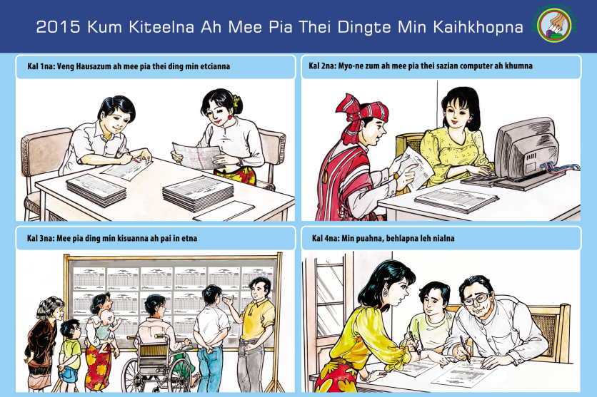
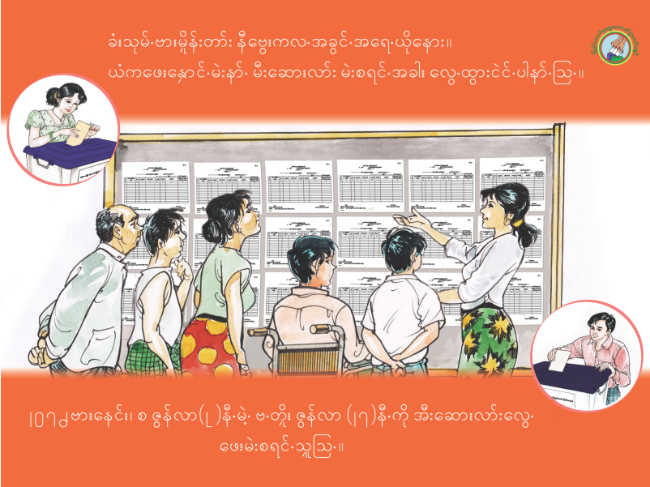
Voter Education Materials: Voter List Displays

Slide 4
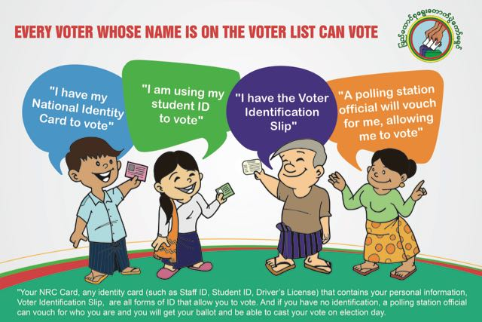
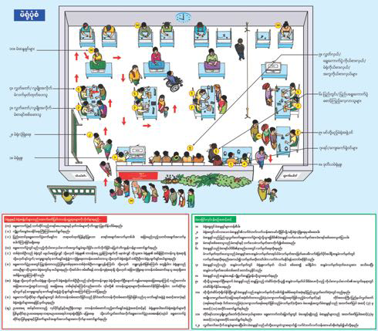
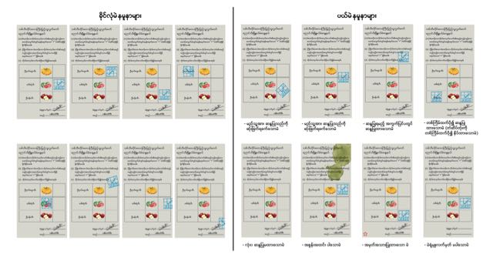
to
Voter Education Materials:
Election Day and Voting

Slide 5
to
Voter Education Materials: Videos

Slide 6
to
Additional Materials for Stakeholders

Slide 7
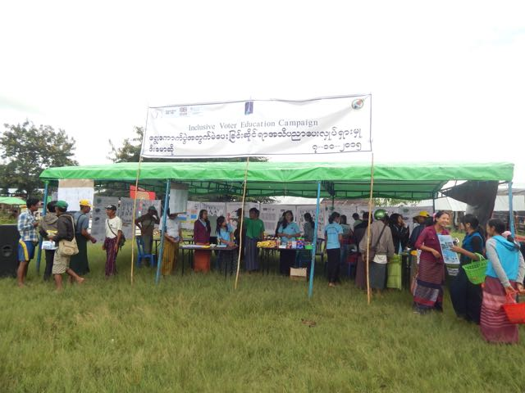
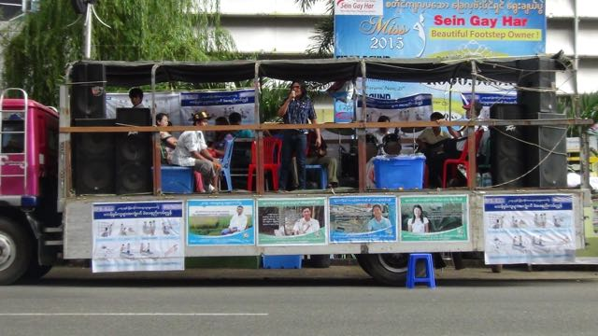
to
Voter Education Distribution Strategy:
Voter Education followed two modes:
Cooperation with Stakeholders: Government Institutions, CSOs, political parties, and voters to disseminate posters and pamphlets in local communities
Mass Media: Social Media, Radio, Television, Newspaper, Journals

Slide 8
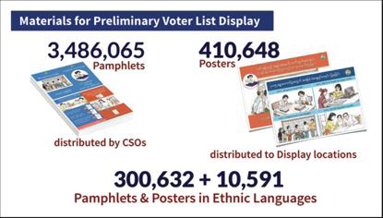
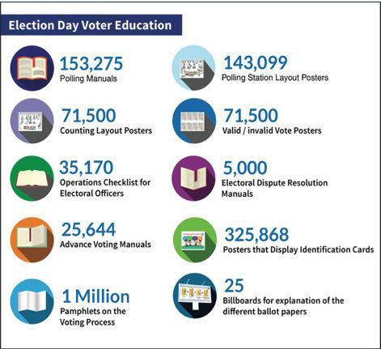
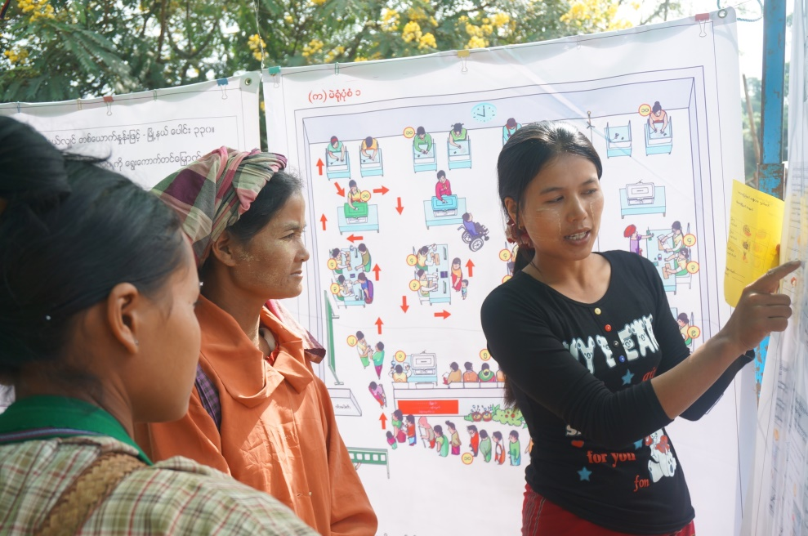
Voter Education Materials Distribution with CSOs

Slide 9
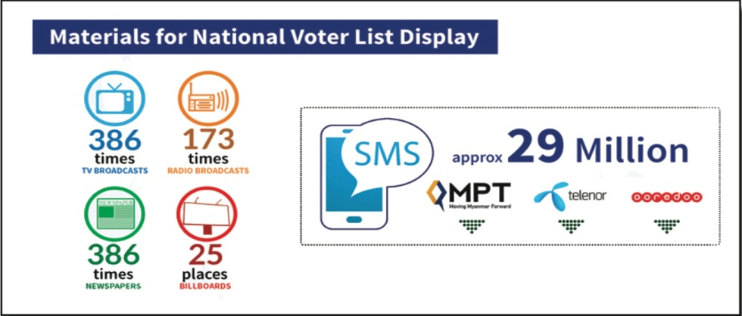
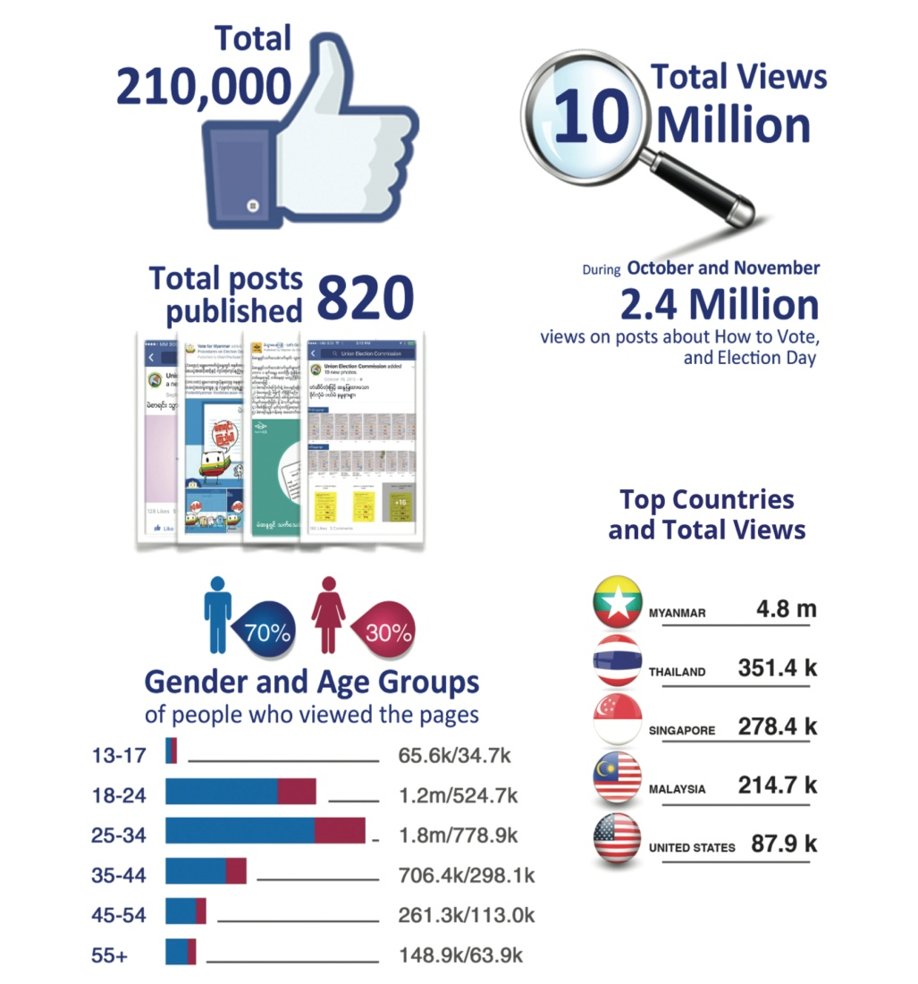
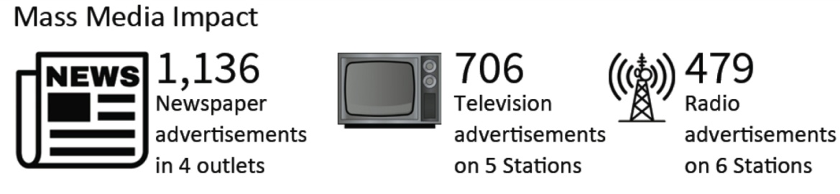
Mass Media Voter Education

Slide 10
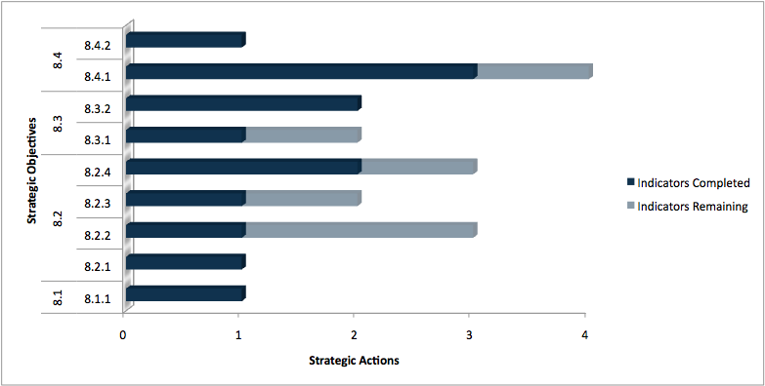
to
UEC Strategic Plan (2014-2018)
Strategic Pillar 8: Voter Education
Strategic Goal: To create awareness of the electoral process among all citizens and increase participation through coordinated and effective civic and voter education campaigns.

Slide 11
Inclusion in Voter Education
Millions of materials were printed and distributed but communities needed sustained messaging to ensure the inclusion of women, youth, persons with disabilities, and ethnic minorities.
Myanmar is a population of 33.4 million voters and this includes a diverse population:
  Over 17 million women
  Over 2 million persons with disabilities
  118 Ethnic Languages
  Many first time voters
How can the UEC use existing voter education materials to promote inclusion across a diverse society?

Slide 12
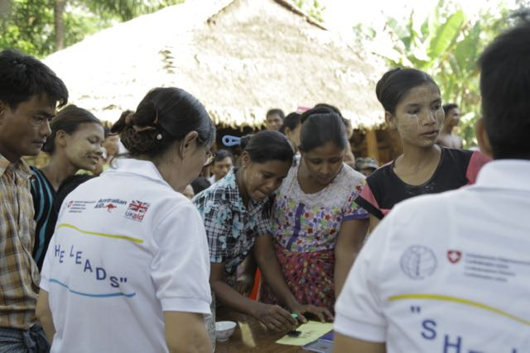
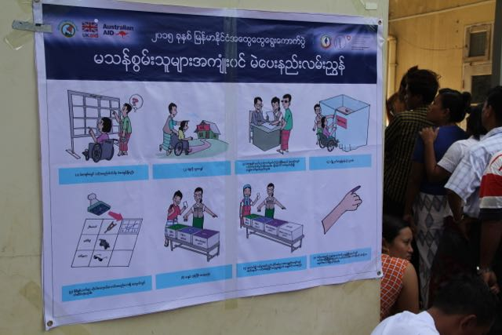
UEC Partnerships with CSOs
9 National Meetings with 60+ CSOs
2 Rounds of Regional Meetings with 800+ CSO representatives
UEC distributed voter education materials to CSOs for conducting voter education in communities.
CSOs held trainings and meetings in communities to discuss electoral events, like voter list display, how to make corrections to the voter list, how to mark a ballot properly, and polling simulations.
Trainings were held in local languages and focused on inclusion of ethnic populations, persons with disabilities and women.

Slide 13
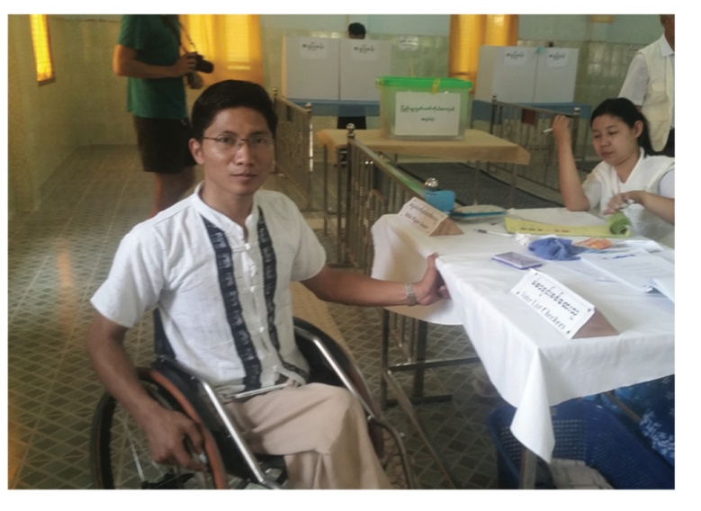
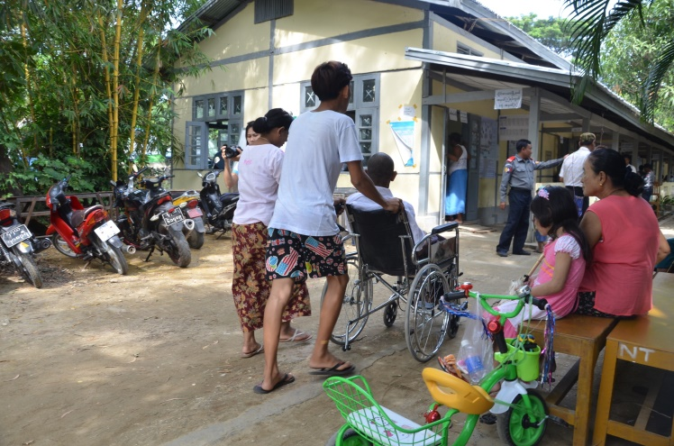
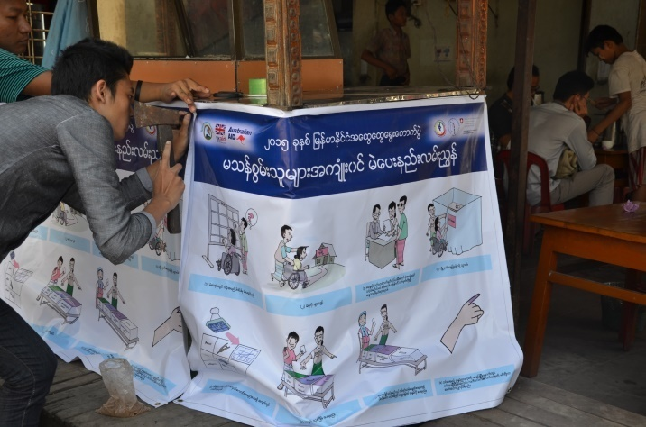
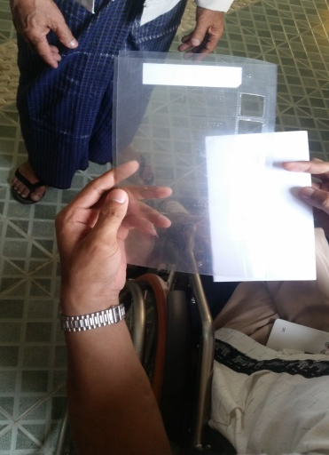
Voter Education for Persons with Disabilities
Voter Education targeted persons with disabilities, with messages that demonstrated methods for persons with disabilities to vote as well as piloting 18 polling stations that were accessible for persons with disabilities.
CSOs developed the “Awareness Booklet on Disability Inclusive Elections” and a “How to Vote Guidebook for persons with disabilities” that were based on UEC materials and regulations.
72% of persons with disabilities that voted at that polling stations thought that they were accessible.

Slide 14
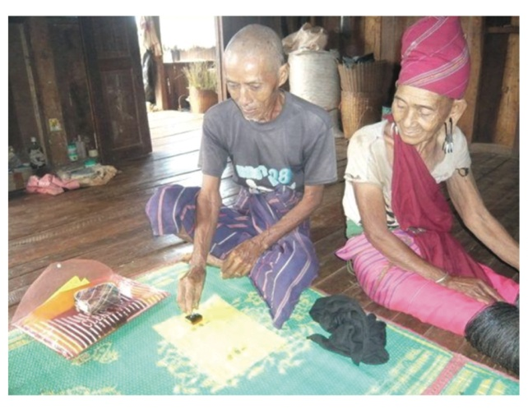
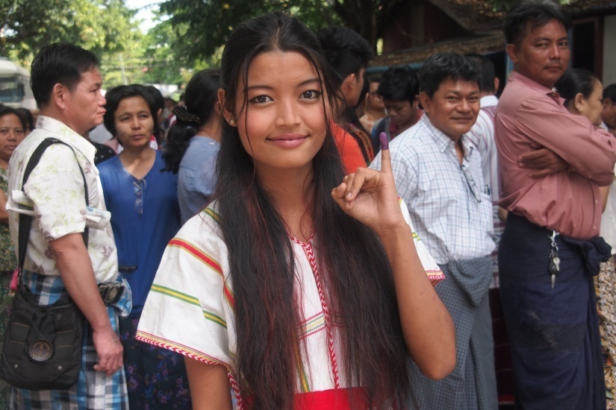
Voter Education and Ethnic Inclusion
Myanmar has 118 Ethnic Languages
Voter Education Developed in 16 Ethnic Languages
FAQs developed in 7 Ethnic Languages
Videos developed in 8 Ethnic Languages
Radio Broadcasts and Newspaper Advertisements translated by local media outlets.
CSOs used materials developed by UEC and did translations as well as held trainings in local languages.

Slide 15
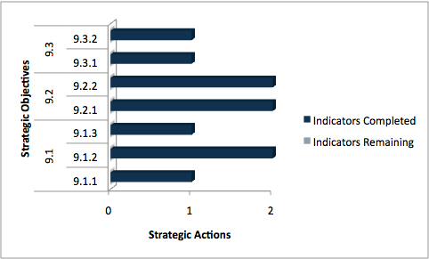
to
UEC Strategic Plan (2014-2018)
Strategic Pillar 9: Promotion of inclusive Participation
Strategic Goal: To encourage more inclusive participation from women, ethnic minorities, persons with disabilities, and internally displaced persons (IDPs) who each face different challenges and barriers to participating in the electoral process.

Slide 16
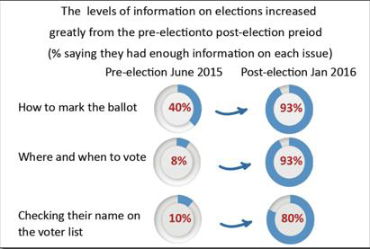
e
Voter Education Impact

Slide 17
Thank You!
Myanmar Delegation
Commissioner H.E. U Aung Myint
Commissioner H.E U Hla Tint

