Slide 1
Higher Independent Authority for Elections
Persons with disabilities

Slide 2
Persons with disabilities’ rights: constitutionally ensured rights
Article 48 of the Tunisian Constitution: The state protects persons with disabilities from all forms of discrimination.
Every citizen with disabilities has a the right to benefit, depending on the nature of his disability, from all measures to ensure a full integration in society, and the state shall take all measures necessary to achieve this.

Slide 3
Article 131 of the electoral law: polling stations are prepared to enable voters with disabilities to exercise their right to vote, according to measures taken by the Authority.
Voters with a disability exercise their right to vote in accordance with the measures taken by the Authority, taking into account the principle of personal and secret polling within the limits required by the disability. Each voter with a disability card benefits from the measures and procedures for people with disabilities on the day of the vote.

Slide 4
According to the report of WHO(world health organaization) for the year 2013, persons with disabilities represent 13.5% of the population in Tunisia.

Slide 5
What it is guaranteed by the law for persons with disabilities
Bringing and attendant: the electoral law guarantees to the blind person or the person baring a physical disability that prevents him from writing to bring an attendant (spouse, descendants or parents) to help him exercise his right to vote.
If they don’t bring an attendant voters with disabilities have the right to ask the president of the polling station to assign a present voter from the audience to help them exercise his right to vote.

Slide 6
High Independent Authority for Elections and persons with disabilities
The High Independent Authority for Election has sought to take into account the needs of persons with disabilities in its work and in particular:
-Voters information and education
-Ensuring that persons with disabilities exercise their right fully and independently on polling day

Slide 7
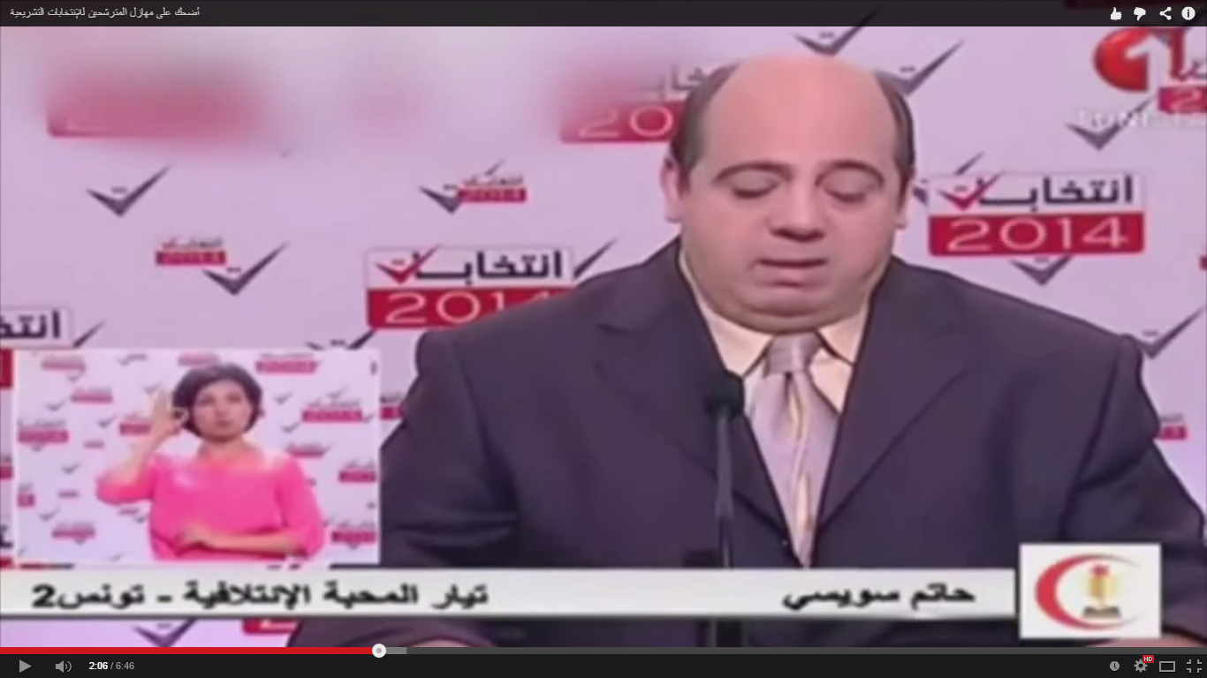
Voter information
The use of sign language in media segments of the High Independent Authority for Elections as well as in television shows for electoral programs Balmitrahan elections.

Slide 8
Voter Education
The High Independent Authority for Election integrated the status of disability in almost all educational materials used as well as the production of special tools to educate and inform persons with disabilities with the help of organizations and associations working in the field of the defense of the rights of persons with disabilities.

Slide 9
The most important educational materials to persons with disabilities
Manual in the language of «Braille» for the 2014 Elections: A manual containing the most important information concerning the 2014 elections has been distributed in a systematic way by the associations that work with persons with disabilities
Guide on the 2014 elections for persons with disabilities: the explanation of the phases of the voting, the rights of persons with disabilities on voting day, the definition of the most important terms etc.
Banner of the voting phases for persons with disabilities: polling phases for persons with disabilities.

Slide 10
Banner of the voting phases for persons with disabilities
Guide of the elections of 2014 for people with disabilities
Manual on the elections of 2014 in the language of «Braille»

Slide 11
The most important educational materials to persons with disabilities
El Mjaied family: segment dedicated to the persons with disability,
Educational segment to persons with disabilities
A short film (15 minutes) about the right to vote for persons with disabilities: exposing some of the information related to the elections (method of seat allocation, the electoral system...)

Slide 12
Segments dedicated to the persons with disabilities

Slide 13
What About the voting day?
The Authority has taken the necessary measures to guarantee the right of persons with disabilities in voting fully and independently and in the best conditions within the limits of the possibilities available
Adjusting the polling stations: In cooperation with the Tunisian Organization for persons with disabilities, a group of polling stations and was visited and 45 polling centers that were classified as not eligible to receive persons with disabilities were adjusted in the various districts,

Slide 14
What about the voting day?
The ballot in the language of «Braille»: the ballot is printed with the candidates numbers in the language of «Bray» and is available at each polling station at the request of the visually impaired voter.
A memorandum addressed to the members of the polling stations: the memo exposed what should be taken into account when preparing the polling station for the reception of persons with disabilities (lighting, placement of furniture, communication ...)

Slide 15
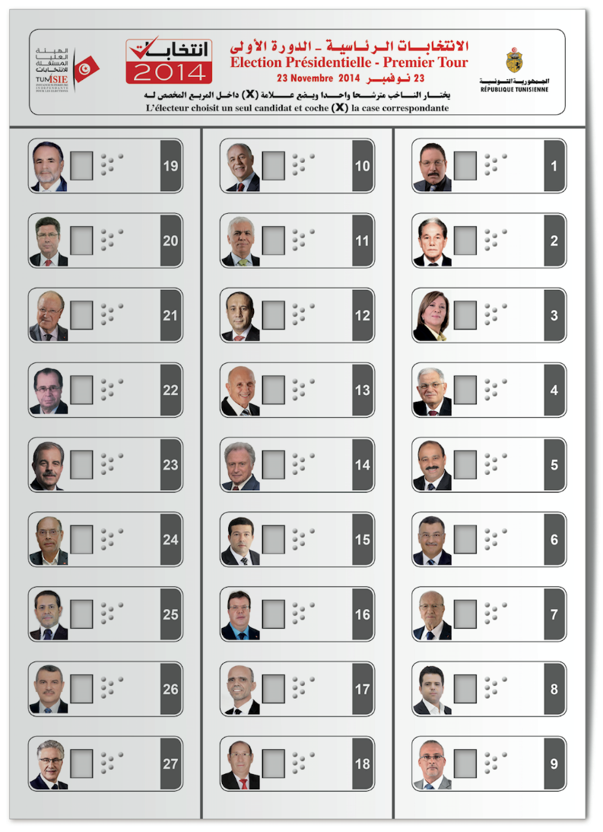
The ballot in the language of «Braille»

Slide 16
THANK YOU

