Slide 1
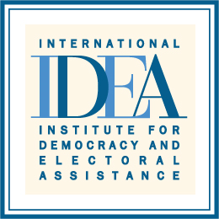
Inclusive Electoral Literacy: Informal Education Channels
Sheri Meyerhoffer, Head of Mission
International IDEA, Nepal

Slide 2
Why voter education matters
A failed experiment
Lack of understanding = lack of confidence
Lack of confidence = lack of smooth democratic transition
Lesson?
It’s not enough for the government or a select group of experts (albeit citizen experts!) to understand the transition plan
A democracy requires citizens to understand and take ownership to effect change

Slide 3
Voter Education Channels in Nepal
Informal
Formal Channels
Voter Education Channels
Training
Secondary level School Curriculum
Audio
Visual
Interactive Programs
University Courses

Slide 4
Training
Election Commission of Nepal (ECN) adopted BRIDGE modular trainings in 2008
Research on global best practices for voter education used to identify modules most applicable in context of Nepal
Eleven (11) BRIDGE modules (out of 24 in V2) selected and customized

Slide 5
BRIDGE Modules in Nepal
Modules focused on election implementation
Introduction to electoral management
Electoral dispute resolution
Political finance
Polling, counting and results
Voter registration
Pre-election activities
Electoral systems
Modules focused on election participation
Voter education;
Gender, inclusion and elections
Media and elections
Access to the electoral process
Electoral systems

Slide 6
BRIDGE Training Audiences
ECN and Government staff to enhance capacity of electoral management
Training for key electoral stakeholders- media, political parties, observer groups, civil society organizations etc. for greater participation and involvement
Training for security sector agencies - (Nepal Police, Armed Police, National Intelligence Bureau and Nepal Army) for safe and secure elections
Focused training for disadvantaged groups – women, Dalit, Madhesi, Muslim, Indigenous Peoples etc.
Special trainings for differently-abled citizens

Slide 7
Interactive Programs
International IDEA delivers voter education in Nepal through Civic Initiative Centres (CICs)
CICs managed in collaboration with Nepal’s Legislature Parliament Secretariat and implemented through a national NGO
14 Centres established in 2010
Located in all 7 of Nepal’s new provincial boundaries
Located in 3 ecological zones Terai (7); Hill (6); Mountain (1)
CICs have delivered interactive programs in all of Nepal’s 75 Districts and reached all Village Development Committees across the country

Slide 8
CIC Objectives
Increase understanding of constitutional provisions including those related to elections, the electoral system, civil and political rights etc.
Support civic education at the local level on various topics including voter and election related matters

Slide 9
CIC Target Audiences
Political parties
Civil society
Representatives from marginalized communities including women, Dalits, Indigenous Peoples, Madhesis, Muslims
Professional associations (lawyers, business, teachers/professors, journalists, doctors, engineers)
Government offices (District level)
Community organizations (Village level)
Academics
Journalists
Teachers and students

Slide 10
CIC Role in Voter Education
To inform people at the local level on:
Their right to vote and the importance of voting
The electoral system
Proposed constitutional provisions related to the elections and the electoral system
The basic features of the provisions of The Constitution of Nepal 2015 related to elections and the electoral system
To prepare people at the local level to:
Participate in the official public opinion collection on the Preliminary Draft Constitution in July 2015
Comment on proposed electoral legislation, regulations, policies and practices

Slide 11
CIC Activities 2010-16
Interactive workshops
National TV and Local FM Radio broadcasts
Distribution of printed resource materials
Libraries and resource centers in CIC offices

Slide 12
CIC Impact
Enhanced awareness and understanding of Nepali people on the electoral system, the election process and their role as voters
Increased confidence of people in democratic electoral processes
Understanding the power of voting particularly among marginalized groups

Slide 13
Concluding Remarks
BRIDGE training to support the ECN in the area of voter/electoral education to:
Minimize the invalid votes and maximize the voters turnouts
Strengthen and upgrade the managerial capacity of the electoral management body
CICs – civic education to increase
Voter confidence
Citizen participation in elections
Informed democratic decisions

Slide 14
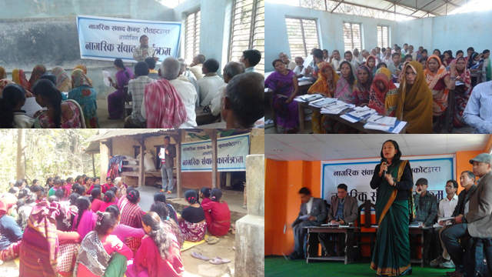
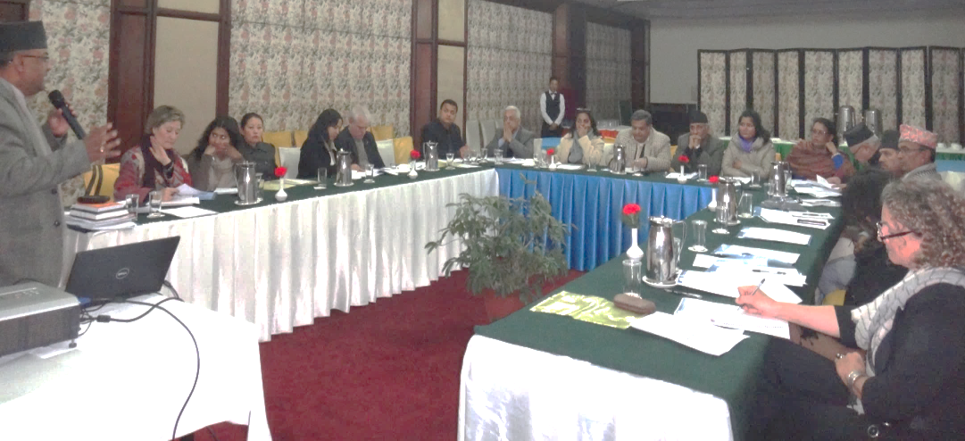
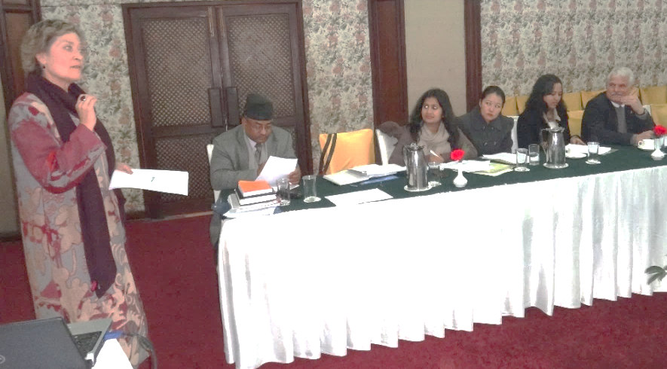
Thank You!

