Slide 1
INCLUSIVE ELECTORAL EDUCATION THROUGH INFORMAL EDUCATION CHANNEL
Hasyim Asy’ari
General Election Commission of The Republic of Indonesia

Slide 2
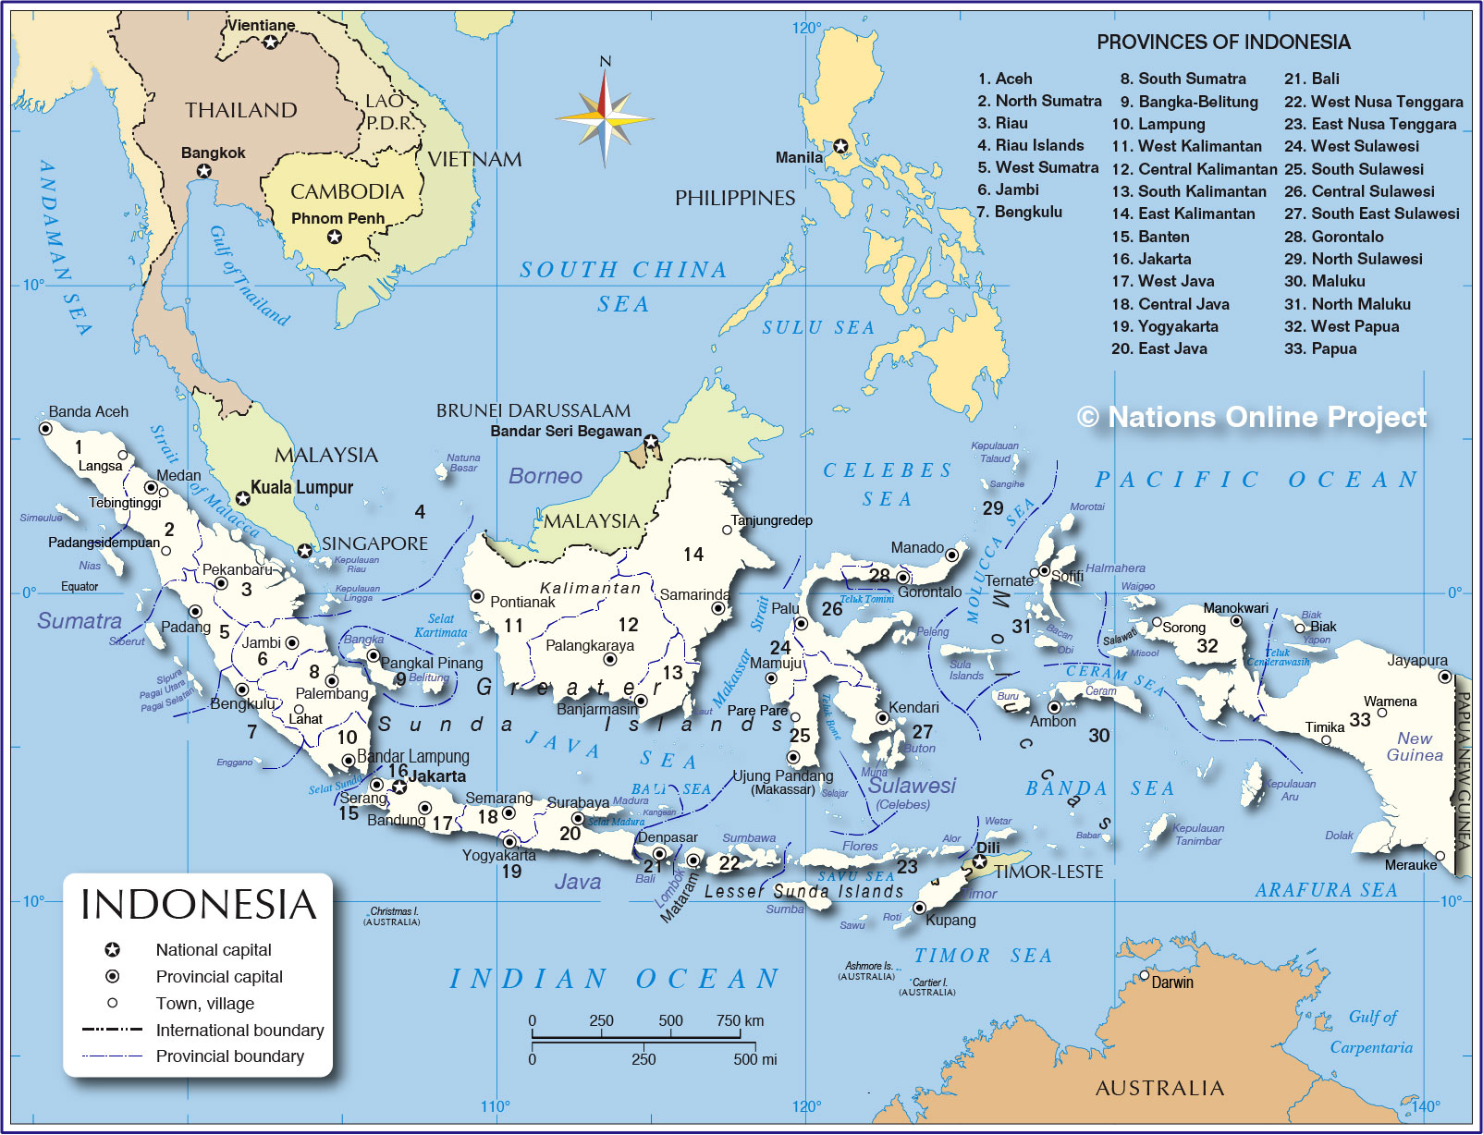
INDONESIA MAP

Slide 3
INDONESIA
34 PROVINCES
514 REGENCIES/
MUNICIPALITIES
7160 DISTRICTS
83184 VILLAGES

Slide 4
INDONESIA ELECTIONS
Probably the most complex electoral event globally
479,183 polling stations across 17,000 islands
34 provinces, 514 regencies/municipalities, 7,160 districts, 83,184 sub-districts/villages
4 million polling station officials
700 ballots, 2,450 ballot designs
19,700 candidates, 1 presidency, 532 legislatures
Population: 237.56 million (census 2010)
2014 voters list: 187,847,512
2014 turnout rate: 75.11%

Slide 5
Legal Framework
Constitution of Indonesia (UUD 1945)
Reformasi movement resulted to the significant amendments of the Constitution: human rights & concept of election
Legislative framework governing democratic representation:
Law 15/2011 governing election management bodies
Law 8/2012 governing legislative elections
Law 42/2008 governing presidential elections
Law 2/2011 governing political parties
Law 27/2009 governing the structure of national and sub-national legislatures
Law 23/2014 governing regional administration
Law 1/2015 governing local election
Law 8/2015 governing local election (1st revised of Law 1/2015)
Law 10/2016 governing local election (2nd revised of Law 1/2015)

Slide 6
ELECTIONS in INDONESIA
Parliamentary Election :
◦Regional Representative Council
◦People’s Representative Council
◦Peoples Regional Representative Council
Presidential
Election
Concurrent Governor and Regent/Mayor Election
This elections was held once in five years

Slide 7
INDONESIAN ELECTION SYSTEM MODEL (11 TIMES ELECTIONS)
Transitional New Order
Reformation Era
New Order
Revolutian Era
Democration Consolidation
1955
1971
1977-1982-1987-1992-1997
1999
2004-2009-2014
Close List Proportional Representation
For Presidential Election :
1955-1999 : Elected by HR
2004-2009-2014 : Elected by Voters by Two Round System
National HR, Provincial HR, and District (Mun/City) HR = open list PR
2004 = Candidate Number Order
2009-2014 = Most Voted
Provincial Representative = SNTV (single non transferable vote)

Slide 8
LEGISLATIVE ELECTIONS
From 1998 until now, there had been four legislative elections held, they are 1999, 2004, 2009 and 2014 elections. Legislative elections on April 9, 2014 included:
House of Representatives (DPR) & Regional Representatives Council (DPD)
National Level: DPR - 560 seats from 77 electoral district & DPD - 132 seats from 33 provinces
Provincial Level: 2,112 seats from 259 constituencies
Regency Municipality level: 16,895 seats from 2,102 constituencies
All elected at the same day, requiring 4 different ballots during the Election Day

Slide 9
LEGISLATIVE ELECTIONS
Seats Allocation
2009 election vs 2014 election
Gender Quota:
2004 election: 30% women in candidate list
2009 election: 30% women with at list one women within three candidates, no binding sanction
2014 election: 30% women with at list one women within three candidates, with binding sanction

Slide 10
PRESIDENTIAL ELECTIONS
President as Head of Executive elected directly by the people
Maximum two five-year term of service
Min 25% of total vote required for a party or coalition to nominate candidate pairs
Candidate who receives >50% wins the election
Run-off election between top two candidates if no one reaches the 50% threshold in round one

Slide 11
LOCAL ELECTIONS
Local election is an election to select head of regional.
Previously, the date of local election different from one region to another. By the Law Number 8 Year 2015, government decide to conduct local election from regions concurrently.
The schedule of concurrent local elections is designed to accommodate the end of term of each regional head. The end of term varies as previously each region conducted local elections in different dates.
Concurrent local elections for all regions in Indonesia is designed to be conducted in 2027.

Slide 12
LOCAL ELECTIONS
Gubernatorial election: electing head executive of a province with min 30% of total votes
Regency/Municipality election: electing head executive of a regency/municipality
Kecamatan appointments by the Regent/Mayor at regency/municipality level
Ward/village appointments and elections
The head of Kelurahan is a civil servant appointed by the sub-district head
The head village is a civilian directly elected by villagers in locally organized elections

Slide 13
Schedule of Concurrent Local Elections
Regional Head end of term: 2015 –June 2016
Elections was held on December 2015 in
Next Election :
2020
9 Provinces | 36 Municipalities | 224 Regencies
2027 Concurrent Local Elections
Regional Head end of term: July 2016 – December 2017
Elections will be held on February 2017 in
Next Election :
2022
8 Provinces | 18 Municipalities | 76 Regencies
Regional Head end of term: 2018-2019
Elections will be held on June 2018 in
Next Election :
2023
17 Provinces | 39 Municipalities | 115 Regencies

Slide 14
POLITICAL PARTIES IN INDONESIA
Indonesia is multi-party system with 73 registered political parties
Each political parties must undergo registration and verification to run in election
2009 election: 38 national parties + 6 Acehnese political parties
Amendment of electoral law set high requirements for political parties to run in election
2014 election: 12 national parties + 3 Acehnese political parties
Nonpartisan candidates are only allowed to compete for the 132 DPD seats and for governor, regent, mayor and village

Slide 15
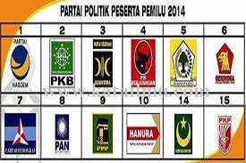
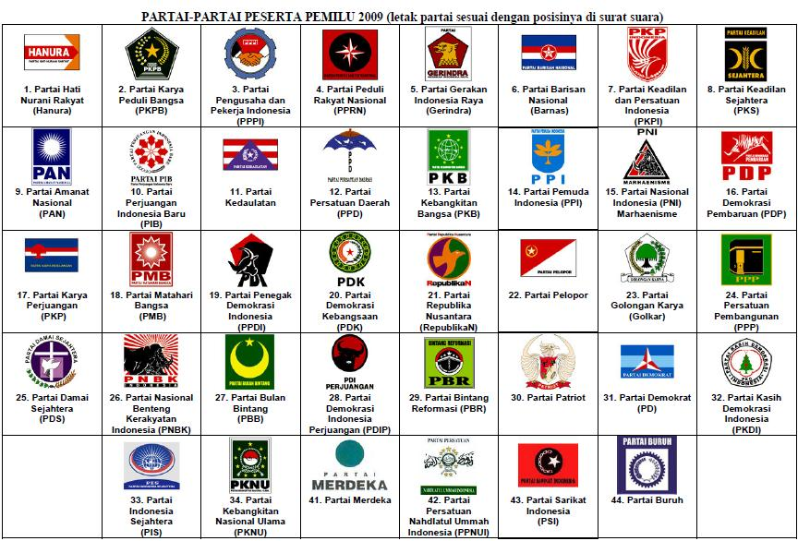
POLITICAL PARTIES IN INDONESIA
Year 2009
44 POLITICAL PARTIES
Year 2014
15 POLITICAL PARTIES
YEAR 2004
24 POLITICAL PARTIES

Slide 16
COMPARATION
 | ELECTION 2004 | ELECTION 2009 | ELECTION 2014
Political Parties | 24 | 44 (38 National + 6 Local) | 15 (12 National + 3 Local)
Voters | 148.000.368 | 171.265.442 | 187.847.512
Turn Out | 84.07% | 71% | 75,11%
Poling Places (TPS) | 581.393 | 519.920 | 545.778

Slide 17
Indonesia’s Electoral Management Bodies
Unlike other countries, Indonesia has 3 (three) EMBs with different functions:
THE GENERAL ELECTION COMMISSION (KPU)
KPU is electoral management body that is responsible for conducting elections
THE ELECTION SUPERVISORY BOARD (BAWASLU)
Bawaslu is electoral management body that is responsible for supervising electoral conduct and the first gateway and adjudicator of electoral disputes
THE HONORARY COUNCIL OF ELECTION MANAGEMENT BODIES / THE EMB ETHICS COUNCIL (DKPP)
DKPP is electoral management body that is responsible for resolving allegations of ethical violations conducted by either KPU or Bawaslu

Slide 18
Indonesia’s Electoral Management Bodies
General Election Commission (KPU)
Independent election management body responsible to conduct national and regional elections
President inaugurated 7 selected KPU commissioners for 5-year term of service
The KPU secretariat at national and regional level
The KPU civil servant staff: approximately 13,865 staff and 2,659 Commissioners in 531 offices across Indonesia

Slide 19
Indonesia’s Electoral Management Bodies
Election Oversight Body (Bawaslu)
In charge of overseeing that an electoral complaint is directed to the appropriate body and resolved correctly:
Criminal -> police
Administrative -> KPU
5 Commissioners elected for 5-year term
Power provided to Bawaslu by Law 8/2012
Provisions in Law 15/2011 establishes the Bawaslu and the KPU as equal and separate institutions
Bawaslu secretariat at national and regional level
A type of oversight body that is unique to Indonesia

Slide 20
Indonesia’s Electoral Management Bodies
Honorary Council of Election Management Bodies (DKPP)
National-level ethics council to review and decide upon reports of alleged violations of the code of ethics committed by members of the KPU and Bawaslu
Established within two months after the inauguration of KPU and Bawaslu commissioners
7 members: 1 from KPU, 1 from Bawaslu, and 5 community leaders; 5-year term
Unique to Indonesia, has powers to recommend commissioners’ dismissal. Its rulings are final and binding

Slide 21
General Election Commission Hierarchy
KPU RI
Commissioner : 7 person
Term of office: 5 (five) years
PROVINCIAL KPU
Commissioner : 5 (each Province)
REGENCY/ MUNICIPAL KPU
Commissioner : 5 (each Regency/Municipality)
SUB-DISTRICT ELECTION COMMITTEE
( PPK )
Number of members in each PPK : 5
Ad hoc body
(6 months before election day until 2 months after election day)
VOTING COMMITTEE
(PPS)
Number of members in each PPS : 3
Ad hoc
POLLING STATION OFFICERS
(KPPS)
Number of members in each KPPS : 7

Slide 22
OVERSEAS AD-HOC ELECTION COMMITTEES UNDER KPU
OVERSEAS ELECTION COMMITTEE
(PPLN)
Total Number of Committees: 130
Total Number of Officers: 650 (5 each)
Total Number of Secretariat Workers: 390
OVERSEAS POLLING STATION OFFICER
(KPPSLN)
KPPSLN: 7 each x 498 = 3,486 officers
OVERSEAS VOTER DATA UPDATE OFFICER
(Pantarlih LN)
PANTARLIH LN: 1 each
Total number of officer 130 PPLN =
873 officers (2013)
A PPLN reports directly to the national KPU

Slide 23
Scop Program of Voter Education
Non-Electoral Period → Civic Education
Electoral Period
→ Voter Education

Slide 24
GOALS OF VOTER EDUCATION
Increased Participation
Increasing Literacy Politics
Increased Volunteer

Slide 25
Group target
Cluster I: General
Young Voters
Cluster II: Contextual
Regional voter turnout low
Regional potential conflict of election violation
Conflict region
Religion
Disability and Marginal
Women

Slide 26
MATERIAL of VOTER EDUCATION
Intituional
Election
Politic Participant
Other Relevant Materials
Democracy

Slide 27
Role of Communication and Technology for Voter Education
Role of ICT implementation in election:
Increase administrative efficiency
Reduce long-term costs
Enhance political transparency
Ensure citizen’s rights of Public Information
Encourage public participation in decision process
Increase citizen role and participation in the electoral process

Slide 28
Role of Communication and Technology for Voter Education
ICT solutions used by the KPU:
SIDALIH (Voter Registration Information System)
Largest national voter database in the world
SITAP (Election Stage Information System)
Collects data from all stages of election
SILON (Candidacy Information System)
SITUNG (Vote Counting Recapitulation Information System)
Collect scanned image of election result from polling station
Tabulate polling station results into preliminary result
Encourage public crowdsourcing initiative to tabulate election results based from scanned image displayed in KPU website: kawalpemilu.org and kawalpilkada.org

Slide 29
Voter Education in Curricula & Extra Curricula
Building electoral organizer capacity
Strategy to encourage Public Participation: ensure KPU’s policy and practices are sensitive to voter participation
Professionalism is key to successful election, obtained through:
Building Resources in Democracy, Governance and Elections (BRIDGE) trainings
Technical Guidance
Providing scholarship for Master’s Degree on Electoral Management Study Program (in cooperation with 9 state universities)
Giving “KPU Award” for excellent local KPUs

Slide 30
Inclusive Electoral Education Through Informal Education Channel
Educate a broad range of stakeholders and “special” groups of voter about the importance of being a voter
Women voters
First-time voters: “KPU Goes to Campus”
Voters with disability:
Braille template ballot paper
Technical guidance for accessible polling station for voters with disability
Voter education for people with disability
Potentially marginalized voters

Slide 31
Inclusive Electoral Education Through Informal Education Channel
Synergy with Civil Society Organization (CSO)
Establishment of Voter Education Media Center (VEMC) in collaboration with national CSOs
Improved information on election processes and engaged the public more directly in voter outreach
Distributed KPU materials; hosted interactive public discussions; and supported multi-media voter education campaigns
Consolidated guidance and lessons products learned from the 2014 elections

Slide 32
ACCESSIBLE ELECTION FOR VOTER WITH DISSABILITIES
KPU has committed to condut accessible election for voter with dissabilities.
As an institution that have authorities on conducting the election, KPU makes efforts to protect and fullfilled citizen with dissabilty rights on politics, by :
Issuing Regulation which inclusively giving affirmative action for voter with dissability
Cooperate with other institution and stakeholders concern on dissability

Slide 33
KPU giving affirmative action to voter with dissability in all Electoral Stages
1. REGULATION DRAFTING PROCESS STAGE
KPU working with all stakeholder to collect aspirations and recommendations regarding how to make an accessible elections for voters with disabilities
KPU have a MoU with PPUA Penca to provide a better accessible elections.
KPU already increasing cooperation with disability organization in formulating KPU regulation relating to disabled voters
Example of KPU regulation for accessible election
one of Election Socialization target is voter with dissabilities
(Regulation of KPU Number 5 Year 2015 on Socialization and Citizen Participation)
Polling Station has to be accessible for voter with dissabilities
(Regulation of KPU Number 6 Year 2015 on Norms, Standard, Procedure, Procurement and Distribution of Election Logistic)
KPU giving access to citizen with dissabilities on public debate for President candidate
(Regulation of KPU Number 7 Year 2015 on Campaign)
Physical and spiritual requirements can not detered citizen with dissabilities on any candidacy (Regulation of KPU Number 9 year 2015 on Candidacy)

Slide 34
2. Voter Registry Stage
The fixed voter list should include all eligible Indonesian citizens without exception.
The KPU Regulation about voter registry mentions that the voter information must include the information about the type of disability a voter has.
Information about the type of voters’ disabilities is very important to provide proper service during polling.
Number of Voter with Dissability
Number of Voters with physical impairment
Number of Voters with vision impairment
Number of Voters with hearing impairment
Number of Voters with mental disability
Others
number of polling stations
number of voters
number of first-time voters

Slide 35
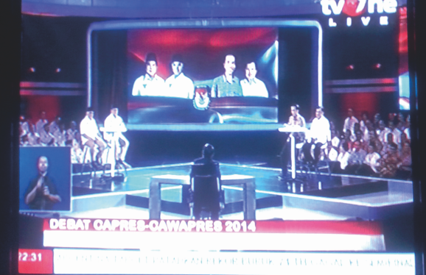
3. SOSIALIZATION STAGE
Voters with disabilities are one of KPU’s main priorities for targeted voter education, besides first-time voters and female voters.
Electoral information dissemination was provided through the mass media and KPU’s website.
KPU has a module and socialization and voter education materials especially for disabled voters.
KPU has a spesific budget to educate voters with disabilites (brosure, leaflet and other education materials)
KPU collaborate with TV Station in broadcasting President and Vice President debate, where in the debate there is also sign-language interpreter
Sign-language interpreter

Slide 36
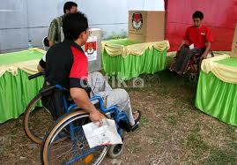
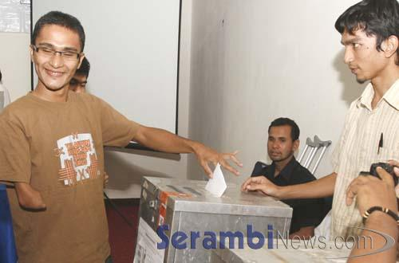
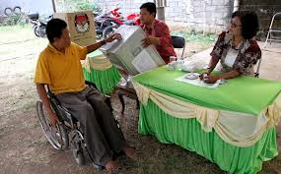
3. VOTING STAGE
KPU Regulation explain things as follows :
In a notice to vote at the polling stations should be mentioned the ease for people with disabilities in voting at the polling stations.
Table / board of voting booth and for marking the ballot, and table with empty space beneath it for people with disabilities using wheelchairs.
The entrance and exit polling at least 90cm sized in order to ensure access for people with disabilities motion using a wheelchair.
Location of polling stations should be easily accessible, in a flat place that is not rocky, not hilly, not thick grassy, not jump over ditches and exhibits the stairs

Slide 37
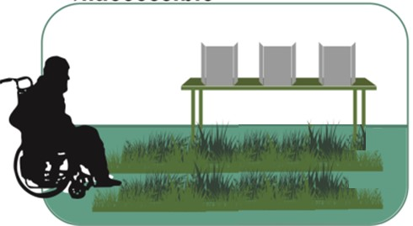
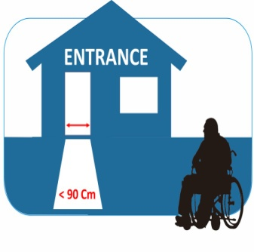
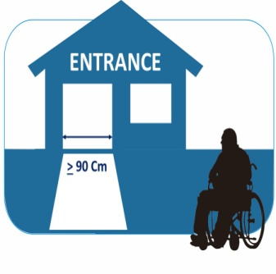
MONITORING FINDINGS
Inaccessible
Accessible
PATHWAYS
30%
70%
Accessible pathway to the polling stations for persons with disabilities
Inaccessible
Accessible
LOCATION
Accessible
32%
68%
Locations must be accessible by wheelchair user and the elderly
Inaccessible
Accessible
ENTRANCE
16%
84%
Entrance should be at least 90 cm in with in order to guarantee access for wheelchair user
Accessible Polling Station

Slide 38
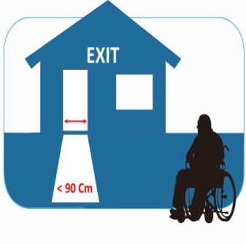
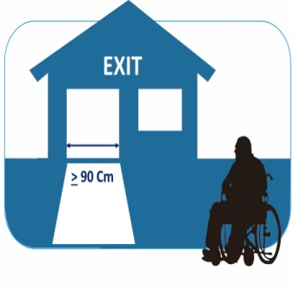
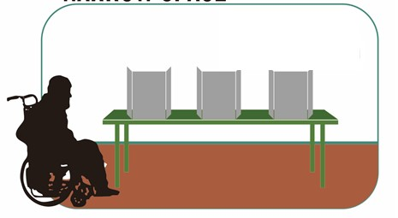
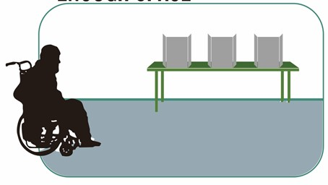
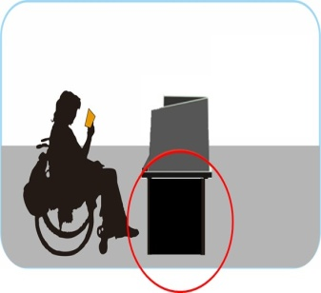
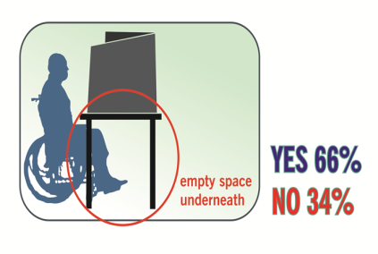
MONITORING FINDINGS
Inaccessible
Accessible
EXIT
19%
81%
Exit should be at least 90 cm in with in order to guarantee access for wheelchair user
Inaccessible
Accessible
SPACE
38%
62%
Narrow Space
Space to maneuver inside the polling station
Enough Space
Inaccessible
Accessible
BOOTH
Solid space
underneath
34%
66%
Voting booth table with an empty space underneath for easy access for wheelchair user
Accessible Polling Station

Slide 39
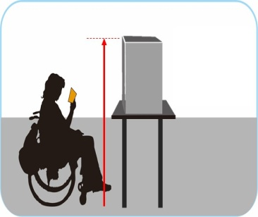
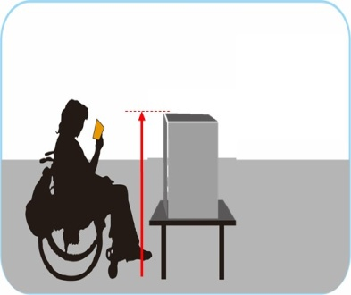
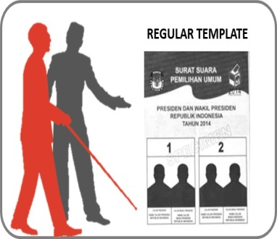
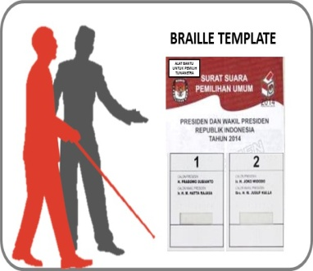
MONITORING FINDINGS
Inaccessible
Accessible
BALLOT BOX
34%
66%
Ballot box table with sufficient height for easy access for wheelchair user
Inaccessible
Accessible
BRAILLE TEMPLATE
35%
65%
Availability of braille template at polling stations
Accessible Polling Station

Slide 40
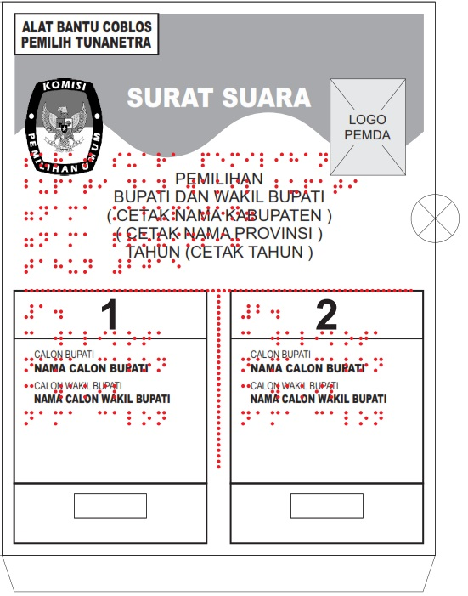
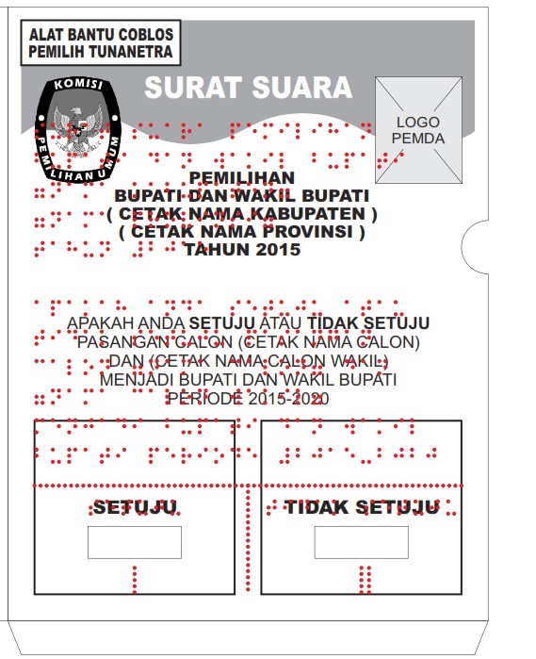
BRAILLE TEMPLATE FOR BALLOT PAPER
KPU designed and produced electoral information dissemination materials in Braille format for voters with vision impairment

Slide 41
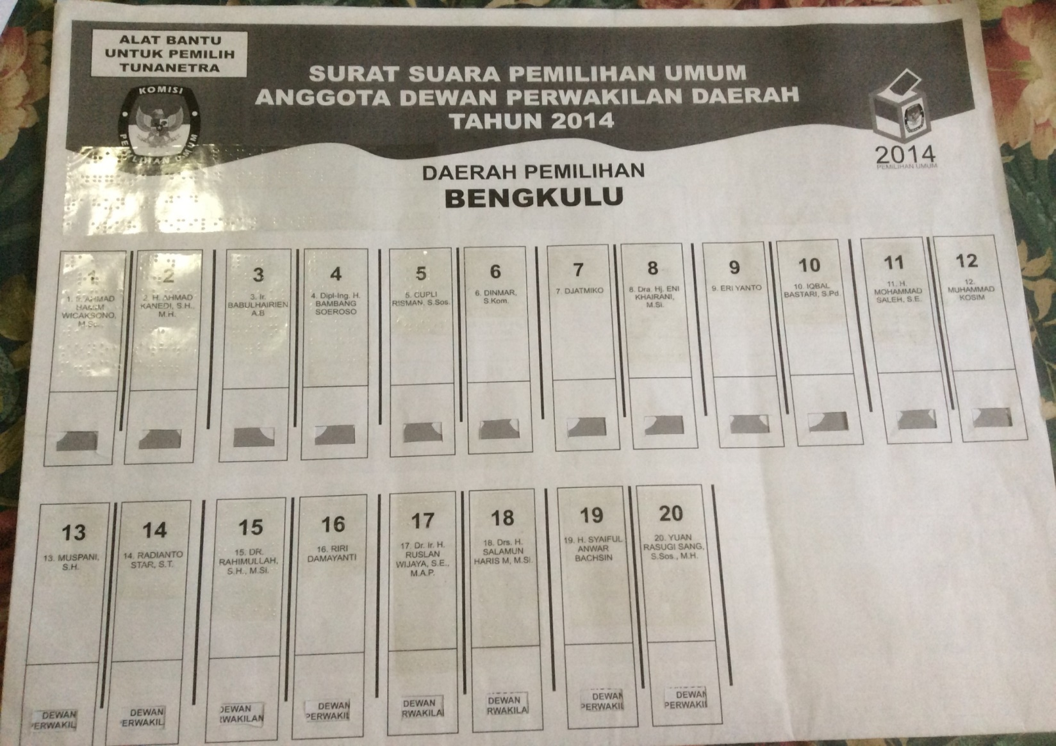
BRAILLE TEMPLETE LEGISLATIVE ELECTIONS

Slide 42
COOPERATION WITH INSTITUTION CONCERN TO DISSABILITY
National Commission of Human Rights (KOMNAS HAM)
During the election, KOMNAS HAM reporting issues on human rights violation on election. KPU following up the issues for ensuring political rights for citizen with dissabilities.
AGENDA
The General Election Network for Disability Access (AGENDA) was established in 2011 as a forum to improve access to political and electoral opportunities for persons with dissabilities in Southeast Asia.
It developed a training module and the EMB self-assessments to help EMBs prepare for the conduct of accessible elections to increase awareness.
Center for Election Access of Citizens with Disabilities (PPUA-PENCA)
KPU worked with PPUA-PENCA to create political education for people with disabilities and consult them on electoral procedures to ensure the election is more accessible for everyone.
KPU also work together with PPUA PENCA on designing braille template for ballot paper.
Forum for Integration and Advocacy for Citizens with Dissabilities (SIGAB)
KPU worked with CSO concern on dissabiltiy for holding socialization and voting simulation for dissabilities in some regions.
The People’s Voter Education Network (JPPR)
JPPR is one of the Indonesian accreditated observer. JPPR submitted election observation reports which include results and recomendation for improvements.
One of the recomendation is making sure the polling station accessible for the voters with dissabilities.

Slide 43
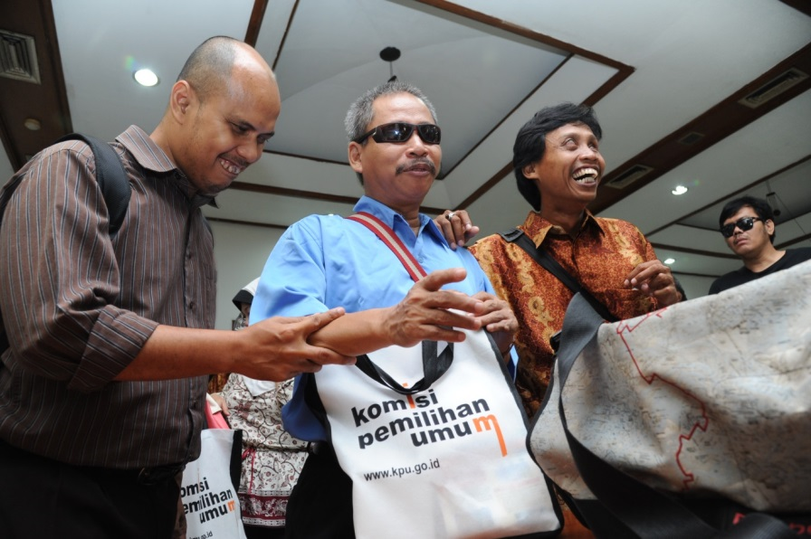
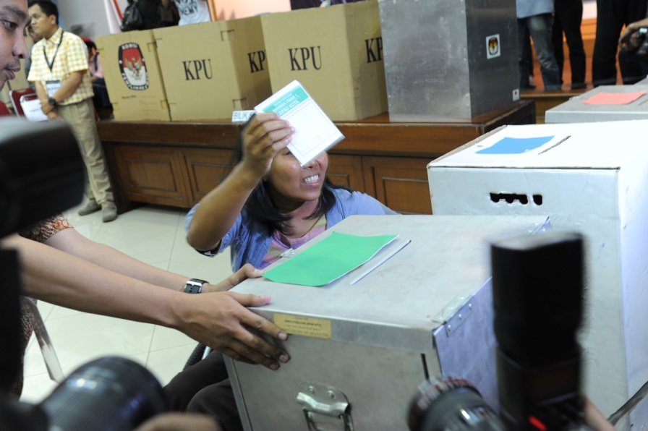
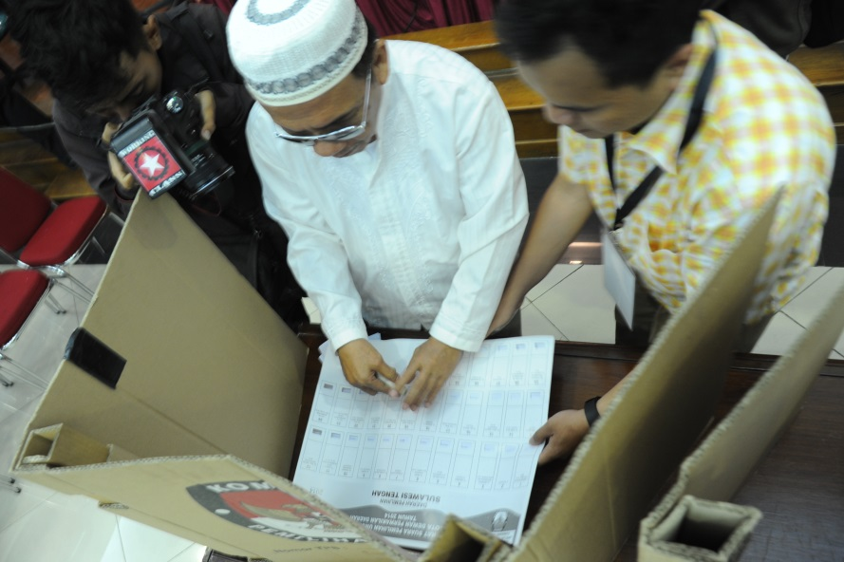
Disabilities Participants in Implementing of Simulation Ballot, in the main Coutroom of KPU, 4 April 2014

Slide 44
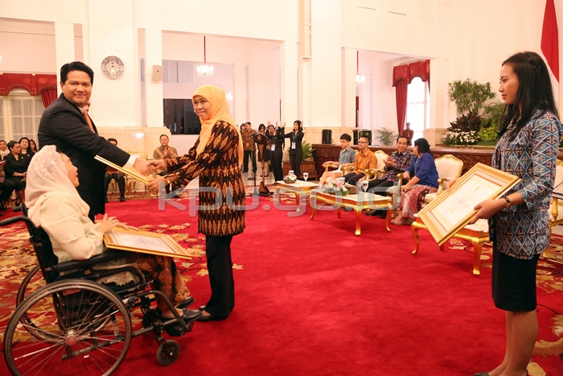
AWARD
KPU GETS AWARD FROM THE GOVERNMENT OF REPUBLIK INDONESIA FOR ITS EFFORT TO PROTECT AND FULFILLED POLITICAL RIGHTS FOR CITIZEN WITH DISSABILITIES

