Slide 1
The U.S. Election Assistance Commission
The Honorable Thomas Hicks, Chairman

Slide 2
EAC’s Chartering Legislation - Help America Vote Act (HAVA)
HAVA enacted by the United States Congress to make sweeping reforms to the nation's voting process.
HAVA addresses improvements to voting systems and voter access that were identified following the contested 2000 presidential election.
HAVA creates new mandatory minimum standards for states to follow in several key areas of election administration.
HAVA Provides Funding to Help States
Meet The New Standards
Replace Voting Systems
Improve Election Administration
havainfo@eac.gov

Slide 3
U.S. Election Assistance Commission (EAC)
Established by the Help America Vote Act (HAVA)
Signed into law by President George W. Bush, Oct. 29, 2002
EAC opened its doors on April 5, 2004
Independent, Bipartisan Commission
Consists of Four commissioners
Two commissioners from each political party
Presidential appointees that are approved by the senate
First four commissioners sworn into office on Dec. 13, 2003
3
havainfo@eac.gov

Slide 4
U.S. Election Assistance Commission
Leadership
Nominated by the President and Confirmed by the U.S. Senate
Current Commissioners sworn into office Jan 13, 2015
Thomas Hicks, Chairman - thicks@eac.gov
Matthew Masterson, Vice-Chairman - mmasterson@eac.gov
Christy McCormick - cmccormick@eac.gov
4
havainfo@eac.gov

Slide 5
EAC College Programs
$3.177 Million Well Spent
EAC was created with a mandate to
Educate college students on elections and
Encourage college students to work in election administration
Grant Based Program
Colleges Applied for funds to build their own programs and EAC supplied funding for certain, selected programs
89 Grants were awarded
havainfo@eac.gov

Slide 6
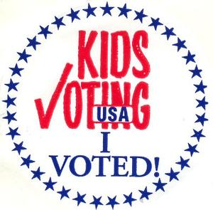
EAC College Program - 2010 Grantees

Slide 7
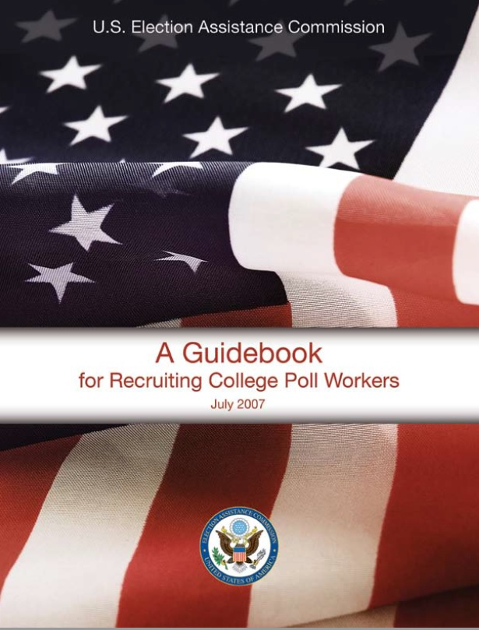
EAC College Program
Young poll workers are instrumental to the United States Election administration process

Slide 8
Help America Vote Mock Election Program
Allowed students to become familiar with voting processes and technologies.
Once eligible to vote they will be more comfortable with their civic duties.
300,000 in grant funds for the first year.

Slide 9
Mock Election Program Recipients
Secretary of State of the Commonwealth of Kentucky; Franklin, KY
Polk County Auditor’s Office; Des Moines, IA
Washington Secretary of State; Olympia, WA
Montana Secretary of State; Helena, MT
League of Women Voters of Oregon Education Fund; Salem, OR
Rhode Island and Providence Plantations; Providence, RI
Michigan Government Television; Lansing, MI
Seminole County Supervisor of Elections; Sanford, FL

Slide 10
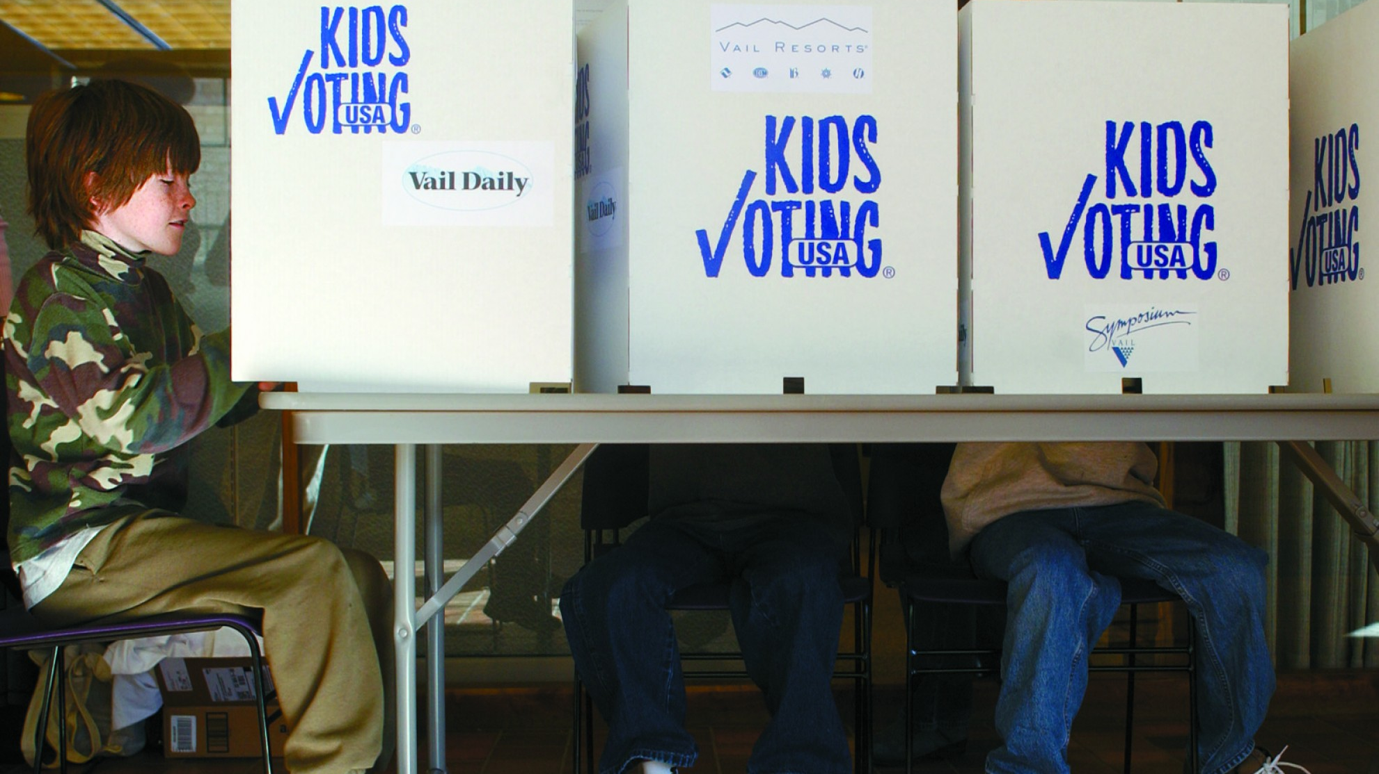
Kids Voting USA
A nonpartisan, grassroots-driven voter education program committed to creating lifelong voting habits in children, increasing family communication about citizenship, and encouraging greater adult voter turnout.
- EAC 2010 Grantee - Involves Students and Families
- research and implement

Slide 11
Empower youth to become ethical leaders and responsible citizens

Slide 12
Promote an enlightened and responsible citizenry committed to democratic principles and actively engaged in the practice of democracy in the United States and other Countries
- Produces curricular materials - national network of state and congressional coordinators

Slide 13
The Future of Our Electoral System is in our Schools

Slide 14
Questions?

Slide 15
Social Media
@EACgov
@Redandblue2024
Facebook.com/eacgov1
BeReady@eac.gov
listen@eac.gov
YouTube Channel:
Election Assistance Commission
www.eac.gov
havainfo@eac.gov

Slide 16
Contact Us:
Thomas Hicks
Chairman
Phone: (301)563-3971
Email: Thicks@eac.gov
U.S. Election Assistance Commission
Phone: 1-877-747-1471
Email: havainfo@eac.gov

