Slide 1
The ways and means to impart electoral literacy,
Through
Curricula and extra Curricula in educational institutes of Sri Lanka.

Slide 2
Content
Introduction
Types of Educational Institutes in SL
Electoral literacy in curricula
Electoral literacy in Co- curricula
Challenges

Slide 3
Introduction
Sri Lanka is divided in to 9 provinces and 25 District for the Administrative purposes.
The total population of the county is 21.9 Million by 2015.
Population ,below 25 years of the age is 8.5 Million
The total number of the voters in 2015 is
15.4 Million.

Slide 4
Introduction
Election management body and other related agencies of a country is responsible for nurturing a democratic nation with a political literate and empowered citizenry that cherishes democratic values and promotes good governance.

Slide 5
Introduction
The competence required to adjust for different activities of the society as a future citizen should be given by and large through education.
School children and youths in higher educational institutes must be provided with opportunities to gain the required competencies to acquire the core values of the society where they are living.

Slide 6
Level of Educational Institutes in Sri Lanka
Primary education lasts five to six years
(Grades 1-5).
Junior secondary level lasts for 4 years
(Grades 6-9)
Senior secondary level (Grades 10-11) which is the preparation for the General Certificate of Education (G.C.E)
Collegiate level to study for another 2 years (grades 12-13) to sit for the G.C.E Advanced Level.
Tertiary education is mainly done by the National Universities, Institutes designed for study on entrance/membership for professional bodies both foreign (such as CIMA, BCS, etc.) and local (such as SLIM, NSBM,NAITA) and vocational /technical colleges

Slide 7
Electoral literacy in curricula
Tertiary education is mainly done by the National Universities, autonomous degree awarding institutes, Institutes designed for study on entrance/membership for professional bodies both foreign (such as CIMA, BCS, ACCA, etc.) and local (such as SLIM) and vocational technical colleges that specialize in mechanical and electronic subjects.
Tertiary education is mainly done by the National Universities, autonomous degree awarding institutes, Institutes designed for study on entrance/membership for professional bodies both foreign (such as CIMA, BCS, ACCA, etc.) and local (such as SLIM) and vocational technical colleges that specialize in mechanical and electronic subjects.
Democracy is a social system and a way of life, it is also a system of Government.
The future generation is given the experiences of Democratic system of government, its practice and values.

Slide 8
Electoral literacy in curricula
Tertiary education is mainly done by the National Universities, autonomous degree awarding institutes, Institutes designed for study on entrance/membership for professional bodies both foreign (such as CIMA, BCS, ACCA, etc.) and local (such as SLIM) and vocational technical colleges that specialize in mechanical and electronic subjects.
Tertiary education is mainly done by the National Universities, autonomous degree awarding institutes, Institutes designed for study on entrance/membership for professional bodies both foreign (such as CIMA, BCS, ACCA, etc.) and local (such as SLIM) and vocational technical colleges that specialize in mechanical and electronic subjects.
A research study on Civic Education was conducted In Sri Lanka in 2003 to assess the status of democratic and civic competencies of students completing Grade 9 in the school system, to develop a comprehensive long-term program to promote democratic and pluralistic values through the school education system.

Slide 9
Electoral literacy in curricula
Tertiary education is mainly done by the National Universities, autonomous degree awarding institutes, Institutes designed for study on entrance/membership for professional bodies both foreign (such as CIMA, BCS, ACCA, etc.) and local (such as SLIM) and vocational technical colleges that specialize in mechanical and electronic subjects.
Tertiary education is mainly done by the National Universities, autonomous degree awarding institutes, Institutes designed for study on entrance/membership for professional bodies both foreign (such as CIMA, BCS, ACCA, etc.) and local (such as SLIM) and vocational technical colleges that specialize in mechanical and electronic subjects.
There were two main findings in that research study.
Teacher training is required for civic related curriculum
Schools are places where civic education ought to be taught and can be taught effectively and that civic education matters a great deal in facilitating students’ civic development.

Slide 10
Electoral literacy in curricula
Tertiary education is mainly done by the National Universities, autonomous degree awarding institutes, Institutes designed for study on entrance/membership for professional bodies both foreign (such as CIMA, BCS, ACCA, etc.) and local (such as SLIM) and vocational technical colleges that specialize in mechanical and electronic subjects.
Tertiary education is mainly done by the National Universities, autonomous degree awarding institutes, Institutes designed for study on entrance/membership for professional bodies both foreign (such as CIMA, BCS, ACCA, etc.) and local (such as SLIM) and vocational technical colleges that specialize in mechanical and electronic subjects.
Ministry of education and National Institute of Education have prepared and revising the materials and textbooks on civic education from Grade 9 onwards as an optional subject.

Slide 11
Electoral literacy in Co- curricula
For school students,
The Student Parliament program
It has been introduced by the authorities, in order to give students a practical experience of democracy, the values of the democratic government and representative democracy, its responsibility, accountability, exercising the vote and significance of exercising the vote , supremacy of the Law.

Slide 12
Electoral literacy in Co- curricula
For school students,
Educational camps on democracy
It is a concept of understanding of the principles of democracy and its practices while developing leadership skills in children both in government and non government sector schools focusing Democracy and Importance of the right to universal suffrage.
Arts, and essay competitions, debates, fun games / group activities and guest lectures, are being scheduled.

Slide 13
Electoral literacy in Co- curricula
For youths,
Youth vote Sri Lanka program
This is to ensure broader awareness among students in tertiary level educational institutes on democracy. Theme of this program is “An informed voter is a powerful voter.”
This program is mainly conducted as a one day formal work shop. During the sessions participants are exposed to topics like, Electoral process in Sri Lanka while touching the laws related to the elections. Democracy and Importance of the right to universal suffrage,

Slide 14
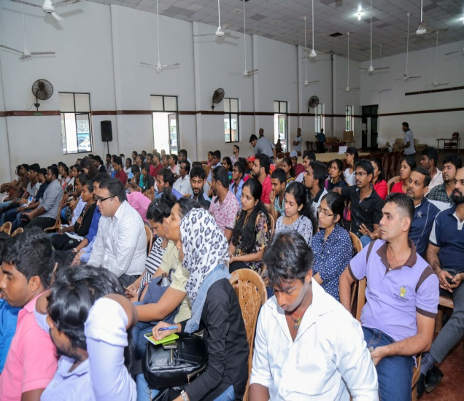
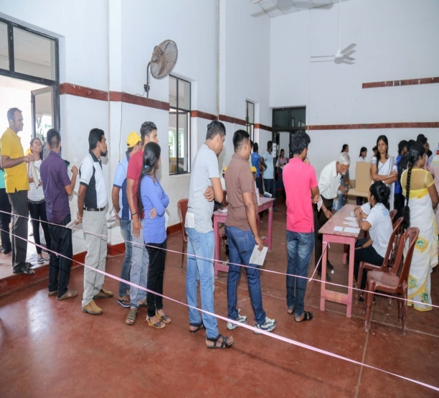
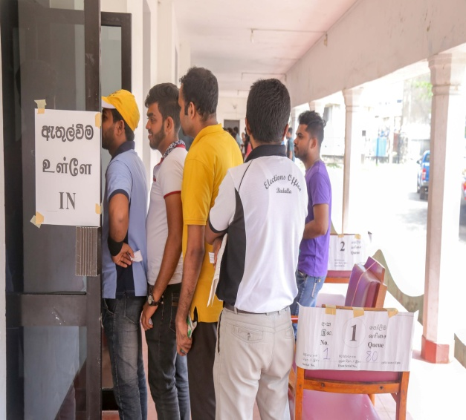
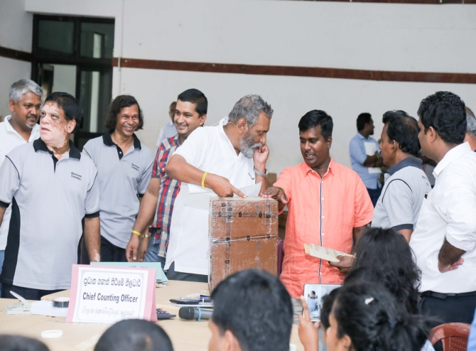
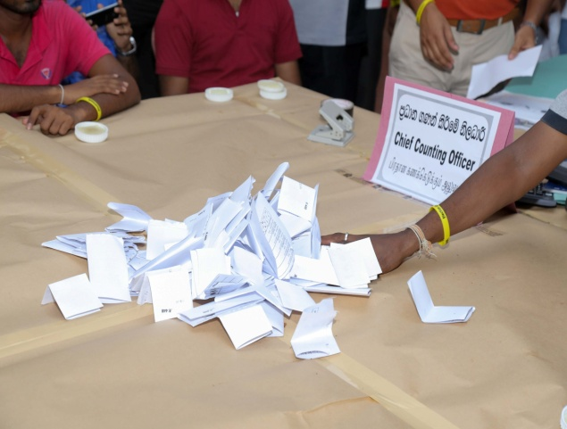

Slide 15
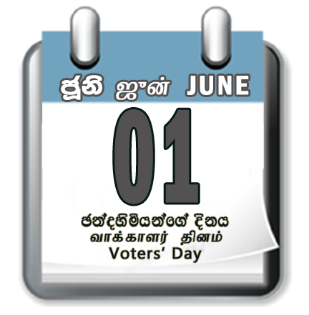
In order to educate the public on the importance of having their names registered in the electoral roll, Voters’ Day was celebrated island-wide on

Slide 16
Legal Basis of
Registration of Voters
Registration of Electors Act No. 44 of 1980
Registering Officer
Government Agent/ District Secretary
Enumerators
Grama Niladhari/ Village Headman

Slide 17
Eligibility to be a
voter in Sri Lanka
Must be a citizen of Sri Lanka.
Must have attained the age of 18 years on the qualifying date.
Must be an ordinary resident of the relevant address.
Must not have found or declared to be of unsound mind under any law in force.
Must not have been serving or not served imprisonment during the immediate presiding seven years.

Slide 18
Voter Registration
Collecting of Forms from Chief Occupants
Collecting of Forms @ Election Offices
A, B List Preparation, Checking
Double Processing
Displaying A, B List
Claims / Objections
Add / Remove Names
Displaying the Draft
Certifying the Register
Distribution of Enumeration Forms to Chief Occupants

Slide 19
E- Services

Slide 20
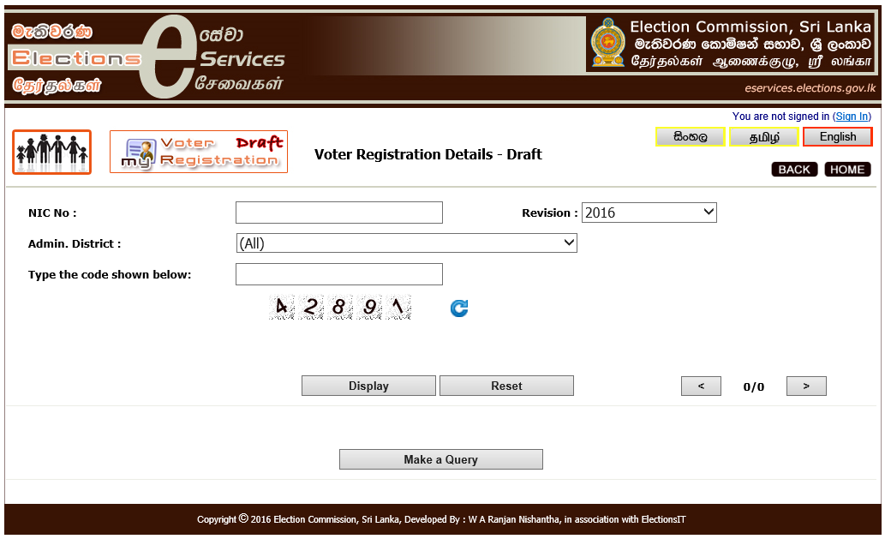

Slide 21
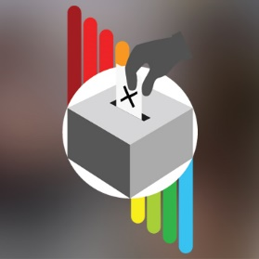
Social Media
Facebook - www.elections.gov.lk/facebook
Twitter - www.elections.gov.lk/twitter
blog- www.elections.gov.lk/blog
Web – www.elections.gov.lk

Slide 22
Face book,

Slide 23
Twitter,

Slide 24
Blog

Slide 25
Web Site

Slide 26
Outcome
2005
2010
2015
Presidential
Total Polled %
72.91
74.49
81.52
Rejection %
1.10
1.15
0.97

Slide 27
Challenges on electoral literacy in
formal education
There is a greater problem in accessing voter educational strategies.
No way to educate people who are dropped out from main educational stream.
Difficulties in addressing students with disabilities.
Problem pertaining in linkage of researches done, monitoring and evaluation with policy formulation.

Slide 28
Thank you !

