Slide 1
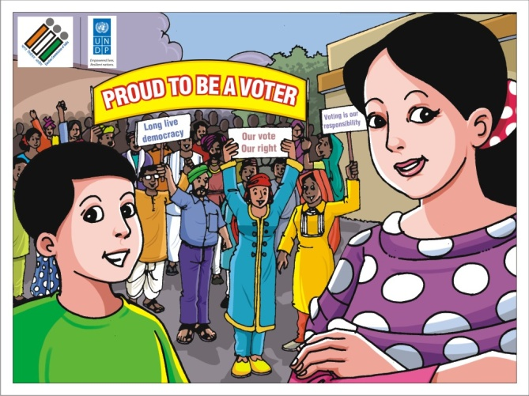
ELECTORAL LITERACY IN FORMAL EDUCATION: EDUCATION CURRICULA & EXTRA CURRICULA
Dr. Chandra Bhushan Kumar
Chief Electoral Officer, Delhi
ELECTION COMMISSION OF INDIA

Slide 2
INCLUSIVE
GETS REGISTERED AND PARTICIPATES
INFORMED
UNDERSTANDS THE VALUE OF ELECTIONS
ETHICAL
FREE FROM INDUCEMENTS

Slide 3
content
Electoral Literacy
and Multiple Forms in Schools
Formal Education:
curricula and extra-curricula
Challenges and Opportunities

Slide 4
Electoral Literacy in Schools: Multiple forms
Civic Education (most popular mode of imparting electoral literacy)
Social and Political Life (National Curriculum Framework, NCF, 2005 changed ‘civics’ to move away from colonial mindset and to promote diverse and liberal discourse)
Political Science (usually at higher education level, though a clear link with ‘social and political life’ is indicated in the NCF 2005)

Slide 5
Three dimensions of electoral literacy
knowledge
the facts and ideas of democracy, citizenship, the government, and global concerns that students need to know to be informed participants in civic life
skill
the ability to navigate the rules and processes of citizenship and governance in our society (critical engagement)
value
the democratic ideals and commitment to those ideals that motivate civic commitment (equality, liberty)

Slide 6
School education in india
Education in Concurrent List: Federal (Union) as well as Provinces (States) have the freedom to design the curricula.
Federal level, National Council of Educational Research and Training (NCERT) developes curricula of school education in consonance with the principles of National Curriculum Framework, 2005.
State Council of Educational Research and Training (SCERTs) and State Education Boards either adopt or adapt NCERT’s model syllabi and textbooks or develop their own syllabi and textbooks based on NCF.
18 Provinces use NCERT textbooks; Rest 18 have adapted to it.

Slide 7
Electoral Literacy targeted for School students (in ‘000)
Level | Girls | Boys | Total
Upper Primary (VI-VIII) | 32035 | 33746 | 65781
Secondary (IX-X) | 17477 | 19484 | 36961
Senior Secondary (XI-XII) | 10406 | 11747 | 22153
Total |  |  | 124895

Slide 8
Social and Political Life – I, II, III

Slide 9
Upper Primary Stage
Class VI Social and Political Life-I (2006)
Chapter 3 What is Government? (pp. 32-34)
Chapter 4 Key Elements of a Democratic Government (pp. 36-37)
Class VII Social and Political Life-II (2007)
Chapter 1 On Equality (pp. 4-6)
Chapter 3 How the State Government Works (pp. 30-41)
Class VIII Social and Political Life-III (2008)
Chapter 1 The Indian Constitution (pp. 12-13)
Chapter 3 Why Do We Need a Parliament? (pp. 30-41)

Slide 10
Democratic Politics–I and II

Slide 11
Secondary Stage
Class IX Democratic Politics-I (2006)
Chapter 1 Democracy in the Contemporary World (pp. 11-12)
Chapter 2 What is Democracy? Why Democracy? (pp. 24-39)
Chapter 3 Constitutional Design (pp. 44-51)
Chapter 4 Electoral Politics (pp. 56-76)
Class X Democratic Politics-II (2007)
Chapter 6 Political Parties (pp. 71-88)
Chapter 7 Outcomes of Democracy (p.90-92,95-96,98-99)
Chapter 8 Challenges to Democracy (p.106,108-111)

Slide 12
Senior Secondary Stage
Chapter 1: Constitution: Why and How? (pp. 4,12-16,18)
Chapter 3: Election and Representation (pp. 51-77)

Slide 14
Do you know when the last Assembly election was held in your state? Which other elections have taken place in your locality in the last five years? Write down the level of elections (National, Assembly, Panchayat, etc.), when were they held and the name and designation (MP, MLA, etc.) of the persons who got elected from your area. Why do we need elections?
Elections have become a part and parcel of our democratic life. No one can imagine a situation where a government would disrespect the verdict of an election. Similarly, no one can imagine that a government would be formed without holding elections. In fact, regularity and periodicity of elections has earned fame for India as a great democratic experiment.

Slide 15
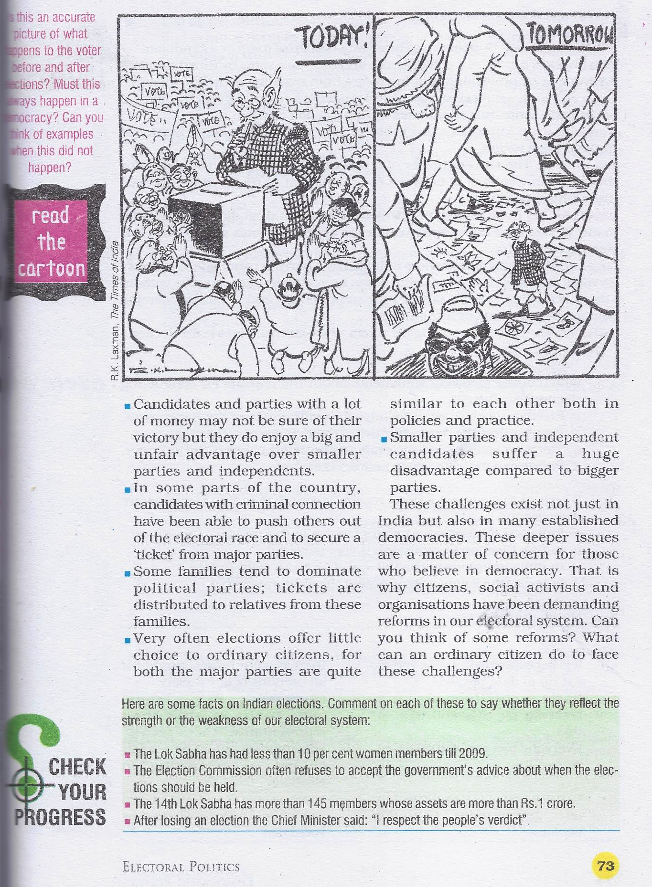

Slide 16
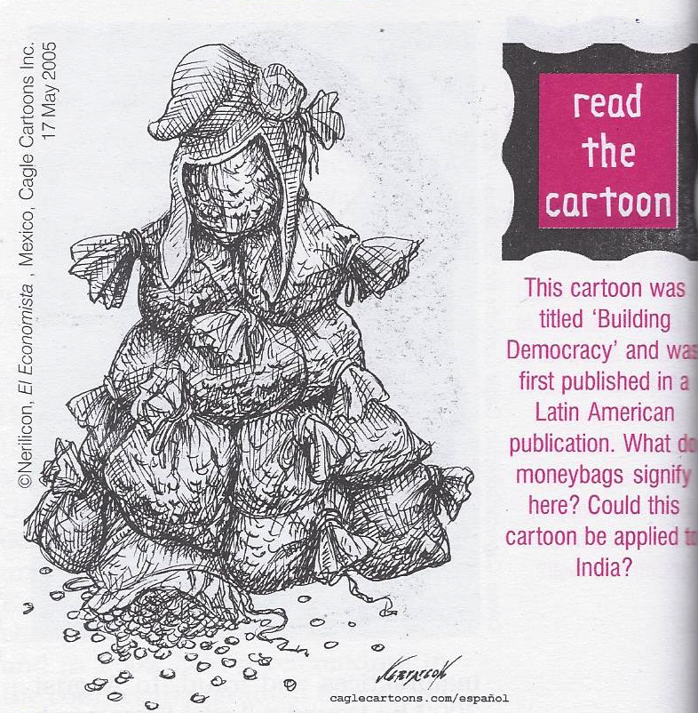

Slide 17
Textbooks for electoral literacy
The textbooks in these subject areas aim to promote education for democracy.
Various electoral issues are described and explained in a child-friendly manner with help of visuals to engage attention of students.
They provide ample scope for discussion and debate in the classroom, especially using the in-text questions, exercises and activities.
Moreover, the activities in the textbooks are aimed at making learners take greater interest in the electoral issues in their respective localities.
These issues also provide space for moving beyond the textbooks and connect with the real world.

Slide 18
ECI with Schools: SVEEP
Sankalp Patra
Edutainment
Concept of campus ambassadors
National Voters Day: 25 January and VOTER’s PLEDGE
Institutional linkages with education department

Slide 19
VOTER’s PLEDGE IN SCHOOLS
“We, the citizens of India, having abiding faith in democracy, hereby pledge to uphold the democratic traditions of our country and the dignity of free, fair and peaceful elections, and to vote in every election fearlessly and without being influenced by considerations of religion, race, caste, community, language or any inducement”

Slide 20
Campus Ambassador
Facilitating the voter registration by providing forms and guiding how to fill forms both manually and on-line and co-ordinating with the election machinery for approval of new applications, correction and distribution of voter cards to the campus electorate
Organizing special drive for registration i.e. correction of errors, transposition of names, voting process and ethical voting with the help of local Election office
Creating core team of students to work as volunteers for the SVEEP activities in the campus
Organizing talk/workshops etc. for capacity building in voter education among student community
Organising National Voters’ Day programme in their campus

Slide 21
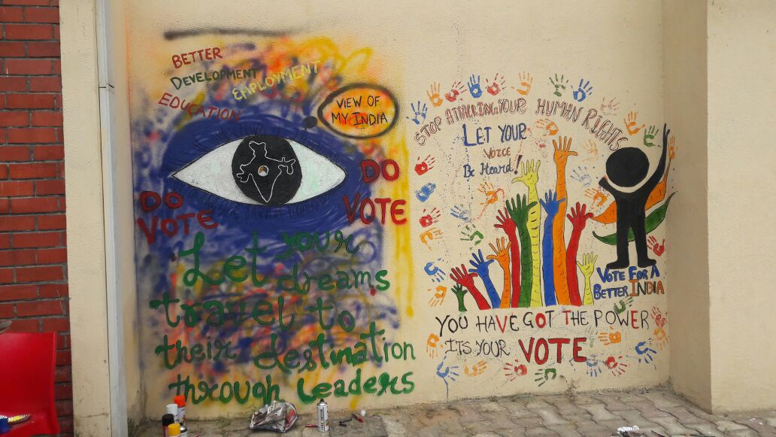

Slide 22
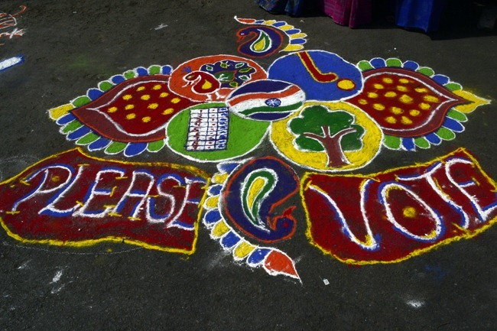

Slide 23
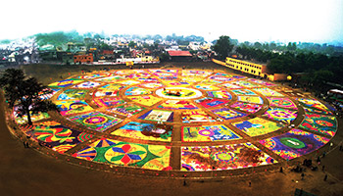
World’s Largest Rangoli in Uttar Pradesh: Created by more than 770 students
The largest rangoli, 190,000 sqft in area and a mammoth map of India using 240,000 candles were among the high visibility activities taken up in Bulandshahr to motivate people to vote in the elections

Slide 24
Edutainment for students

Slide 25
challenges
Understanding, embracing, and upholding the values of electoral democracy
Teacher’s education
opportunities
Developing scenario-based engagement
Concept of supplementary reading material
Curriculum engagement planned

Slide 26
Thanks a lot

