Slide 1
Civic Education and Youth Engagement in Canada Ms. Karine Morin Chief of Staff
Voter Education for Inclusive, Informed & Ethical Participation
New Delhi, India
October 2016
September 26, 2016

Slide 2
Civic Education and Youth Engagement in Canada
Presentation Overview
Mandate of Elections Canada
Youth Voter turnout
Teaching democracy
Recommendations to Parliament
Conclusion

Slide 3
Civic Education and Youth Engagement in Canada
Youth Voter Turnout

Slide 4
Civic Education and Youth Engagement in Canada
Teaching Democracy
Educators as civic influencers in the classroom
Hands-on civic education programs in the classroom
Increased political knowledge
Inculcation of voting as a learned habit
A higher likelihood of voting

Slide 5
Civic Education and Youth Engagement in Canada
Classroom Tools & Resources

Slide 6
Civic Education and Youth Engagement in Canada
Hands-on Program
Classroom Activities
School-wide event
Sense of Civic Duty
Evaluation

Slide 7
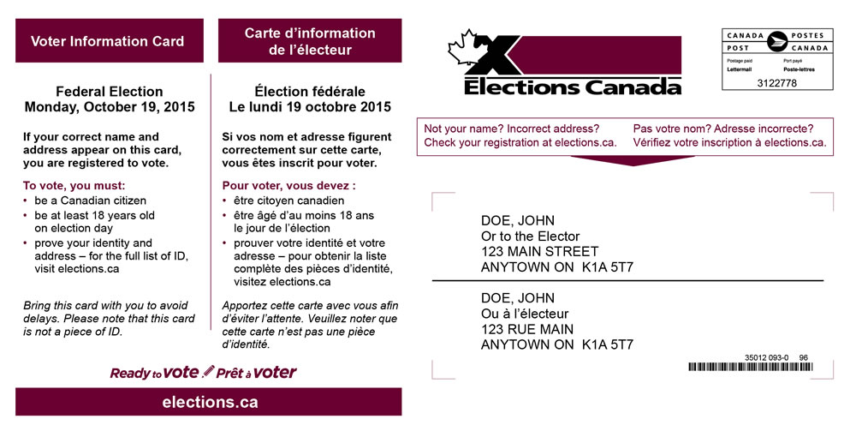
Civic Education and Youth Engagement in Canada
Three Key Recommendations to Parliament
Allow pre-registration of new, young electors.
Allow Voter Information Card as documentary evidence of address.
Allow young people to work as election workers.

Slide 8
Conclusion
Renewal of Civic Education Program
Questions?

