Slide 1
The Australian Electoral Commission

Slide 2
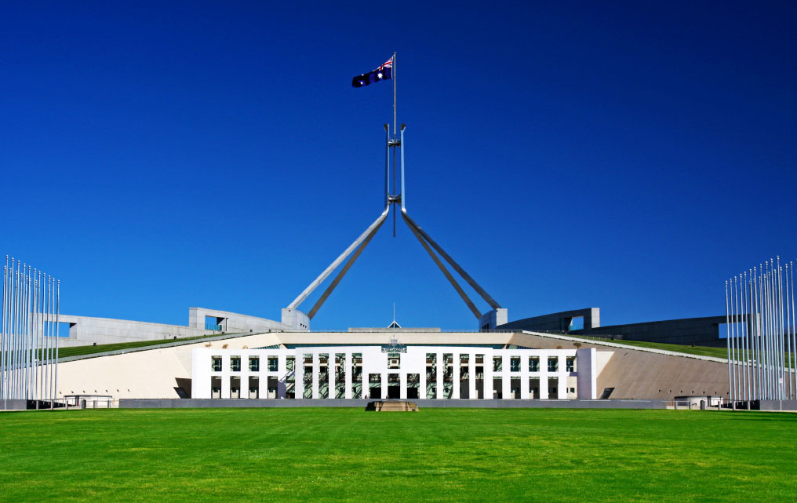
The Australian political system

Slide 3
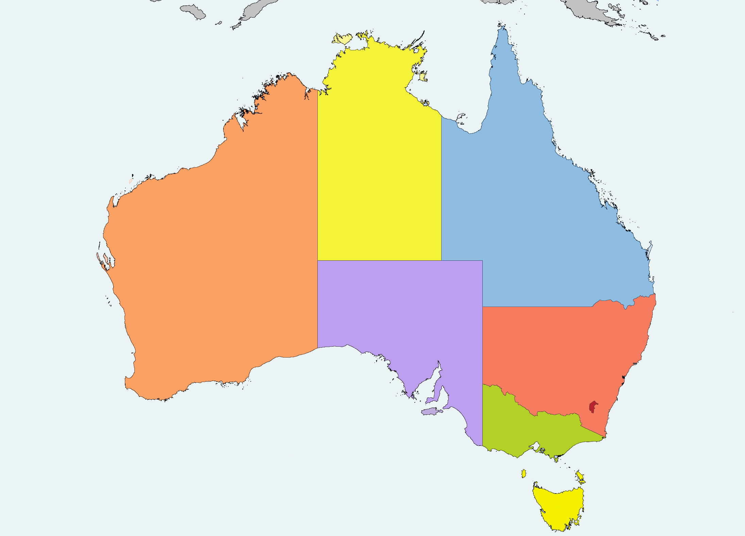
Electoral education in Australia
Notes:
This presentation is outline the activities of the AEC in educating young Australians about the voting system through their school years.
Usually the first question the AEC is asked about its education program is “Why bother working with schools if students are not old enough to vote?”
In practical terms, there are two key reasons:
The Australian Electoral Act mandates the AEC’s role to Inform and Educate. From the time the AEC was established as a Statutory Authority in 1984, this has been interpreted as including a role working with the education sector (schools) to electoral education for school students.
Audience demand: Schools approach the AEC looking for information and services. Electoral education is part or the school curriculum and teachers often need support in order to deliver this.

Slide 4
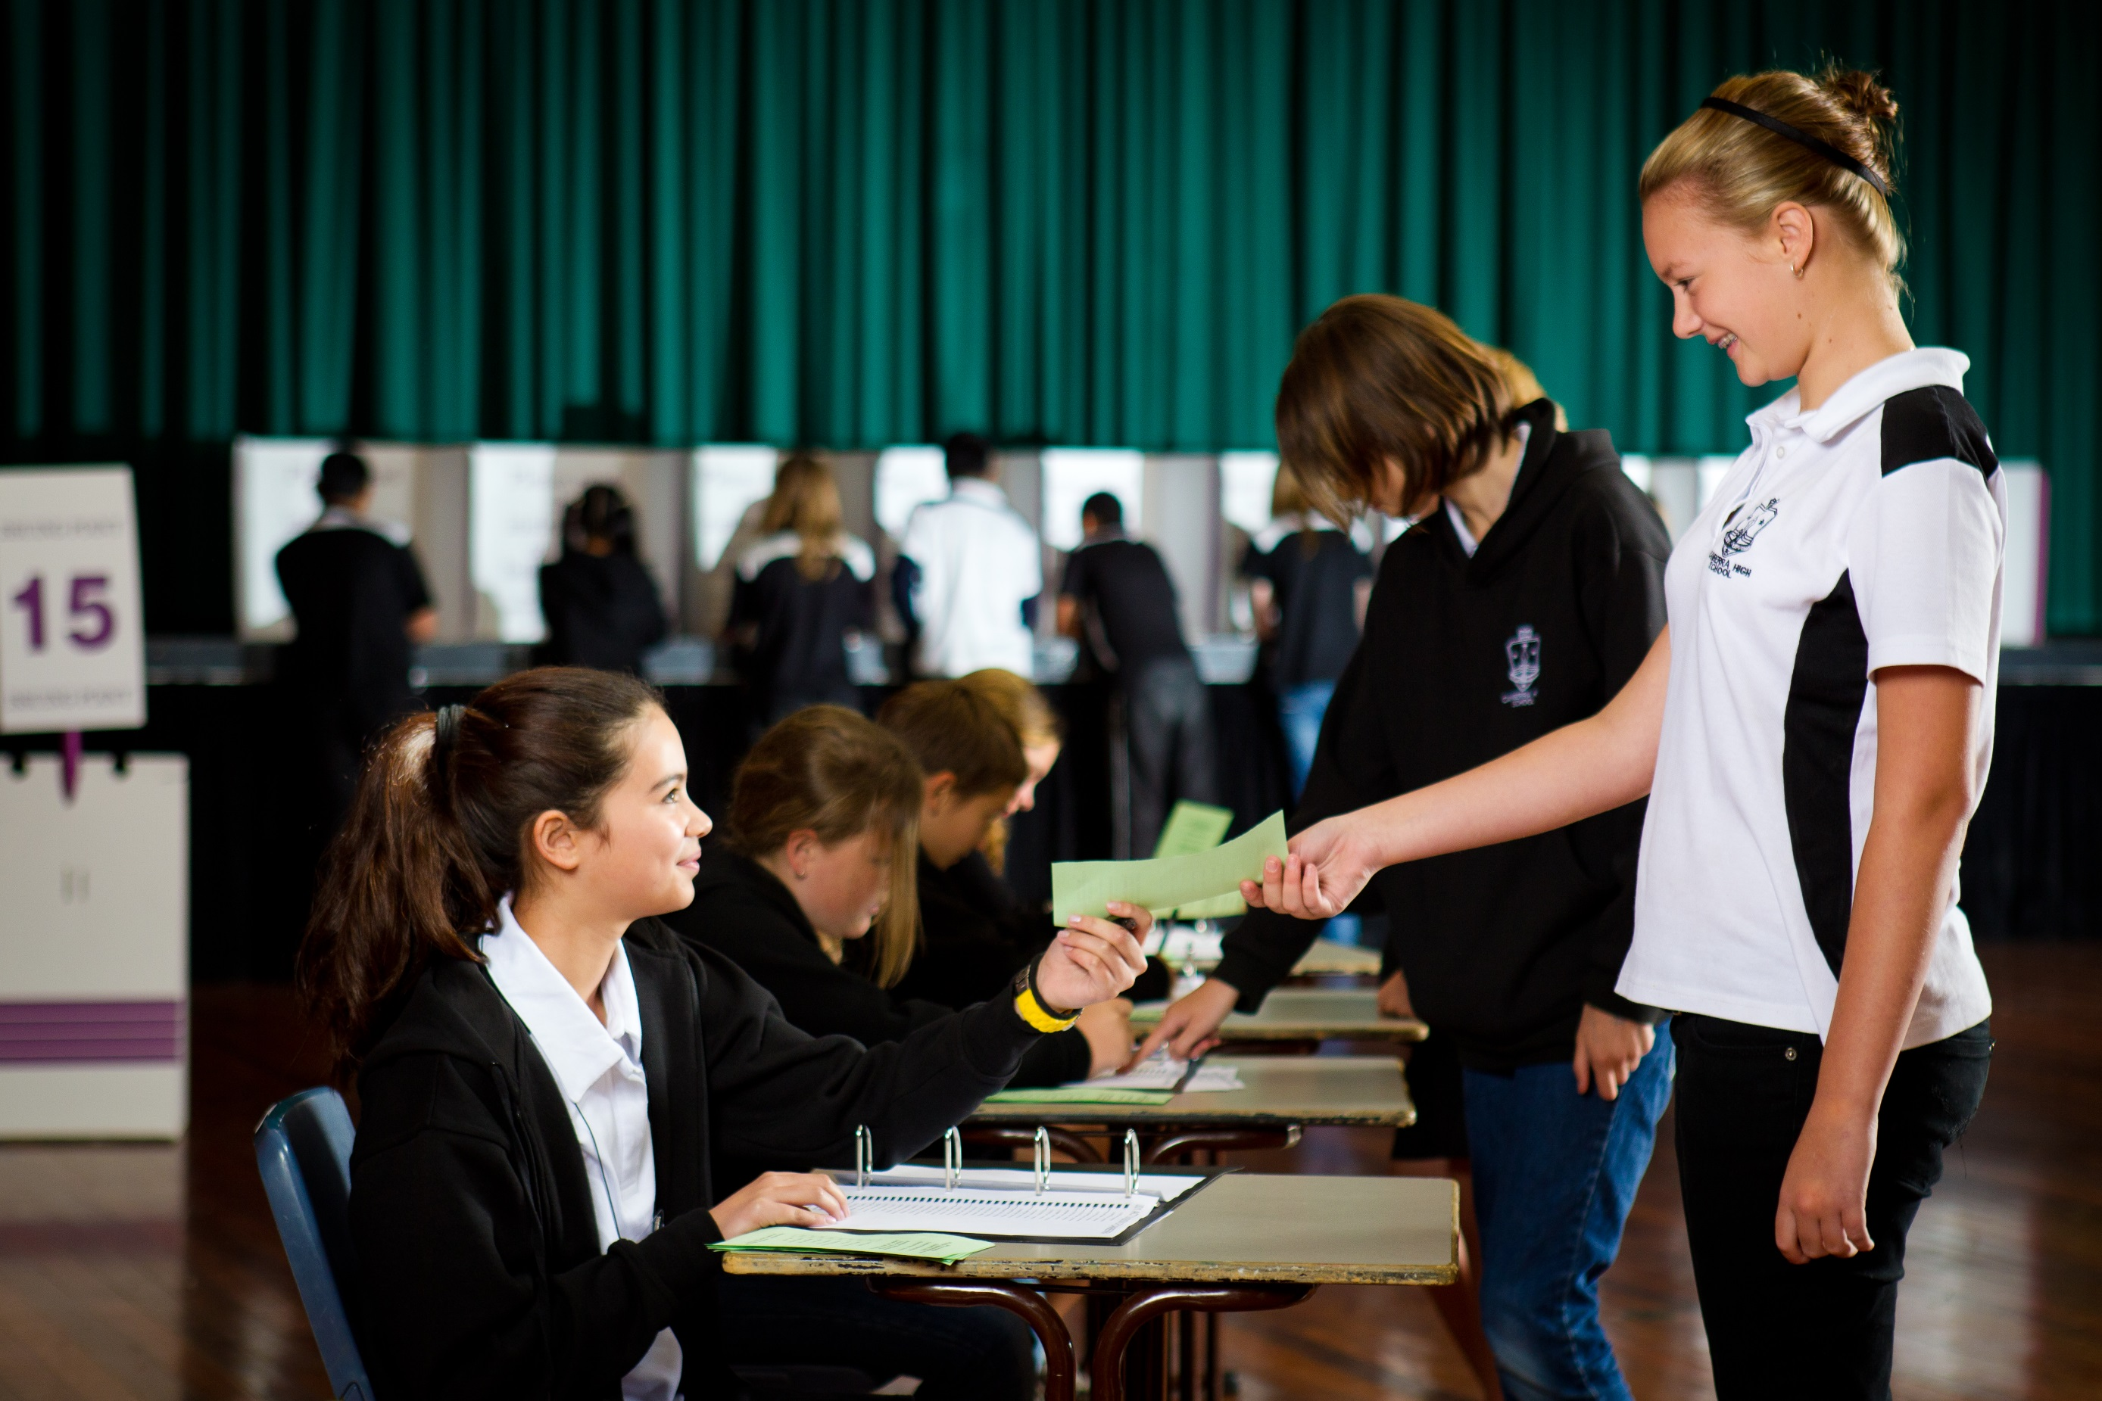
National Electoral Education Centre
Notes:
Approximately 100,000 school students visit Canberra each year.
PACER rebate supports a visit to the capital as part of the Civics and Citizenship curriculum.
The NEEC is one of Canberra’s key educational attractions, winning the 2015 ACT Education Tourism Award.
For many schools, a key part of Civics learning is a visit to Canberra, which is subsidised by a Government rebate program (PACER). The AEC operates an education centre (NEEC), which along with a visit to parliament House and the National War memorial, form key parts of a civics excursion.
Approximately 100,000 students travel to Canberra each year, primarily 11-12 years old. This provides the AEC with a ready made audience for its education centre. Visiting students take part in a 90 minute program exploring the history of democracy and voting. Students then take part in an election.

Slide 5
Notes:
Not all students visit Canberra, and even for those that do there is a need to reinforce the learning through repetition.
It is common for schools to hold elections for positions in student government and leadership roles.
The AEC’s Get Voting program uses school elections as a learning opportunity for students.
Get Voting is a website which provides instructions and resources for teachers so that they can conduct a school election using good electoral process, to teach students the value of free and fair elections. The website allows schools to create custom made ballot papers and to order ballot boxes and other material especially designed for schools. Last year approximately 50,000 students took part in a Get Voting Election.
There were 3,750,973 enrolled school age students Across Australia in 2015 : Source ABS, 2016

Slide 6
Professional learning workshops
Notes:
Accredited training for teachers
Delivers information and classroom strategies
Teachers are the gatekeepers for student learning. Providing them with the skills and knowledge they need to teacher students about voting helps the AEC to achieve its educational goals.
Teachers must complete 20 hour mandatory training each year
Civics is an area which many teachers lack confidence
The AEC runs workshops for teachers to train them in using AEC education materials in the classroom
This builds trust in the AEC as an education service provider
The AEC is accredited to provide PL in the ACT and NSW and is working on online delivery.

Slide 7
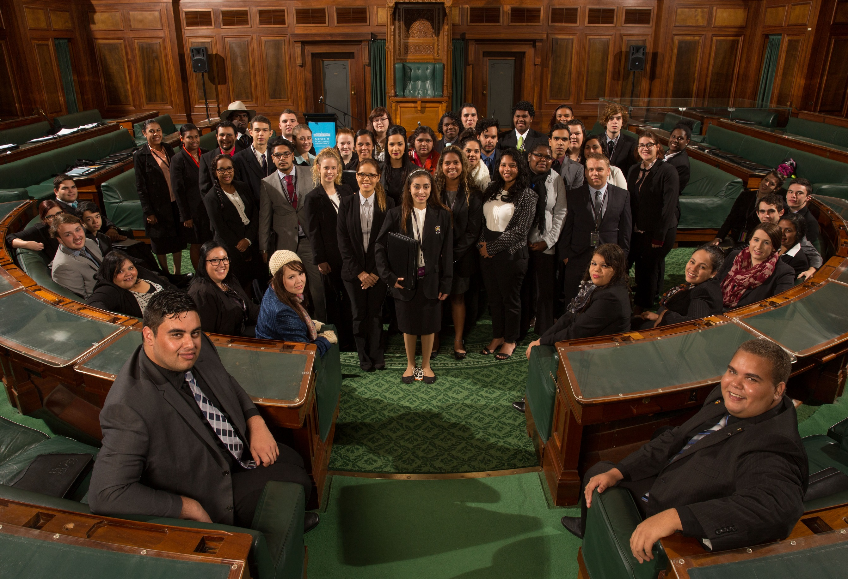
National Indigenous Youth Parliament

Slide 8
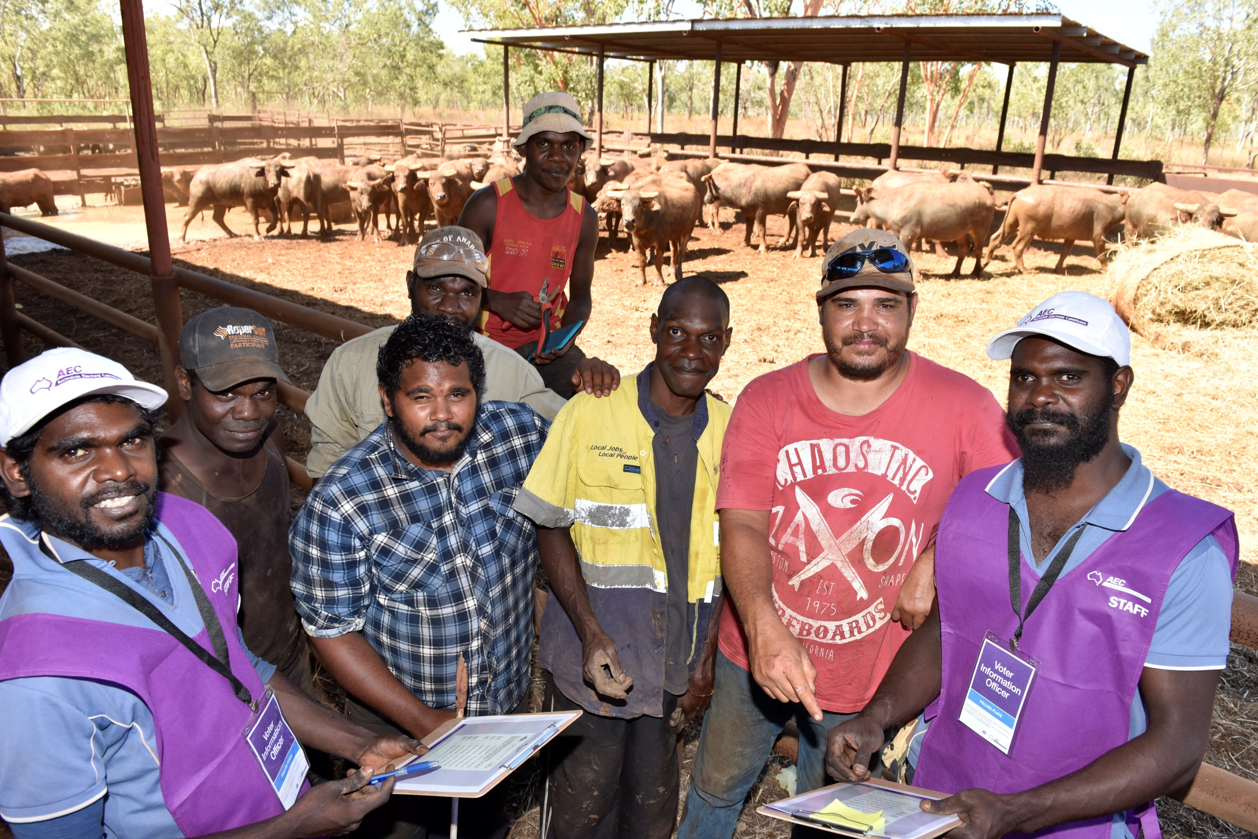
Community programs
Notes:
Libraries partnership
Online education kit
Voter Information Officers
In addition to the schools program, the AEC is expanding its work in community education. Over the past two elections, serval new strategies have been trialled.
Community engagement uses similar methods to the education program, in that it provides face-to-face instruction, activities and simple language information for specific audiences. It aims to educate those who may not understand Australia’s system of government, such as new migrant communities.
In the lead up to the 2016 Election, the AEC partnered with Australia Libraries Association to deliver community workshops about voting in public libraries around Australia. Libraries have good connections with their local communicates and are a trusted source of information. They are also present in most towns and centres all over the country. 115 sessions were delivered, in 63 locations and 17 languages. The feedback was positive however more time was required to promote sessions and increase attendance.
The online community kit is a free to access set of materials for any community organisation who wishes to conduct voter information sessions. It will form the basis for future community engagement, as it did with the libraries program.
Voter information officers are a last line of defence for informality. They are employed to work on election day, standing outside the polling place and offering information about how to complete the ballot paper to the public. They are generally used in communities with high informality and speak multiple languages to suit the local community needs.
These activities are now being reviewed as part of the development of an ongoing community engagement strategy.

Slide 9
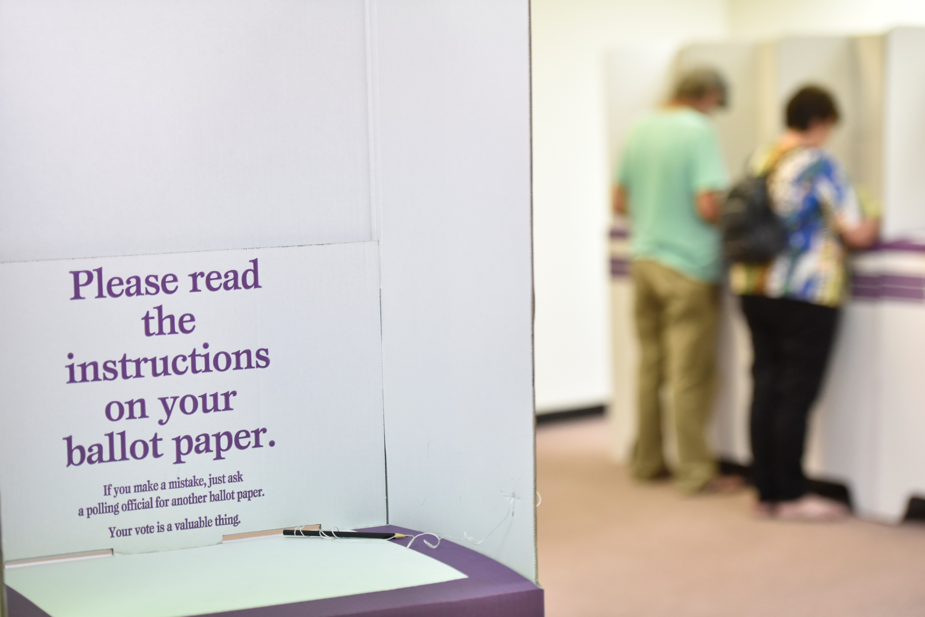
Civics and Citizenship school curriculum
Government
Identity
Law
Electoral Education
Notes:
Australian schools teach a national curriculum in all subjects (with some variation in implementation across the states). The curriculum provides national standards which schools must meet, and key areas of learning on which all Australian students must receive instruction.
Part of the social sciences (like History and geography), the subject of Civics and Citizenship ensures Australia students learn about their democratic society and how Australia is governed. The Civics curriculum was developed in 2013 by ACARA (Australian Curriculum and Assessment Reporting Authority).
Teachers, academics and subject matter experts had input into the civics curriculum, including the AEC who took an active role in ensuring the inclusion of electoral education.
The civics curriculum requires approx. 20 hours of study per year, or 2% of total teaching time. It is also not delivered as a stand alone subject, rather it is incorporated into history, English, legal studies or politics, and other subjects. So while civics provides the need for electoral education in schools, it is a very small part of the overall curriculum.
Even within the Civics and citizenship curriculum, electoral education is one small part. The curriculum is made up of three main areas of learning: Law, Identity and culture, and Government.
Voting and electoral process are specifically identified in upper primary school, when students are 11-12 years old. This presents challenges for the AEC the highest demand for education services is from this age group, despite being a long way off enrolling.
However, there is some evidence that engaging with students early can build confidence in the electoral process which will carry through to adulthood. Thus the AEC sees the opportunity to work with students as a way of building good relationships with the community and future electors.

